Slide 1
Apacer Sidefill Technology
Introduction
Sales and Marketing Center
April, 2022

Slide 2
Agenda
‧ Vibration in Industrial Environments
‧ Sidefill and It’s Benefits
‧ Industrial Applications
‧ Apacer’s Strengths

Slide 3
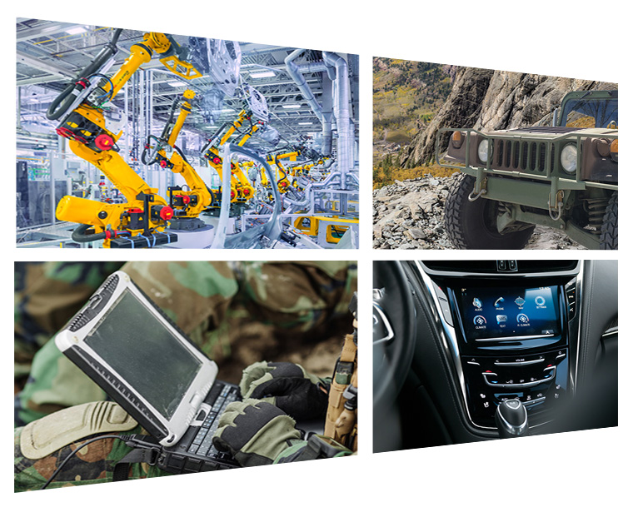
Vibration in Industrial Environments
In some specific industrial application environments, constant vibration or sudden shock conditions may be encountered. These may affect the durability and reliability of industrial-grade SSDs and memory modules in mechanical systems, resulting in data loss, abnormal shutdowns or system failure.
It is important
to reinforce the storage product’s resistance to vibration and shock to ensure product reliability.
Vibration and shock in manufacturing process or application environments

Slide 4
What is Sidefill and It’s Benefits
Sidefill
Increases the mechanical strength of solder joints
Reduces thermal stress damage
Apacer’s Sidefill technology strengthens the connections between solder joints and their board, making them more robust and vibration-resistant. It also allows for heat dissipation to offset thermal damage.
Benefits
Enhances product reliability and lifespan
Reinforce the product’s resistance to
shock and vibration

Slide 5
Sidefill Technology
The Application Process
Uses an automatic Sidefill dispenser system to ensure extremely high accuracy.
Dries the epoxy via UV light to maintain stability.
Includes in-house testing and inspection to ensure the application is smooth, uniform and correct.
Compliant with the MIL-STD-810G wide temperature, vibration and shock requirements.
Refer to JEITA EIAJ ED-4702A bending test.

Slide 6
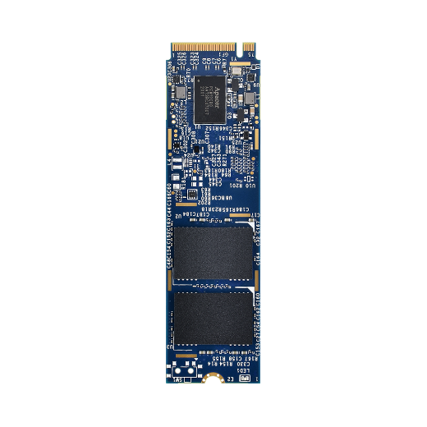
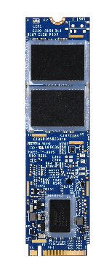
Sidefill Technology
Side View
Apacer adopts an automated Sidefill dispensing system to ensure high product reliability. Customers can choose the most suitable solution for their application needs.
Standard Product
Product’s Applied Sidefill
All powered by carefully selected industrial-grade NAND & components.

Slide 7
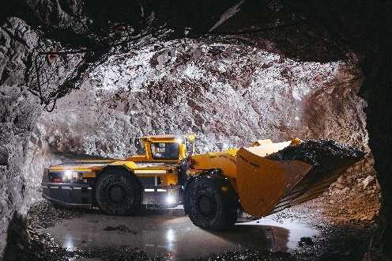
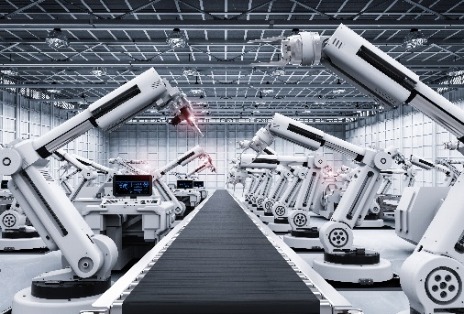
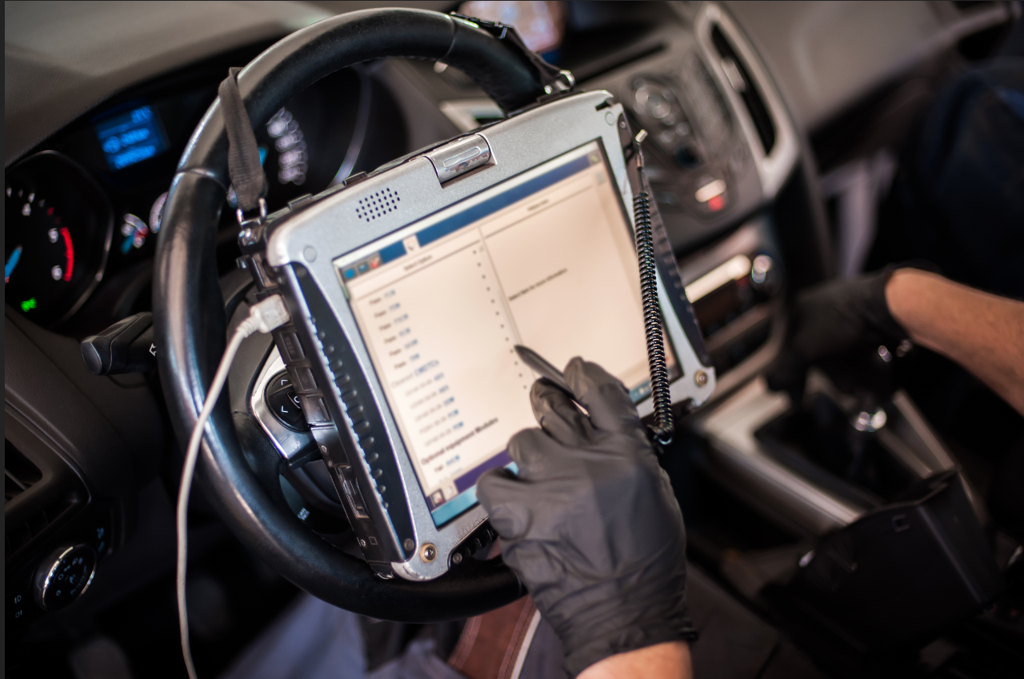
Industrial Applications
Sidefill technology increases product reliability and resistance to various thermal and mechanical shocks, ensuring that products continue to operate normally in high vibration and under extreme environmental changes. It’s an ideal solution for industrial equipment, such as that used in defense technology, vehicles, outdoor applications and rugged computers.
Mining Machine
Automation
In-Vehicle
Rugged Computers
Ensuring products continue to operate normally in high vibration
9

Slide 8
Apacerʼs Strengths
Widely Recognized Certification
Longevity
Strong R&D and Customization Capabilities
Fixed BOM support
6+6 PCN/EOL Policy
Unique S/N for RMA tracking

Slide 9
Thank you!
industrial.apacer.com/
©Copyright Apacer Technology Inc. Confidential. Unauthorized use, dissemination,
distribution, or reproduction of this document is not allowed without the permission of
Apacer Technology Inc. Specifications of details may change without notice.
This document and its contents are confidential©Copyright Apacer Technology Inc.

