Slide 1
Apacer Protective Coating Technologies Introduction
Sales and Marketing Center
Sep. 2020

Slide 2
Agenda
‧ Why Industrial Coatings are Important
‧ Conformal Coating
‧ Nano Coating
‧ Coating Technology Comparison
‧ Apacer’s Strengths in Protective Coating Technologies

Slide 3
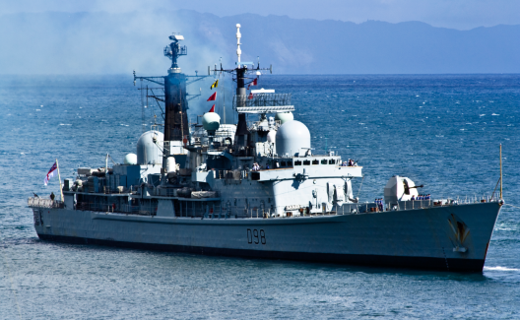
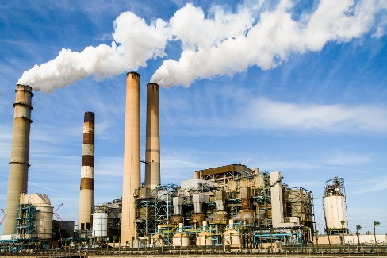
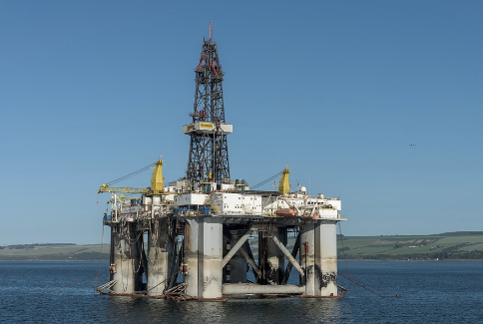
Why Industrial Coatings are Important
As industrial devices products have been widely used in various kinds of applications, the need for industrial-grade SSDs and memory modules that are tough enough to survive more punishing environments is rapidly increasing.
Industrial coatings can safeguard devices from dust ingression or liquid immersion, further ensuring product reliability.
Moisture
Particulates
Dust
Gases
Contaminants in manufacturing process or application environments

Slide 4
Material used: Acrylic/Urethane
Alternate materials: Epoxy and silicone
Compliant with the IP53 rating and MIL-STD-810G
Conformal Coating
Process of Application
Uses automated conformal coating spray system to apply
conformal coating with extremely high dispensing accuracy.
Makes the glue dry by the process of baking.
Performs in-house testing and inspection to ensure the application
is smooth, uniform and correct.
Follows the IPC-A-610E standard to ensure coating material never
Comes into contact with gold fingers.
* UV illumination is used to confirm that the coating is even and unbroken over the desired surface area.

Slide 5
Conformal Coating
Related Test Method and Highlights
IP53 rating: Dust and waterproof test
MIL-STD-810G: Salt fog test
Testing | Standard | Detail
Dust test | IEC 60529 IP5X | Ingress of dust is not entirely prevented, but it must not enter in sufficient quantity to interfere with the satisfactory operation of the equipment.
Waterproof test | IEC 60529 IPX3 | Water falling as a spray at any angle up to 60° from the vertical shall have no harmful effect.
Salt fog test | MIL-STD-810G Method 509.5:2008 | 5 ± 1 percent salt solution exposure for 2 cycles x 48hours

Slide 6
Nano Coating
Material used: Parylene
Compliant with the IP57 rating
Process of Deposition
A solid raw material known as dimer is heated in a vacuum and vaporized into a dimeric gas.
The gas is pyrolyzed to cleave the dimer to its monomeric form.
In the room-temperature deposition chamber, the monomer gas deposits on all surfaces
as a thin, transparent polymer film.
This gaseous application method results in an extremely even and uniform application,
and the film of coating material is incredibly thin.
The CVD (Chemical Vapor Deposition) of Parylene
Notes:
程序圖 or 介紹文件

Slide 7
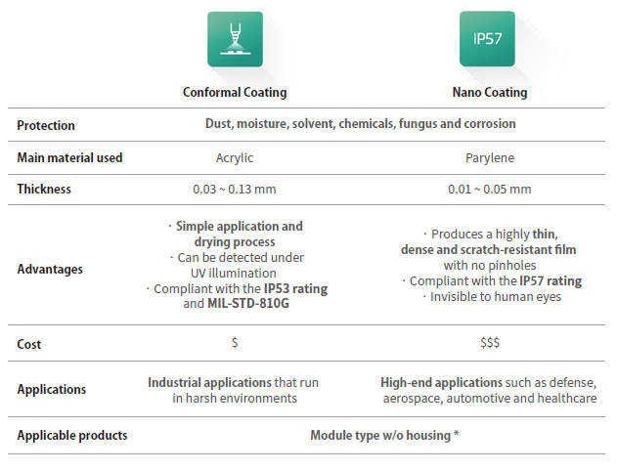
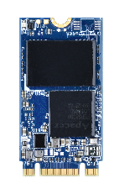
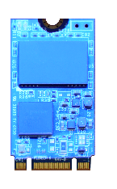
Coating Technology Comparison
Notes:
單位改一致mm

Slide 8
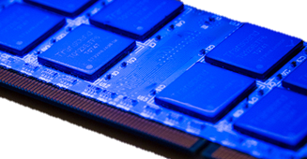
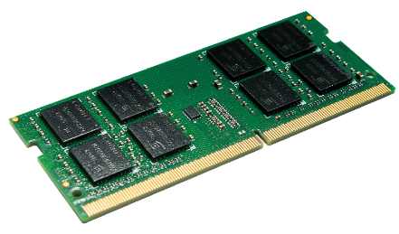
Apacer’s Strengths in Protective Coating Technologies
Automated conformal coating system
Conformal coating can be applied by manual or automated operations.
Apacer adopts automated conformal coating system to ensure high product reliability.
Time-consuming
Highly dependent on the skill level of operators
Low dispensing accuracy
High risk of producing uneven film thickness
that can leave the modules unprotected
Manual spray
conformal coatings
Simple and efficient
Easy to achieve a desired coating thickness
Accurately control the dispensing accuracy and consistency
Automated spray
conformal
coatings

Slide 9
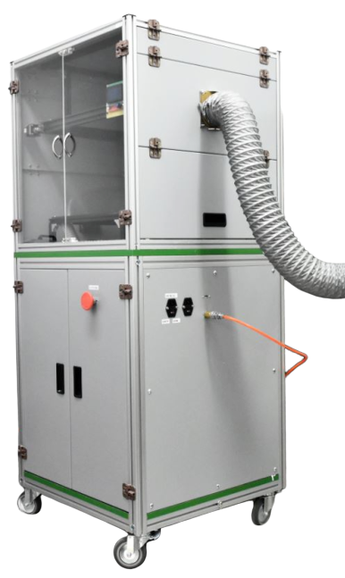
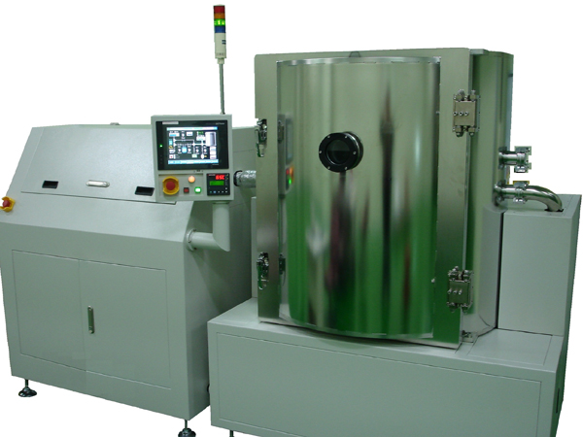
Apacer’s Strengths in Protective Coating Technologies
Experienced team and application
Apacer’s production facility has many engineers and production staff that are well trained and experienced in the process of coating technologies.
Conformal coating station
(in-house application)
Nano coating station

Slide 10
Apacer’s Protective Coating Technologies Introduction Video

Slide 11
Thank you!
industrial.apacer.com/
©Copyright Apacer Technology Inc. Confidential. Unauthorized use, dissemination,
distribution, or reproduction of this document is not allowed without the permission of
Apacer Technology Inc. Specifications of details may change without notice.
This document and its contents are confidential©Copyright Apacer Technology Inc.

