Slide 1
Anti-Sulfuration SSDs Sales Kit
Sales and Marketing Center
April 2021

Slide 2
Sulfur, The Invisible Killer of SSDs
Sulfur in the air has proven to have powerful negative effects on electronic components.
In the face of environmental pollution, electronic components exposed to high temperature, humidity and pollution are often prone to sulfuration, weakening and damaging products.
Sulfur-containing environments

Slide 3
The Demand for Anti-sulfuration Gradually Moves from
Niche Applications to the Mainstream Market
To reduce the impact of pollutants on system availability, large data centers start to implement strict environmental control management and regulate indoor air quality according to ISA 71.04-2013 compliance for G1 level. This approach has recently been adopted by small- and medium-sized data centers as well as edge applications.
The use of products with sulfur corrosion resistance can help increase the service life of equipment.
Data center
Networked systems
Edge devices

Slide 4
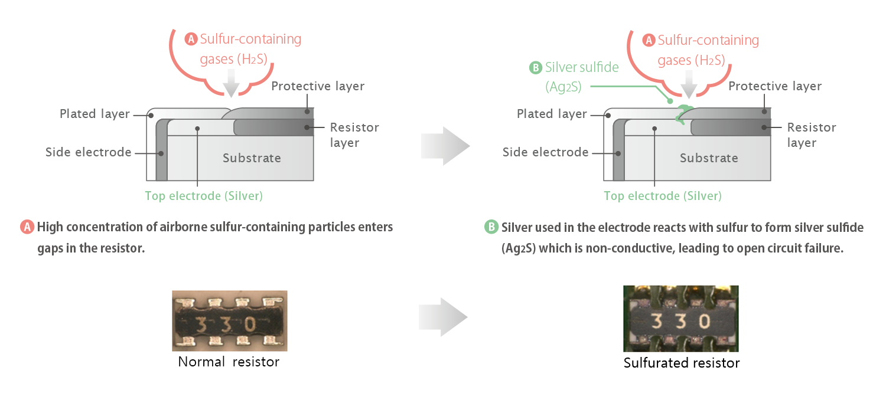
Silver Sulfide (Ag2S) Formation
The silver in the electrodes of resistors reacts with the sulfur in the air in a simple chemical reaction. The result is silver sulfide, which usually appears as a dark black discoloration on the surface of the electrode.
Normal resistor
Sulfurated resistor

Slide 5
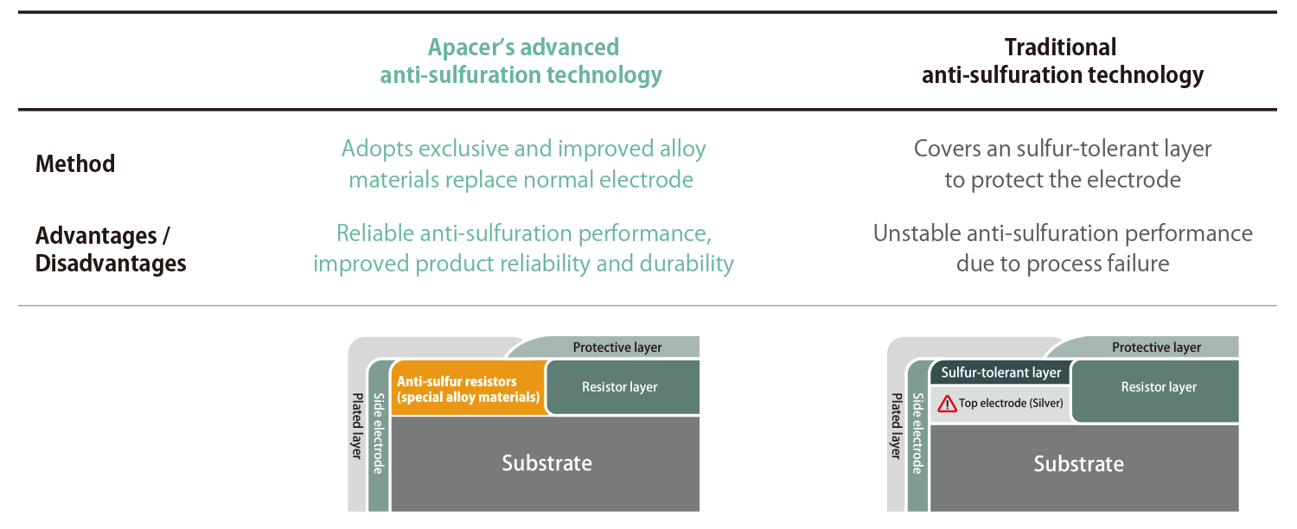
Anti-Sulfuration Technology Comparison
There is a crucial difference between using anti-sulfur electrode materials and simply adding an extra sulfur-tolerant layer.
For more information, please visit: https://industrial.apacer.com/en-ww/Technology/Anti-Sulfuration

Slide 6
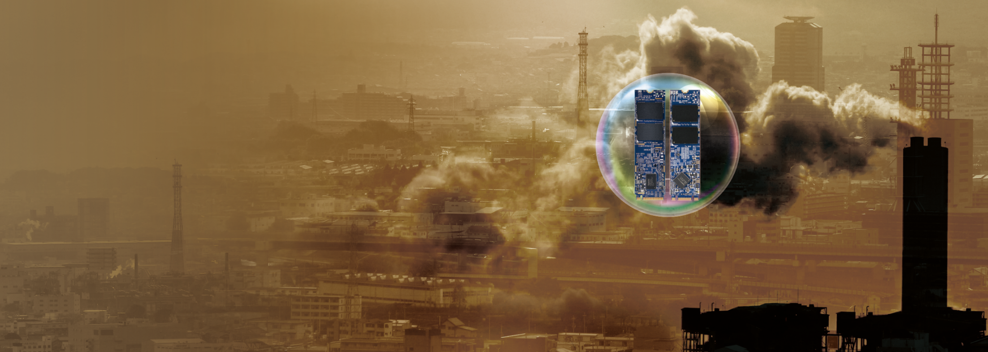
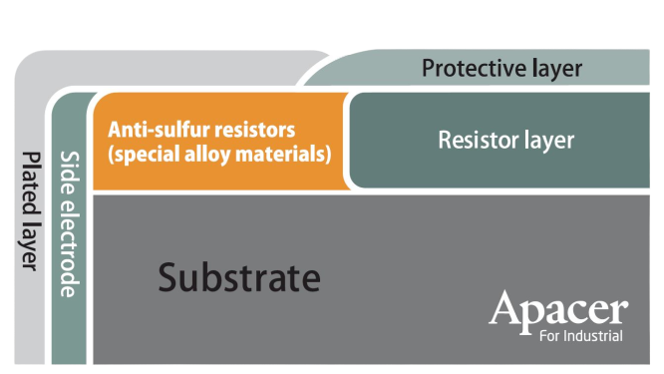
Apacer’s Strength: Anti-Sulfuration Technology
Based on the strength of Apacer’s patented anti-sulfuration technology for DRAM modules, Apacer anti-sulfuration SSDs not only use special alloy materials but also achieve a complete air barrier through rigorously inspected special materials and technologies to ensure the best protection for electronic products.

Slide 7
ANSI/ISA 71.04 Compliance
Copper and silver metal materials are widely used in electric products. Therefore, there are two corrosion failure modes, including copper corrosion and silver corrosion.
A guideline from the ANSI/ISA 71.04-2013 standard classifies the severity of air quality of field/end-user environment into four levels, including G1, G2, G3 and GX.
Severity Level | Reactivity | Copper Corrosion | Silver Corrosion | Remarks
G1 | Mild | < 300 Angstroms / 30 days | < 200 Angstroms / 30 days | Corrosion is not a factor determining equipment reliability.
G2 | Moderate | < 1,000 Angstroms / 30 days | < 1,000 Angstroms / 30 days | Corrosion effects are measurable and corrosion may be a factor.
G3 | Harsh | < 2,000 Angstroms / 30 days | < 2,000 Angstroms / 30 days | High probability that corrosive attachment will occur.
GX | Severe | > 2,000 Angstroms / 30 days | > 2,000 Angstroms / 30 days | Extremely high rate of corrosion. Only specially designed and packaged equipment to survive.
* ANSI: American National Standards Institute
* ISA: International Society of Automation

Slide 8
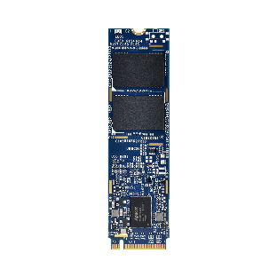
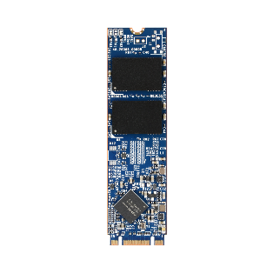
Test Method for ANSI/ISA 71.04 Compliance
To meet the ANSI/ISA 71.04-2013 standard, Apacer’s anti-sulfuration technology for industrial SSDs has passed a completed corrosion verification, including FoS and MFG testing methods, proven to have the best resistance to not only silver corrosion but also copper corrosion and creep corrosion.
Methods | Flower of Sulfur (FoS) Test | Mixed Flowing-Gas (MFG) Test
Level | Entry-level accelerated corrosion testing | High-level accelerated corrosion testing
Simulation environment | Silver corrosion | Copper corrosion and creep corrosion
Corrosive agents used | Octasulfur S8 | H2S, NO2, SO2, Cl2, NH3, O3
Corrosion products | Sulfide, oxide | Sulfide, sulfate, chloride, oxide, nitrate
Notes:
the copper corrosion and creep corrosion- MFG Test
silver corrosion - FoS test

Slide 9
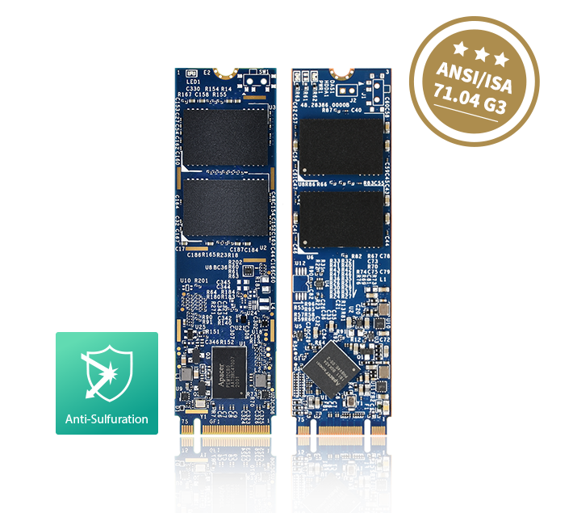
Apacer Anti-Sulfuration SSDs Passed
G3 Level of ANSI/ISA 71.04 Certification
Full protection from sulfuration with complete and strict certification

Slide 10
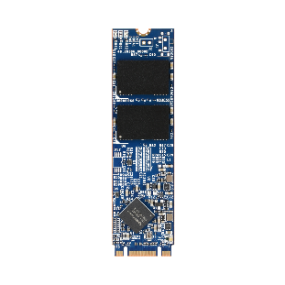
Models that Support Anti-Sulfuration
Model Name | PV220-M280 | SV250-M280 | SH250-M280
Interface | PCIe Gen3 x4 | SATA 3.2 (6Gb/s) | SATA 3.2 (6Gb/s)
Capacity | 120GB ~ 1920GB | 30GB ~ 960GB | 10GB ~ 320GB
Connector | M.2 M Key | M.2 B & M key | M.2 B & M key
NAND Flash Type | 3D TLC | 3D TLC | 3D TLC
External DRAM | No | No | No
R/W Speed (MB/sec) | 1695 / 1685 | 560 / 520 | 560 / 520
IOPS (4K Random Write) | 144K | 73K | 74K
Wide Temp. (-40°C~85°C) | Yes | Yes | Yes
MTBF (hours) | >3,000,000 | >3,000,000 | >1,000,000
Special Features | Supports Anti-Sulfuration End-to-End Data Protection Supports CoreGlacier™ technology for wide temp. NVMe Secure Erase | Supports Anti-Sulfuration End-to-End Data Protection Supports TCG Opal 2.0 / AES 256-bit encryption | Supports Anti-Sulfuration 3D NAND SLC-liteX technology End-to-End Data Protection Supports AES 256-bit encryption

Slide 11
Case Study: Edge Computing
Customer:
Highway Vehicle Identification and Traffic Monitoring Equipment Provider
Request:
PV220-M280 120/240/480/960GB ET
With coating/without heat sink
Difficulties
Coating IP53 report & Salt fog (MIL-STD-810G)
With/without coating performance test comparison
SSD FIO performance test
Solutions
PV220-M280 120/240GB ET

Slide 12
Industrial Applications

Slide 13
Thank you!
industrial.apacer.com/
©Copyright Apacer Technology Inc. Confidential. Unauthorized use, dissemination,
distribution, or reproduction of this document is not allowed without the permission of
Apacer Technology Inc. Specifications of details may change without notice.
This document and its contents are confidential©Copyright Apacer Technology Inc.

