Slide 1
FIPS &
TCG SSD SV240 Series
Sales & Marketing Center
March, 2023

Slide 2
Agenda
What is FIPS?
Why is FIPS Important?
General Flow of FIPS 140-2 Testing and Validation
Why Choose Apacer’s
Applicable Models

Slide 3
What is FIPS?
“Federal Information Processing Standard, or FIPS”, is a computer security standard that is made in the US government. This accredits the design of the cryptographic modules and implementations of these modules. The validation process for FIPS requires looking at different aspects of the cryptographic module.
The Different Levels of FIPS 140-2
Level 1
Level 2
Level 3
Level 4
The main focus is the software and algorithms used in the crypto.
Tries to show evidence of tampering, such as coatings and seal.
Tries to prevent the tampering.
Responds to the tampering with the deletion of information.

Slide 4
Why is FIPS Important?
Any vendor that wants to work with the US federal government agencies needs to pass FIPS certification. FIPS 140-2 is considered the benchmark for security, the most important standard of the government market. FIPS 140-2 certification assures users that a specific product or technology has passed rigorous testing by an accredited lab, that the test results have been validated, and the product can be used to secure sensitive information.
FIPS 140-2: 11 Specific Security Areas
Cryptographic Module Specification
Cryptographic Module Interfaces
Roles, Services, and Authentication
Software/Firmware Security
Operational Environment
Physical Security
Non-invasive Security
Sensitive Security Parameter Management
Self-Tests
Life-cycle Assurance
Mitigation of Other Attacks

Slide 5
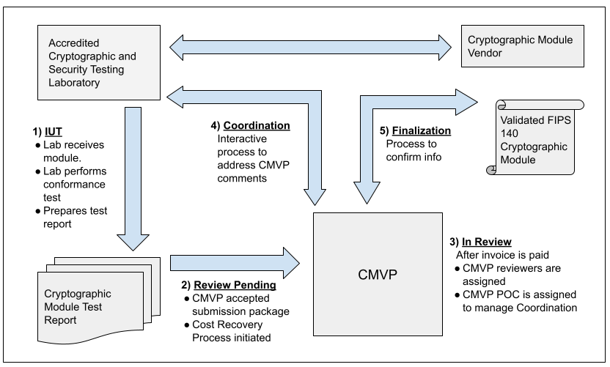
General Flow of FIPS 140-2 Testing & Validation
5
Source: NIST

Slide 6
FIPS Validation
FIPS validation must be done by independent, accredited third-party laboratories, which are accredited by the National Voluntary Laboratory Accreditation Program. The vendor works to create the test reports for the module, and submit them to the National Institute of Standards and Technology (NIST) for review. Only after all of this can a module be deemed “FIPS 140-2 Validated.”
FIPS Validated VS FIPS Compliant
FIPS validated encryption module have been scrutinized by a NIST lab and assigned a CMVP* certificate. That assures whole product passed FIPS validated and can be used to secure sensitive information.
Due to the cost and time associated, some manufacturers might stick with claiming “FIPS Compliant.” This could mean that some parts are designing to FIPS standard, but not all validated by a certified NIST laboratory.
* CMVP, Cryptographic Module Validation Program is experiencing a significant backlog in the validation process. Use of validated modules currently on the active list is encouraged.

Slide 7
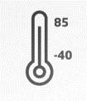
Why Choose Apacer’s
Apacer’s TCG SSD SV240 series have earned FIPS 140-2 Level 2 Certification. It takes security to the next level with a diverse array of extremely secure SSDs.
FIPS Validated
Certificate #4386
Various Form Factors
& R-SATA Support
Wide Temperature
Support
Apacer FIPS-validated encryption modules have been scrutinized by a NIST lab and assigned a CMVP certificate.
Apacer maintains a diverse product line that covers many capacities and form factors, and supports
R-SATA rugged connectors to meet the needs of industrial applications.
Apacer leads the industrial field by being the first to provide wide-temperature-supported FIPS validated SSDs for rugged applications.

Slide 8
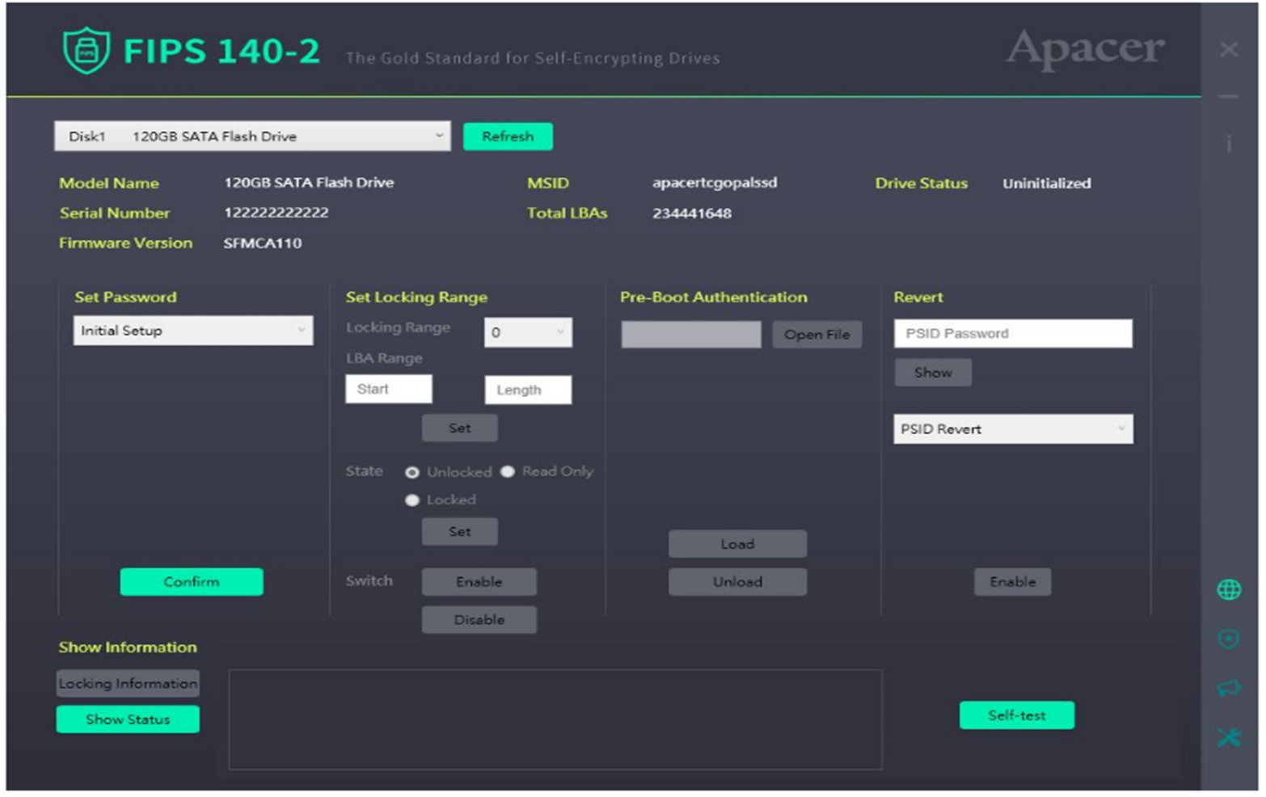
Apacer FIPS Management Tool
Apacer FIPS management tool is a user-friendly and convenient way for users to understand and carry out FIPS 140-2 functions such as setting a password or a locking range, pre-boot authorization, reverting and self-testing.

Slide 9
Industrial Applications
For customers planning to work with US federal agencies, and requiring higher security, such as the fields of healthcare, financial services, 5G infrastructure and defense, FIPS certification validated products are the best solution.
Healthcare
Financial Services
5G Infrastructure
Defense

Slide 10
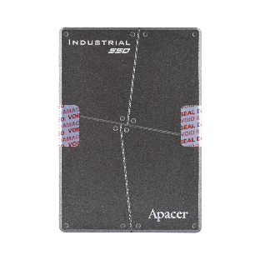
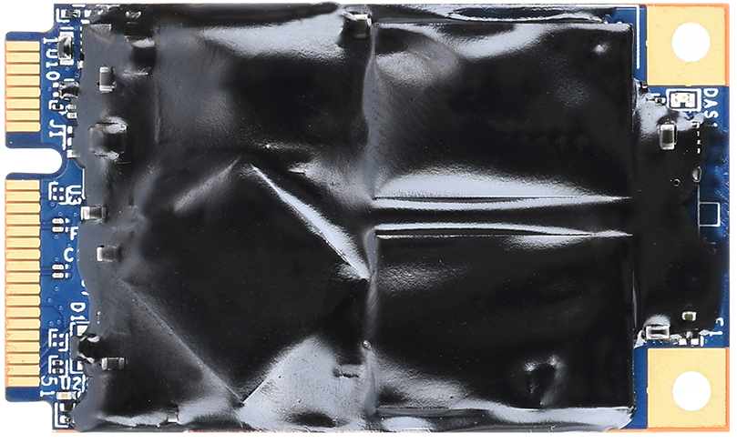
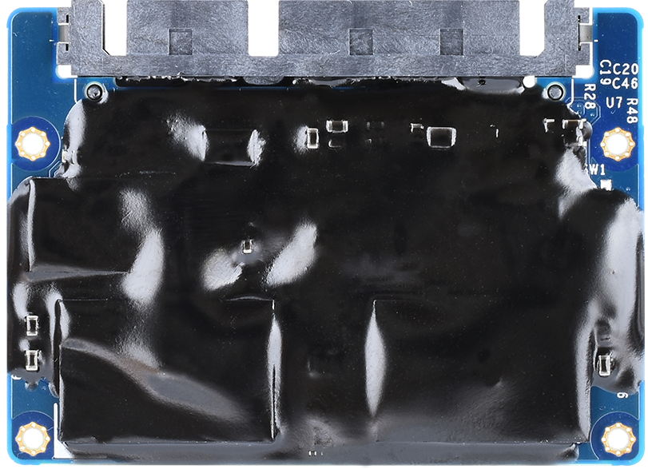
Specification of TCG SSD SV240 Series
Model Name | SV240-25 FIPS140-2 | SV240-M280 FIPS140-2 | SV240-300 FIPS140-2 | SV240-297 FIPS140-2
Interface | SATA 3.2 (6Gb/s) | SATA 3.2 (6Gb/s) | SATA 3.2 (6Gb/s) | SATA 3.2 (6Gb/s)
Capacity | 240GB~1920GB | 240GB~1920GB | 240GB~1920GB | 240GB~960GB
Connector | (7+15) pin | M.2 B & M key | 52-pin mSATA | (7+15) Pin
NAND Flash Type | 3D TLC | 3D TLC | 3D TLC | 3D TLC
External DRAM | Yes | Yes | Yes | Yes
R/W Speed (MB/sec) | 560/500 | 560/500 | 560/500 | 560/500
IOPS (4K Random Write) | 84K | 84K | 84K | 84K
Wide Temp. (-40°C~85°C) | Yes | Yes | Yes | Yes
MTBF (hours) | >3,000,000 | >3,000,000 | >3,000,000 | >3,000,000
Featured Technology
FIPS 140-2 Validated
Supports TCG Opal 2.0 / AES 256-bit Encryption
Wide Temperature
SMART Read Refresh™
S.M.A.R.T. Function

Slide 11
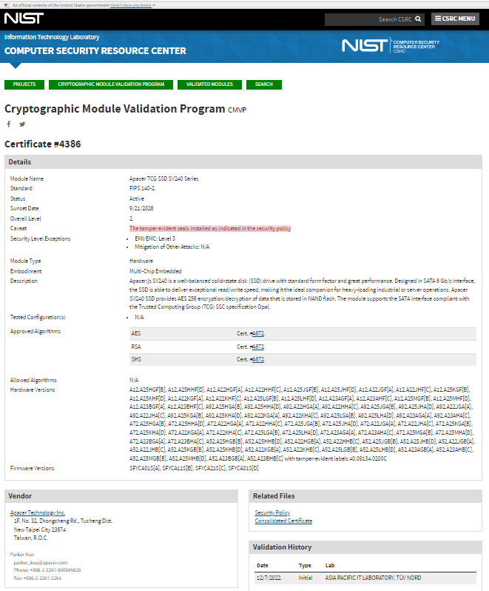
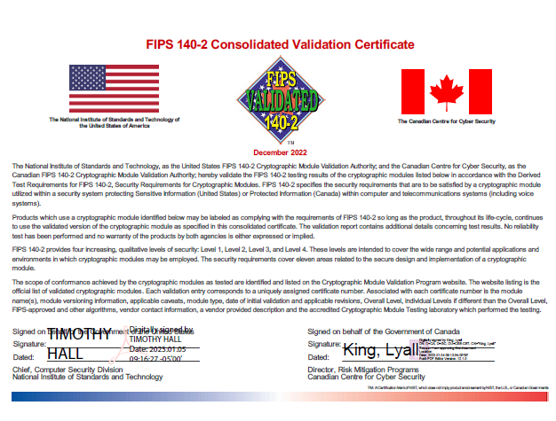
Apacer FIPS Validation Certificate #4386
https://csrc.nist.gov/projects/cryptographic-module-validation-program/certificate/4386
Certificate #4386

Slide 12
Thank you!
industrial.apacer.com/
©Copyright Apacer Technology Inc. Confidential. Unauthorized use, dissemination,
distribution, or reproduction of this document is not allowed without the permission of
Apacer Technology Inc. Specifications of details may change without notice.
This document and its contents are confidential©Copyright Apacer Technology Inc.

