Slide 1
Over-provisioning
Technology
Vertical Market Application Product Division
August 2019

Slide 2
Agenda
Introduction
Concept of Over-provisioning
Advantages of Over-provisioning
Summary
Applicable Models

Slide 3
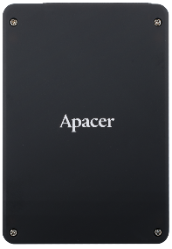
Introduction
In the past, when an SSD was shipped to a customer, almost the entire capacity was available as user capacity. A small amount percent of capacity was set aside for crucial operations, and was referred to as the “system reserved” portion.
Over-provisioning
(OP)
However, manufacturers quickly discovered that this led to higher than desirable write amplification indicators, meaning that the lifespan of a drive would be shortened.
Eventually, Apacer developed its Over-provisioning technology to extend product lifespans. By reserving 7 percent or more of the total capacity, operational lifetimes of SSDs could be significantly extended.
System reserved
User Space
High endurance
High performance

Slide 4
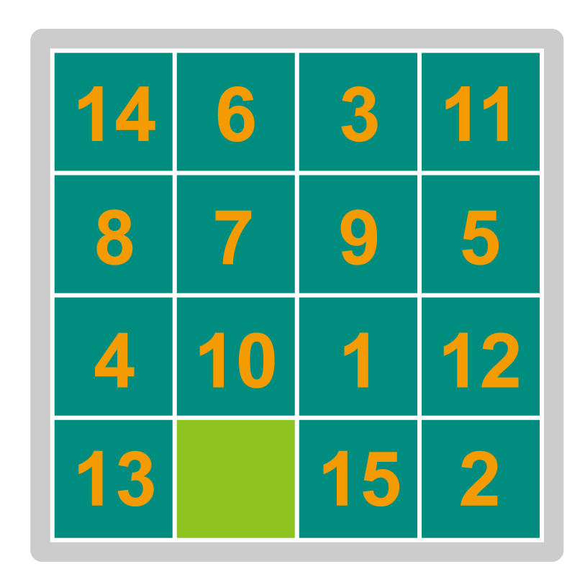
Concept of Over-provisioning
The image below shows a 15 puzzle-game. The object of the game is to arrange the 15 numbers in the correct order. Although there are spaces for 16 numbers, one of the numbers must be removed to allow the freedom to rearrange the other numbers. In fact, if more numbers were removed, it would be even easier to rearrange the remaining numbers.
This is a good metaphor for the concept of Over-provisioning. Due to the nature of how SSDs work, data sometimes needs to be re-arranged by the drive. The 15 numbers represent the capacity of the drive, and the one empty space represents the capacity which is given to the drive to carry out Over-provisioning. By making good use of this small percentage of the total capacity, the SSD can re-arrange the data in the most optimal way as writes and erases are carried out over time.

Slide 5
Advantages of Over-provisioning
The chart below shows two sample drives, with identical data caches. When Over-provisioning is applied, the Write Amplification Indicator is significantly lowered.
 | Capacity | Data Cache | Write Amplification Indicator | Rated Life (128G/day)
Non-OP | 128GB (full capacity) | 128KB | 1.68 | 4.89 years
OP | 120GB | 128KB | 1.47 | 5.59 years
Non-OP | 256GB (full capacity) | 128KB | 1.70 | 4.62 years
OP | 240GB | 128KB | 1.36 | 6.04 years
Write Amplifications are significantly improved

Slide 6
Advantages of Over-provisioning
System Reserved
System Reserved
LBB
LBB
LBB
LBB
LBB
Over-provisioning
120GB
LBB
LBB
LBB
LBB
LBB
7% OP
120GB
7% OP
All SSDs develop later bad blocks (LBBs) over time.
When an LBB is discovered on a drive that supports Over-provisioning, it will be replaced with a Free Block from the reserved space to stabilize operation and extend product durability.
LBB
LBB
LBB
LBB
LBB
LBB
LBB
LBB
LBB
LBB
LBB
LBB
LBB
LBB
LBB
LBB
LBB
LBB
LBB
LBB
LBB
LBB
LBB
LBB
LBB
System Reserved
When the number of bad blocks exceeds a certain level controllers can handle, SSD becomes
“Write Protected”.
(Read Only)
System Reserved
Non Over-provisioning
128GB
LBB
LBB
LBB
LBB
LBB
128GB
LBB
LBB
LBB
LBB
LBB
LBB
LBB
LBB
LBB
LBB
LBB
LBB
LBB
LBB
LBB
LBB
LBB
LBB
LBB
LBB

Slide 7
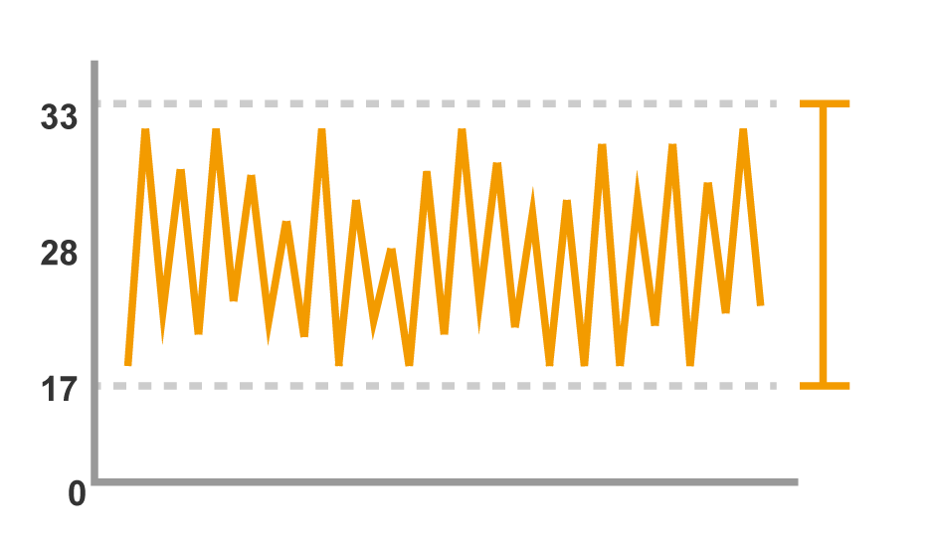
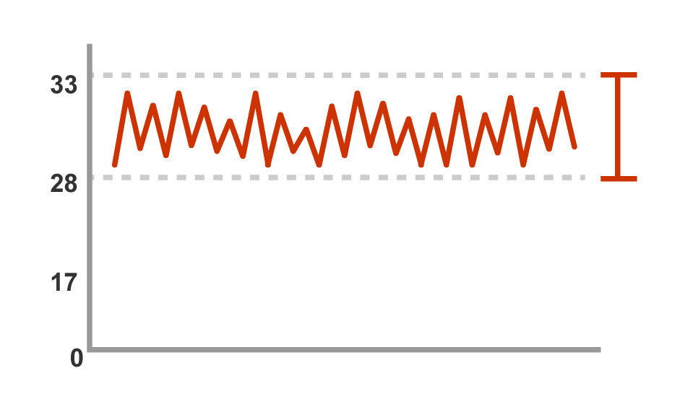
Advantages of Over-provisioning
In background processing performance, the number of reads and writes per second (IOPS) fall within a more predictable and reliable range.
Without OP
With OP
IOPS Speed (in 1,000s)
IOPS Speed (in 1,000s)
Measured Operations Over Time
Measured Operations Over Time
A wide range of IOPS means that performance is unreliable.
A much narrower range of IOPS delivers consistently superior performance.
Result: Drives with Over-Provisioning Promise Consistently Higher Background Processing

Slide 8
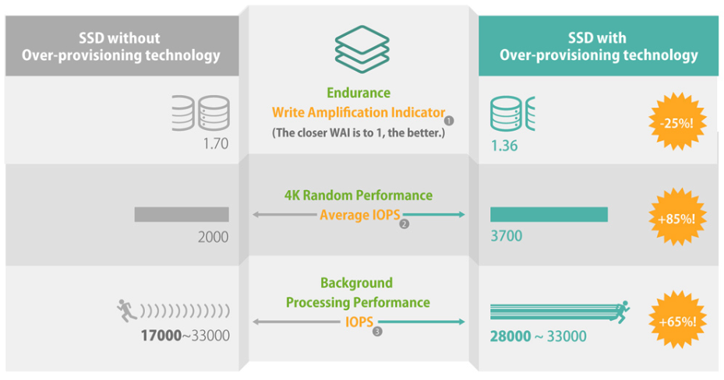
Summary
Users who require read/write intensive and longer-lasting SSDs are recommended
to choose Over-provisioning.
Note:
❶ Test conditions: 256GB SSD; data cache: 1280KB ❷❸ Test conditions: 256GB DRAM-less SSD; data cache: 240KB

Slide 9
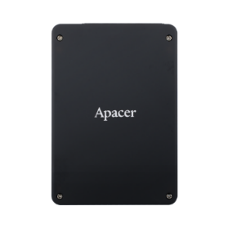
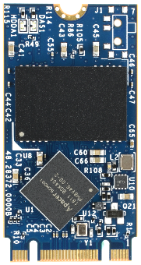
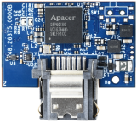
Applicable Models – SATA
Form Factor | 2.5’’ | M.2 2280 | M.2 2242 | Module 7Pin
Model Name | SV250-25 | SV250-M280 | SV250-M242 | SV250-7LP2
NAND Flash Type | 3D TLC | 3D TLC | 3D TLC | 3D TLC
Interface | SATA 3.0 | SATA 3.0 | SATA 3.0 | SATA 3.0
Capacity | 30GB~480GB | 30GB~960GB | 30GB~480GB | 30GB~120GB
Seq. R/W Perf. (MB/sec) | 560/520 | 560/525 | 560/520 | 560/510
Operation Temperature ( °C ) | 0 ~ +70/ -40 ~ + 85 | 0 ~ +70/ -40 ~ + 85 | 0 ~ +70/ -40 ~ + 85 | 0 ~ +70/ -40 ~ + 85
All images shown are for illustration purposes only, and are not shown at actual size.

Slide 10
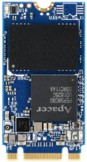
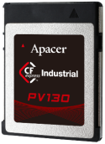
Applicable Models - PCIe
Form Factor | M.2 2280 | M.2 2280 | M.2 2242 | CFX
Model Name | PV310-M280 | PV120-M280 | PV130-M242 | PV130-CFX
NAND Flash Type | 3D TLC | 3D TLC | 3D TLC | 3D TLC
Interface | PCIe NVMe Gen3 x4 | PCIe NVMe Gen3 x2 | PCIe NVMe Gen3 x2 | PCIe NVMe Gen3 x2
Capacity | 240GB-960GB | 120GB-960GB | 60GB-480GB | 120GB-480GB
Seq. R/W Perf. (MB/sec) | 2660/2260 | 1700/1000 | 1600/1000 | 1550/950
Operation Temperature ( °C ) | 0 ~ +70/ -40 ~ + 85 | 0 ~ +70/ -40 ~ + 85 | 0 ~ +70/ -40 ~ + 85 | 0 ~ +70/ -40 ~ + 85
All images shown are for illustration purposes only, and are not shown at actual size.

Slide 11
Thank you!
industrial.apacer.com/
©Copyright Apacer Technology Inc. Confidential. Unauthorized use, dissemination,
distribution, or reproduction of this document is not allowed without the permission of
Apacer Technology Inc. Specifications of details may change without notice.
This document and its contents are confidential©Copyright Apacer Technology Inc.

