Slide 1
SLC-liteX Technologies
Sales & Marketing Center
November, 2022

Slide 2
Agenda
Introduction
What is SLC-liteX
Flash Grade Selection
New Upgrade Technologies – SLC-liteX
Comparison of SLC and SLC-liteX
Application Solutions
Applicable Models

Slide 3
Introduction
NAND Flash is now a mature technology. Many formats are already adopted by many industrial applications. However, with a desire to push the envelope, Apacer has developed certain optimizations of NAND Flash technology. The goal of these optimizations is to provide customers with the amount of P/E cycles that best suits their application.
The following chart shows SLC / TLC Cell Distribution.
Erase state
Program state
0
SLC (1-bit/cell)
1
1
0
Threshold voltage
000
001
TLC (3-bit/cell)
010
011
111
110
101
100
011
010
001
000
100
101
110
Threshold voltage
111

Slide 4
SLC-liteX
SLC-liteX is also based on 3D NAND technology, and the central concept is to make 3D TLC behave like SLC. To do this, cell distribution management for 3D TLC is necessary in order to greatly adjust the voltage delta and charge sensing. The firmware is carefully tweaked by Apacer’s engineering team to offer the greatest number of P/E cycles in this format – 100,000, which is over 33 times more than MLC or industrial 3D TLC.
3D TLC
(3-bit/cell)
111
110
100
101
001
000
010
011
Threshold voltage
3D SLC-liteX
1
0
Threshold voltage

Slide 5
Flash Grade Selection
 | 3K | 20K | 40K |  | 60K | 80K | 100K | Endurance
SLC |  |  |  |  |  |  |  | 5 Years Warranty
USB/Card SLC-liteX |  |  |  |  |  |  |  | 5 Years Warranty
SATA/PCIe SLC-liteX |  |  |  |  |  |  |  | 5 Years Warranty
TLC |  |  |  |  |  |  |  | 2 Years Warranty
2D NAND
3D NAND
100K P/E cycles are available for SATA and PCIe models.
14

Slide 6
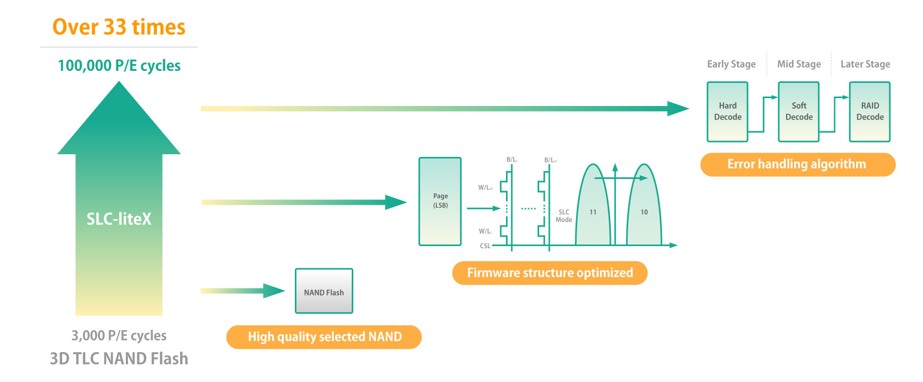
How SLC-liteX Reaches 100,000 P/E Cycles
In order to maximize SSD endurance, Apacer has enhanced its SLC-liteX technology to achieve 100K P/E cycles. Powered by carefully selected NAND components, the firmware structure is specifically optimized to enhance NAND flash stability during daily operations, and the error handling algorithm is significantly improved to avoid any unexpected ECC errors. The result is a prolonged SSD lifespan.

Slide 7
A Brief Comparison of NAND Flash Types
 | SLC | SLC-liteX | TLC
Endurance (P/E) | 60,000 | 30,000 for Card / USB 100,000 for SATA / PCIe | ≤ 3,000
Reliability | High | Higher | Lowest
Bits per cell | 1 | 1 | 3
Cost | $$$ | $$ | $
Capacity | Up to 256GB | Up to 640GB | Up to 2TB
100K P/E cycles are available for SATA and PCIe models.

Slide 8
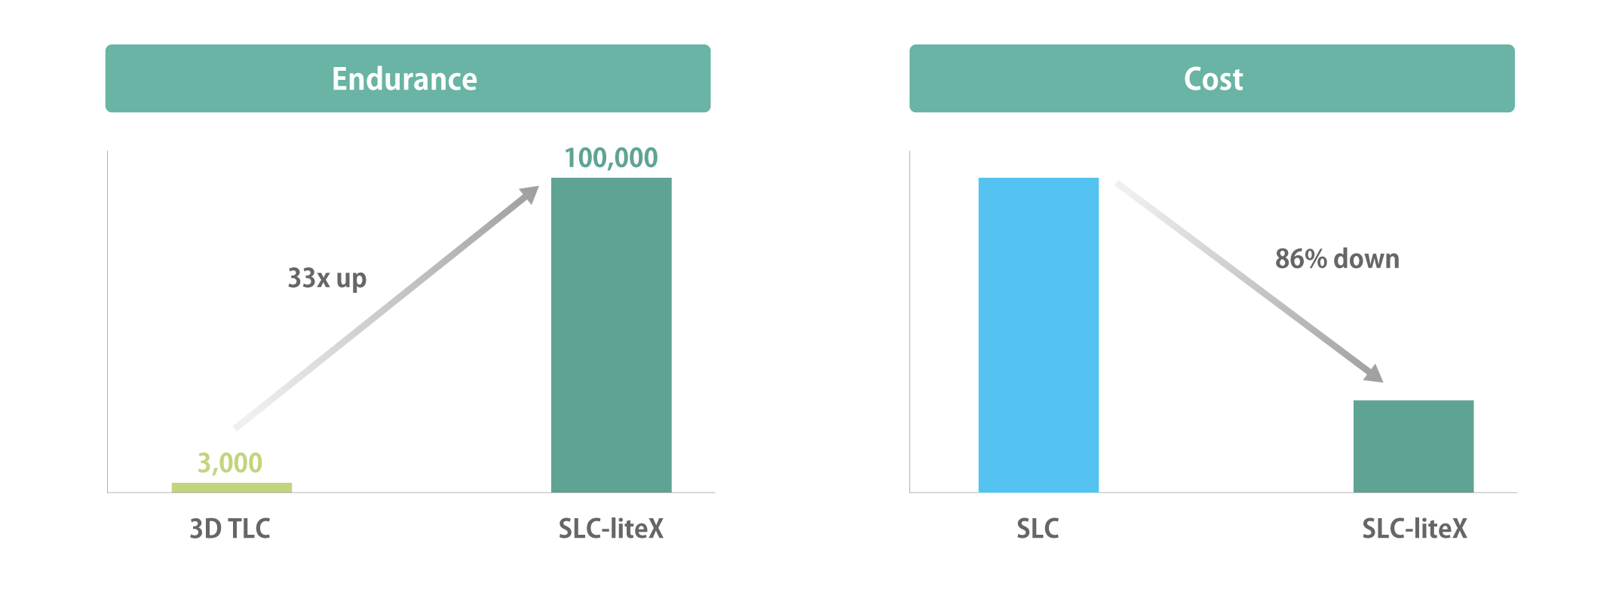
Advantages of Using SLC-liteX
Apacer SLC-liteX products are based on 3D NAND architecture, but their reliability is improved by customized firmware.
Benefits
Increased endurance up to 100,000 P/E cycles
Cost saving more than 86% compared to SLC

Slide 9
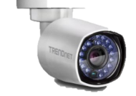
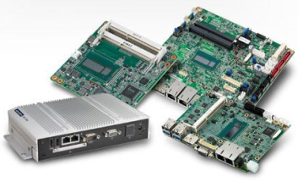
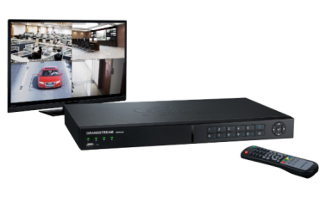
SLC-liteX SSD Solutions
Industrial Applications
NVR
IPC
Gaming
Networking

Slide 10
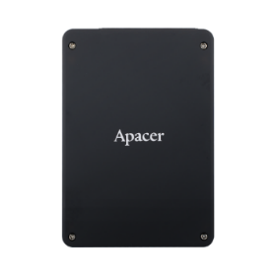
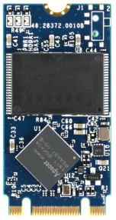
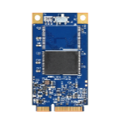
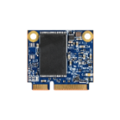
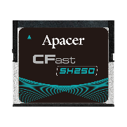
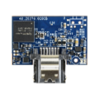
SLC-liteX Product Series
Form Factor | 2.5’’ | M.2 2280 | M.2 2242 | MO-300 | MO-300B | CFast | Module 7Pin
Model Name | SH250-25 | SH250-M280 | SH250-M242 | SH250-300 | SH250-300B | SH250-CFast | SH250-7LP2
Interface | SATA 3.2 (6Gb/s) | SATA 3.2 (6Gb/s) | SATA 3.2 (6Gb/s) | SATA 3.2 (6Gb/s) | SATA 3.2 (6Gb/s) | SATA 3.2 (6Gb/s) | SATA 3.2 (6Gb/s)
Capacity | 10GB~320GB | 10GB~320GB | 10GB~160GB | 10GB~160GB | 10GB~80GB | 10GB~160GB | 20GB~80GB
Seq. R/W Perf. (MB/sec) | 560/520 | 560/520 | 560/520 | 560/520 | 560/510 | 560/515 | 560/510
Operation Temperature ( °C ) | 0 ~ +70/ -40 ~ + 85 | 0 ~ +70/ -40 ~ + 85 | 0 ~ +70/ -40 ~ + 85 | 0 ~ +70/ -40 ~ + 85 | 0 ~ +70/ -40 ~ + 85 | 0 ~ +70/ -40 ~ + 85 | 0 ~ +70/ -40 ~ + 85
Above models support 100K P/E cycles .
All images shown are for illustration purposes only, and are not shown at actual size.

Slide 11
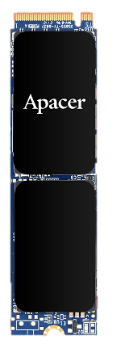
SLC-liteX Product Series
Form Factor | 2.5’’ | M.2 2280 | MO-300 | M.2 2280
Model Name | SH24D-25 | SH24D-M280 | SH24D-300 | PH920-M280
Interface | SATA 3.2 (6Gb/s) | SATA 3.2 (6Gb/s) | SATA 3.2 (6Gb/s) | PCIe Gen3 x4
Capacity | 160GB~640GB | 160GB~640GB | 160GB~640GB | 160GB~640GB
Seq. R/W Perf. (MB/sec) | 560/490 | 560/490 | 560/490 | 1740/1530
Operation Temperature ( °C ) | 0 ~ +70/ -40 ~ + 85 | 0 ~ +70/ -40 ~ + 85 | 0 ~ +70/ -40 ~ + 85 | 0 ~ +70/ -40 ~ + 85
Above models support 100K P/E cycles.
All images shown are for illustration purposes only, and are not shown at actual size.

Slide 12
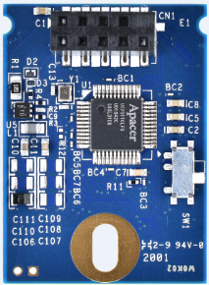
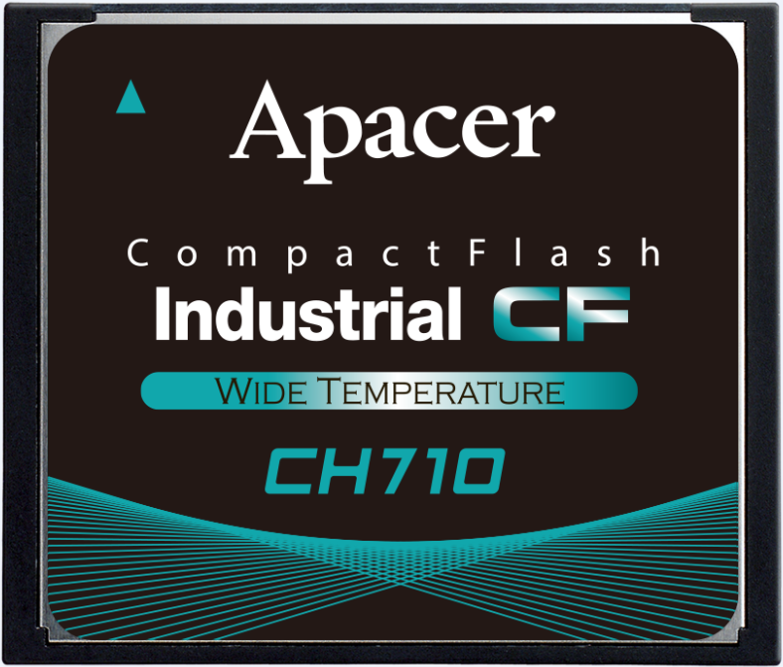
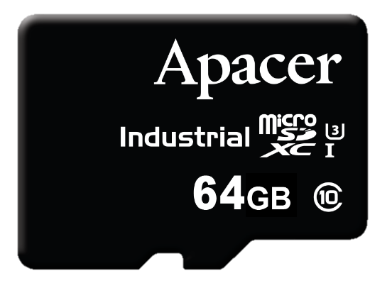
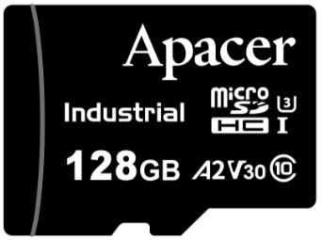
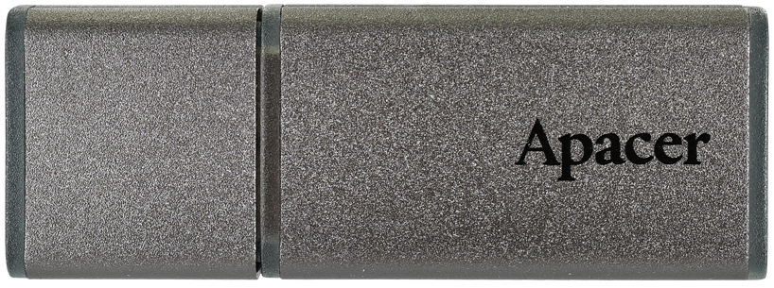
SLC-liteX Product Series
Form Factor | CompactFlash | MicroSD | MicroSD | UDM | USB
Model Name | CH710-CF | CH210-MSD | CH120-MSD | UH110-UFM1 | UH110-UFD1
Interface | CF 6.1 | SD 5.0 | SD 6.1 | USB 2.0 | USB 3.1
Capacity | 8GB~64GB | 16GB~64GB | 16GB~128GB | 8GB~32GB | 16GB~256GB
Seq. R/W Perf. (MB/sec) | 115/80 | 90/70 | 90/80 | 41/25 | 265/125
Operation Temperature ( °C ) | 0 ~ +70/ -40 ~ + 85 | -25 ~ + 85 | -25 ~ + 85/ -40 ~ + 85 | 0 ~ +70/ -40 ~ + 85 | 0 ~ +70/ -40 ~ + 85
Above models support 30K P/E cycles.
All images shown are for illustration purposes only, and are not shown at actual size.

Slide 13
Thank you!
industrial.apacer.com/
©Copyright Apacer Technology Inc. Confidential. Unauthorized use, dissemination,
distribution, or reproduction of this document is not allowed without the permission of
Apacer Technology Inc. Specifications of details may change without notice.
This document and its contents are confidential©Copyright Apacer Technology Inc.

