Slide 1
BiCS5 112-Layer 3D NAND Solutions
Sales and Marketing Center
Jan. 2022

Slide 2
Agenda
‧ The Evolution of BiCS Flash
‧ BiCS5: 112-Layer 3D NAND Technology
‧ Recommended Applications & Product Line-Up

Slide 3
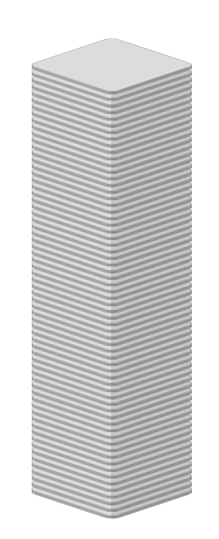
The Evolution of BiCS Flash
BiCS5
112 Layers
Data Rate: 1200 MT/s
Interface: Toggle 4.0
Endurance: 3,000 P/E Cycles
Block Size: 21MB
BiCS4
96 Layers
Data Rate: 800 MT/s
Interface: Toggle 3.0
Endurance: 3,000 P/E Cycles
Block Size: 18MB
BiCS3
64 Layers
Data Rate: 400 MT/s
Interface: Toggle 2.0
Endurance: 3,000 P/E Cycles
Block Size: 12MB
Higher Capacity & Performance
All Available by 2022/Q2
Mass Production
Mass Production

Slide 4
Agenda
‧ The Evolution of BiCS Flash
‧ BiCS5: 112-Layer 3D NAND Technology
‧ Recommended Applications & Product Line-Up

Slide 5
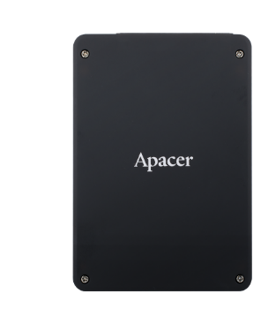
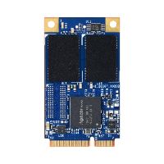
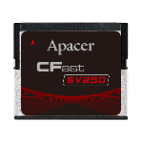
BiCS5: 112-Layer 3D NAND Technology
1
High Capacity, Up to 4TB
Keeps Pace with Growing Data Requirements
2
Remarkable Performance
with Competitive Unit Cost
3
High Endurance with 3,000 P/E Cycles
4
Guaranteed Longevity
The Newest Stacking Process On The Market

Slide 6
Agenda
‧ The Evolution of BiCS Flash
‧ BiCS5: 112-Layer 3D NAND Technology
‧ Recommended Applications & Product Line-Up

Slide 7
Data Center
BiCS5 112-Layer 3D NAND Solutions
Recommended Applications
Large Volumes of Data Storage and Processing
Edge Devices
5G
Base Station
Remarkable Performance, Low Latency Computing and Analysis
Surveillance
Highly Reliable and Stable Data Storage

Slide 8
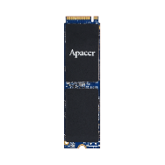
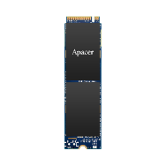
BiCS5 112-Layer 3D NAND Solutions
PCIe SSD Series
Model | PV930-M280 | PV210-M280 | PV920-M280 | PV220-M280 | PT220-M280
Interface | PCIe Gen4 x4 | PCIe Gen3 x4
Form Factor | M.2 2280
Capacity | 480~1920GB | 480~1920GB | 240~1920GB | 240~1920GB | 256GB~2TB
Seq. R/W (MB/s, max.) | 5080/4735 | 3500/2680 | 1740/1550 | 2070/2010 | 2480/2275
Endurance: DWPD (max.) | 2.98 | 3.62 | 1.8 | 3.09 | 3.37
AES 256-bit | Yes | Yes | Yes | Yes | Yes
TCG Opal 2.0 | Optional | Optional | Optional | Optional | No
Signed Firmware Support | Yes | No | Yes | No | No
External DRAM | Yes |  | No (w/HMB)
Operating Temp. (℃) | -40 ~ +85 |  |  |  | 0 ~ +70

Slide 9
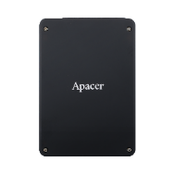
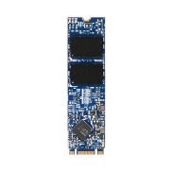
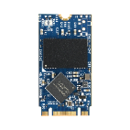
BiCS5 112-Layer 3D NAND Solutions
SATA SSD: SV240/SV250 Series
Model | SV240-25 | SV240- M280 | SV240- 300 | SV250-25 | SV250- M280 | SV250- M242 | SV250- 300 | SV250- 300B
Interface | SATA 3.2 (6Gb/s)
Form Factor | 2.5" | M.2 2280 | JEDEC MO-300 | 2.5" | M.2 2280 | M.2 2242 | JEDEC MO-300 | JEDEC MO-300B
Capacity | 240~3840GB | 240~1920GB | 240~1920GB | 240~1920GB | 240~1920GB | 240~960GB | 240~1920GB | 240~960GB
Seq. R/W (MB/s, max.) | 560/490 | 560/490 | 560/490 | 560/500 | 560/500 | 560/500 | 560/505 | 560/510
Endurance: DWPD (max.) | 3.42 | 3.3 | 3.3 | 3.45 | 3.45 | 3.21 | 3.45 | 3.3
External DRAM | Yes |  |  | No
AES 256-bit | Yes
TCG Opal 2.0 | Optional
Operating Temp. (℃) | -40 ~ +85

Slide 10
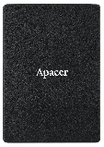
BiCS5 112-Layer 3D NAND Solutions
SATA SSD: ST250 Series
Model | ST250-25 | ST250-M280 | ST250-M242 | ST250-300 | ST250-297
Interface | SATA 3.2 (6Gb/s)
Form Factor | 2.5" | M.2 2280 | M.2 2242 | JEDEC MO-300 | JEDEC MO-297
Capacity | 128GB~2TB | 128GB~2TB | 128GB~1TB | 128GB~2TB | 128GB~2TB
Seq. R/W (MB/s, max.) | 560/510 | 560/510 | 560/510 | 560/510 | 560/510
Endurance: DWPD (max.) | 3.45 | 3.45 | 3.21 | 3.45 | 3.45
AES 256-bit | Yes
TCG Opal 2.0 | No
External DRAM | No
Operating Temp. (℃) | 0 ~ +70

Slide 11
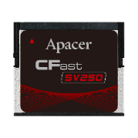
BiCS5 112-Layer 3D NAND Solutions
Industrial Card Series
Model | SV250-CFast | CH120-MSD | CV120-MSD
Interface | SATA 3.2 (6Gb/s) | SD5.0
Form Factor | CFast | microSD
Capacity | 240~960GB | 16~64GB | 64~128GB
Seq. R/W (MB/s, max.) | 560/500 | 95/85 | 85/35
AES 256-bit | Yes | -
TCG Opal 2.0 | Optional | -
SLC-liteX Support | No | Yes | No
S.M.A.R.T. Support | Yes
Flash Translation Layer | Page Mapping
External DRAM | No | -
Operating Temp. (℃) | -40 ~ +85

Slide 12
Thank you!
industrial.apacer.com/
©Copyright Apacer Technology Inc. Confidential. Unauthorized use, dissemination,
distribution, or reproduction of this document is not allowed without the permission of
Apacer Technology Inc. Specifications of details may change without notice.
This document and its contents are confidential©Copyright Apacer Technology Inc.

