Slide 1
Product Competitiveness of
Apacer’s Industrial-grade SSDs
Vertical Market Application Product Division
Feb. 2020

Slide 2
Agenda
‧ Apacer’s strengths in components and design
‧ Key differences between Apacer industrial SSD & others
‧ What sets Apacer apart?

Slide 3
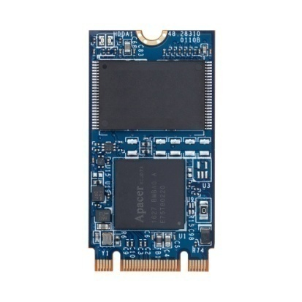
Apacer’s strengths in components and design
Designed with an industrial mindset
Components are selected specifically to withstand industrial environments

Slide 4
Robust design
Resistance to mechanical shock and vibration.
(components are placed in the most suitable positions to ensure signal transfer).
Resistance to higher temperatures through thermal sensor and effective thermal management.
Consistent component availability, selecting wear-resistant parts to ensure longevity.
 | Apacer Industrial-grade SSD | Others
Components wide temp. | All guaranteed by original vendor | Commercial grade or by sorting
Thermal sensor | Yes | No
Thermal management | Yes | No
Circuit design | Highly reliable | Not taken into consideration carefully

Slide 5
Exclusively using industrial-grade components
All support wide-temperature operation and are guaranteed by original vendor.
Key Component | Original Wide Temp. | Sorting Wide Temp.
Flash | Industrial-grade (-40°C ~ +85°C) | Commercial-grade (0~+70°C)
DRAM | Industrial-grade (-40°C ~ +85°C) | Commercial-grade (0~+85°C)
Controller | Industrial-grade (-40°C ~ +85°C) | Commercial-grade (0~+70°C)
Original P/N identification | I-Grade | C-Grade

Slide 6
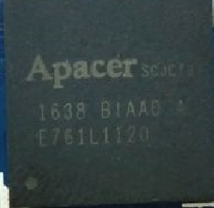
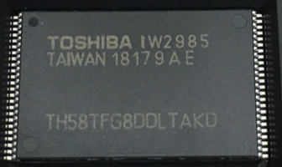
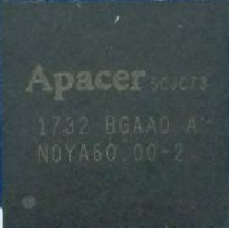
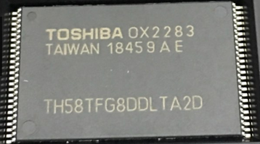
Identifying Commercial-grade & Industrial-grade ICs by marking
Marking examples
I-Grade CTL
I-Grade flash
Second digit starting from the right, letters from C to Z all represent I-Grade.
SCJC73 (fixed)
BIAA0 A (fixed)
K
C-Grade CTL
C-Grade flash
SCJC73 (fixed)
BGAA0 A (fixed)
2
Numeric + A & B are C-Grade

Slide 7
Agenda
‧ Apacer’s strengths in components and design
‧ Key differences between Apacer industrial SSD & others
‧ What sets Apacer apart?

Slide 8
Key differences between Apacer industrial SSD & others
Specification | Apacer industrial-grade SSDs | Consumer-grade SSDs | Major NAND flash manufacturers
 |  |  | Consumer | Enterprise | Embedded
NAND flash | SLC / MLC / TLC | TLC / QLC | TLC / QLC | TLC | TLC/MLC
Endurance / PE Cycle | 60K / 3K / 3K | 300 - 1.5K | DWPD
BOM control / PCN | 6 months LTB + 6 months LTS | N/A | N/A | Depends on customer level
Reliability | High | N/A | N/A | Depends on customer level
Longevity | ≥ 5 years | N/A | N/A | 1 year+ | Not specified
Extended temp. | Standard: 0 ~ +70 °C Extended:-40 ~ +85 °C | 0 - +70 °C | 0 ~ +70 °C | 0 ~ +70 °C | -40 ~ +85 °C
Customization abilities | VA features / HW / FW / SW | N/A | N/A
After sales service | Failure analysis, WW RMA | RMA | RMA | Depends on customer level
Flexibility | Field site support Global logistics Production arrangement | N/A | N/A
Manufacturing site | 100% Taiwan | USA, Taiwan, China | USA, China, Asia

Slide 9
Agenda
‧ Apacer’s strengths in components and design
‧ Key differences between Apacer industrial SSD & others
‧ What sets Apacer apart?

Slide 10
What sets Apacer apart?
Product line
Vertical Market
Comprehensive product lines
High capacities per form factor
Strongest sourcing relationships with IC design houses
Strategic local partner relationships
Established reputation for different vertical markets
TS/FAE
Logistic
Strong R&D/technical expertise/in-house design team
24-hour WW FAE on-site support & 48-hour 1st level FA turnaround
Wide logistics network
Quickest turnaround time
Flexibility

Slide 11
Thank you!
industrial.apacer.com/
©Copyright Apacer Technology Inc. Confidential. Unauthorized use, dissemination,
distribution, or reproduction of this document is not allowed without the permission of
Apacer Technology Inc. Specifications of details may change without notice.
This document and its contents are confidential©Copyright Apacer Technology Inc.

