Slide 1
Industrial Standard SSD
Sales Kit
Apacer Technology Inc.
Product Center, January 2021

Slide 2
Agenda
Industrial Standard SSD Policy
Industrial Standard SSD Model
Industrial Standard V.S. Professional SSD

Slide 3
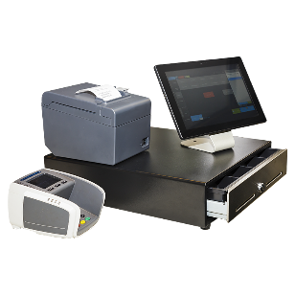
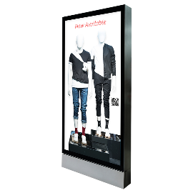
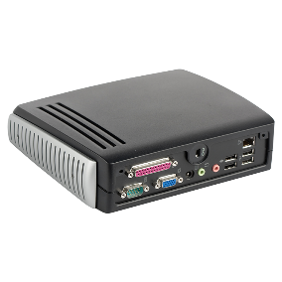
Industrial Standard SSD Policy
POS System
3K
PE Cycle
Fixed
FW/BOM
Slot Machine
PT/ST
Digital Signage
PCN
EOL
FA
Service
Thin Client
Main Policy
Major Applications

Slide 4
Industrial Standard SSD Model
Comparison
ST250
ST170
$$$
Cost
$$
With
Without
Format
3M
2M
MTBF
Yes
No
Thermal Sensor
PID/VID/OEM
No
Customization

Slide 5
Industrial Standard SSD Model
ST250 / PT220 Series
ST250-25
ST250-M242/M280
ST250-300
PT220-M280
2.5”
M.2
MO-300
PCIe M.2
With DEVSLP
Thermal Sensor
Plastic Housing
With Screw Pack
Capacity: 64GB~1TB
With DEVSLP
Thermal Sensor
LED
Capacity: 64GB~1TB
With DEVSLP
Thermal Sensor
LED
Capacity: 128GB~1TB
NVMe G3*4
Thermal Sensor
LED
Capacity: 128GB~1TB
CS: Ready
CS: Ready
CS: 6/E
CS: Ready
CS: Ready
CS: Ready
CS: Ready
CS: Ready

Slide 6
Industrial Standard SSD Model
ST170 Series
ST170-25
ST170-M242
2.5”
M.2
NO DEVSLP
W/O Thermal Sensor
Metal Housing
W/O Screw Pack
Capacity: 128GB~1TB
NO DEVSLP
W/O Thermal Sensor
NO LED
Capacity: 32GB~1TB
CS: 7/E
CS: 7/E
CS: Ready
CS: Ready

Slide 7
Industrial Standard vs Professional SSD Specification
Specification | Industrial Standard | Professional
Form Factor | 2.5” / M.2 / mSATA | 2.5” / M.2 2280 / mSATA
Firmware version | Fix | Not fix
FA service | Yes | No
EOL/PCN notice | Yes | No
BOM Control | Yes | Fix Controller
Warranty | 2-year or 3K P/E count | 3-year or TBW
HW | Thermal sensor/DEVSLP/LED | NA
Reliability Report | Yes | No

Slide 8
Industrial Standard vs Professional SSD
Test Criteria & Certificate
 | Testing | Industrial Standard | Professional
Test Criteria | Function Operation | Yes | Yes
 | System Stress | Yes | NA
 | Application Test (RAID) | Yes | NA
 | Temp. testing | Yes | NA
 | SSD Stress | Yes | NA
 | Power Reliability | Yes | NA
Certificate | Shock/Vibration | Yes | Yes
 | CE/FCC | Yes | Yes
 | BSMI/VCCI | NA | NAS SSD only

Slide 9
Thank you!
industrial.apacer.com/
©Copyright Apacer Technology Inc. Confidential. Unauthorized use, dissemination,
distribution, or reproduction of this document is not allowed without the permission of
Apacer Technology Inc. Specifications of details may change without notice.
This document and its contents are confidential©Copyright Apacer Technology Inc.

