Slide 1
www.apacer.com

Slide 2
Industrial SSD Product Roadmap Card, USB, PATA & eMMC Form Factors 2023 Q4
Product Center
Sep. 2023

Slide 3
Industrial Flash Card, USB, PATA SSD, eMMC
CF Card
SD / microSD Card
USB Module
USB Drive
PATA 2.5” Drive
Module (ADM)
eMMC

Slide 4
Industrial CF Card Roadmap
Flash | Available Now |  | Q4’23 |  |  | Q1’24 |  |  | Q2’24 |  |  | Q3’24
SLC | CF6 512MB~64GB
 | CF6A 256MB~32GB
 | CS710-CF 128MB~64GB
MLC | CF6-M 8GB~128GB
 | CF6A-M 8GB~64GB
 | CM710-CF 8GB~128GB
24/32nm
標準色
附屬
配色
3D TLC
2D MLC
SLC-lite
SLC
類工
24/32nm
SLC-liteX
24nm
Warranty: 5 years or 60K P/E cycles
15nm
15nm
15nm
Warranty: 2 years or 3K P/E cycles
Remarks:
Wide Temp.

Slide 5
Industrial CF Card Roadmap
Flash | Available Now |  | Q4’23 |  |  | Q1’24 |  |  | Q2’24 |  |  | Q3’24
SLC-lite | CF6A-SL 4GB~32GB
SLC-liteX | CH710-CF 8GB~64GB
標準色
附屬
配色
3D TLC
2D MLC
SLC-lite
SLC
類工
15nm
Warranty: 3 years or 20K P/E cycles
BiCS3
SLC-liteX
Warranty: 5 years or 30K P/E cycles
Remarks:
Wide Temp.

Slide 6
Industrial CF Card Roadmap
Flash | Model | SR/SW | 2023 |  | 2024 |  | 2025
 |  |  | H1 | H2 | H1 | H2 | H1 | H2
SLC | CF6 | 110/80
 | CF6A | 60/65
 | CS710-CF | 55/55
MLC | CF6-M | 110/65
 | CF6A-M | 115/75
 | CM710-CF | 90/55
SLC-lite | CF6A-SL | 115/80
SLC-liteX | CH710-CF | 115/80
標準色
附屬
配色
3D TLC
2D MLC
SLC-lite
SLC
類工
512MB~64GB
256MB~32GB
128MB~64GB
SLC-liteX
8GB~128GB
8GB~64GB
8GB~128GB
4GB~32GB
8GB~64GB
Remarks:
SR/SW: Sequential Read/Write
ES CS MP EOL LTS

Slide 7
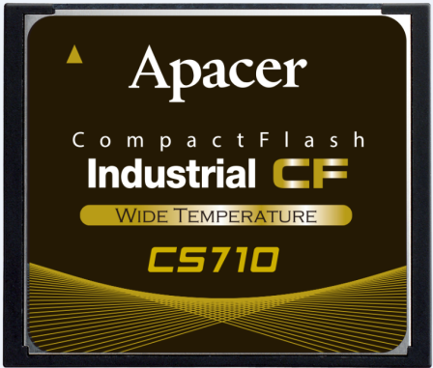
CS710-CF Specification
Model Name | CS710-CF
Transfer Mode | PIO-6 / MWDMA-4 / UDMA-6
Capacity | 128MB~64GB
Controller ECC Engine | 96-Bit/1K bytes
NAND Support | Kioxia 24nm SLC
R/W (MB/sec) | 55/55
IOPS R/W | 2000/1000
Wide Temp. (-40°C~85°C) | Yes
Dimension (L x W x H) | 36.4 x 42.8 x 3.3 mm
Product Features | Applications
S.M.A.R.T Function Global Wear-Leveling Technology ATA Secure Erase Flash Block Management Power Failure Management Page Mapping | Factory Automation, Medical, Gaming, Digital Signage, Transportation, Broadband access application, Lottery printer, Intelligent building
CS: Ready

Slide 8
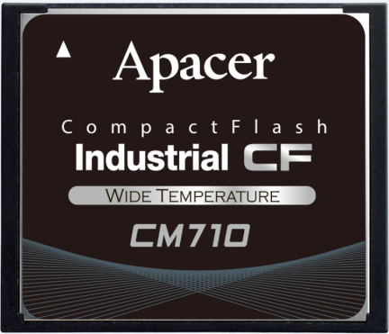
CM710-CF Specification
Model Name | CM710-CF
Transfer Mode | PIO-6 / MWDMA-4 / UDMA-6
Capacity | 8GB~128GB
Controller ECC Engine | 96-Bit/1K bytes
NAND Support | Kioxia 15nm MLC
R/W (MB/sec) | 90/55
IOPS R/W | 2000/1000
Wide Temp. (-40°C~85°C) | Yes
Dimension (L x W x H) | 36.4 x 42.8 x 3.3 mm
Product Features | Applications
S.M.A.R.T Function Global Wear-Leveling Technology ATA Secure Erase Flash Block Management Power Failure Management Page Mapping | Factory Automation, Medical, Gaming, Digital Signage, Transportation, Broadband access application, Lottery printer, Intelligent building
CS: Ready

Slide 9
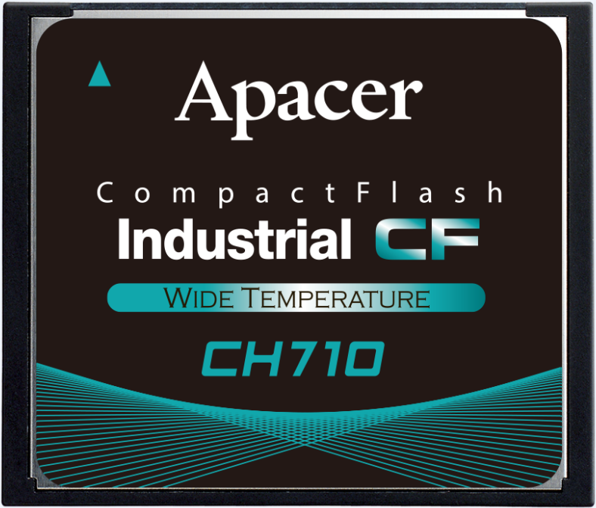
CH710-CF Specification
Model Name | CH710-CF
Transfer Mode | PIO-6 / MWDMA-4 / UDMA-6
Capacity | 8GB~64GB
Controller ECC Engine | 96-Bit/1K bytes
NAND Support | Kioxia BiCS3
R/W (MB/sec) | 115/80
IOPS | 3100/2100
Wide Temp. (-40°C~85°C) | Yes
Dimension (L x W x H) | 36.4 x 42.8 x 3.3 mm
Product Features | Applications
S.M.A.R.T Function Global Wear-Leveling Technology ATA Secure Erase Flash Block Management Power Failure Management Page Mapping | Factory Automation, Medical, Gaming, Digital Signage, Transportation, Broadband access application, Lottery printer, Intelligent building
CS: Ready

Slide 10
Industrial CF SLC Card Comparison Table
Model Name | CF6 | CF6A | CS710-CF
Transfer Mode | PIO-6 MWDMA-4 UDMA-7 | PIO-6 MWDMA-4 UDMA-7 | PIO-6 MWDMA-4 UDMA-6
Capacity | 512MB to 64GB | 256MB to 32GB | 128MB to 64GB
Channel | 4 | 2 | 2
I/O Support | 5V/3.3V | 5V/3.3V | 5V/3.3V
R/W (MB/s) | 110/80 | 60/65 | 55/55
Controller ECC Engine | 72-bit/1K bytes | 72-bit/1K bytes | 96-Bit/1K bytes
Wide Temp. | Yes | Yes | Yes
H/W Write Protection | Yes (CF6 VA) | Yes (CF6A VA) | No
標準色
附屬
配色
3D TLC
2D MLC
SLC-lite
SLC
類工
SLC-liteX
High performance
Cost effective
Mainstream

Slide 11
Industrial CF MLC/TLC Card Comparison Table
Model Name | CF6-M | CF6A-M | CM710-CF | CF6A-SL | CH710-CF
Transfer Mode | PIO-6 MWDMA-4 UDMA-7 | PIO-6 MWDMA-4 UDMA-7 | PIO-6 MWDMA-4 UDMA-6 | PIO-6 MWDMA-4 UDMA-7 | PIO-6 MWDMA-4 UDMA-6
Capacity | 8GB to 128GB | 8GB to 64GB | 8GB to 128GB | 4GB to 32GB | 8GB to 64GB
Channel | 4 | 2 | 2 | 2 | 2
I/O Support | 5V/3.3V | 5V/3.3V | 5V/3.3V | 5V/3.3V | 5V/3.3V
R/W (MB/s) | 110/65 | 115/75 | 90/55 | 115/80 | 115/80
Controller ECC Engine | 72-bit/1K bytes | 72-bit/1K bytes | 96-Bit/1K bytes | 72-bit/1K bytes | 96-Bit/1K bytes
Wide Temp. | Yes | Yes | Yes | Yes | Yes
H/W Write Protection | Yes (customized) | Yes | No | Yes | No
標準色
附屬
配色
3D TLC
2D MLC
SLC-lite
SLC
類工
SLC-liteX
High performance
Cost effective
Mainstream
High P/E cycles: 20K
High P/E cycles: 30K

Slide 12
Industrial Flash Card, USB, PATA SSD, eMMC
CF Card
SD / microSD Card
USB Module
USB Drive
PATA 2.5” Drive
Module (ADM)
eMMC

Slide 13
Industrial SD/microSD Status Update
Model | ES | CS | Note
SD/microSD WORM Card | READY | E/Nov. | ET1288 + WD 1Znm MLC

Slide 14
Industrial SD/microSD 3D NAND Roadmap
Flash | Available Now |  | Q4’23 |  |  | Q1’24 |  |  | Q2’24 |  |  | Q3’24
TLC | Ind. SD 5.0 CV110-SD 32GB~256GB
 | Ind. microSD 6.1 CV120-MSD 64GB~128GB
SLC-liteX | Ind. SD 5.0 CH110-SD 8GB~128GB
 | Ind. microSD 5.0 CH210-MSD 16GB~64GB
 | Ind. SD 6.1 CH120-MSD 16GB~128GB
BiCS3
標準色
附屬
配色
3D TLC
2D MLC
SLC-lite
SLC
類工
BiCS5
Warranty: 3 years or 3K P/E cycles
SLC-liteX
BiCS3
BiCS4
BiCS5
Warranty: 5 years or 30K P/E cycles
Remarks:
Wide Temp.

Slide 15
Industrial SD/microSD 2D NAND Roadmap
Flash | Available Now |  | Q4’23 |  |  | Q1’24 |  |  | Q2’24 |  |  | Q3’24
SLC | Ind. SD 256MB~32GB
 | Ind. SD3.0 R1 1GB~16GB Ind. microSD3.0 R1 1GB~8GB
MLC | Ind. SD/microSD H1-M 8GB~128GB
 | Ind. microSDHC R1-M 8GB~16GB
 | Ind. SD/microSDHC5.1 H2-M 8GB~32GB
 |  |  |  |  | SD/microSD WORM Card
24/32nm
標準色
附屬
配色
3D TLC
2D MLC
SLC-lite
SLC
類工
24/32nm
Warranty: 5 years or 60K P/E cycles
SLC-liteX
15nm
15nm
15nm
Warranty: 2 years or 3K P/E cycles
1Znm
Remarks:
Wide Temp.

Slide 16
Industrial SD/microSD 2D NAND Roadmap
Flash | Available Now |  | Q4’23 |  |  | Q1’24 |  |  | Q2’24 |  |  | Q3’24
SLC-lite | Ind. SD/microSDHC H1-SL 4GB~64GB
 | Ind. SD/microSDHC 5.1 H2-SL 4GB~16GB
標準色
附屬
配色
3D TLC
2D MLC
SLC-lite
SLC
類工
15nm
15nm
SLC-liteX
Warranty: 3 years or 20K P/E cycles
Remarks:
Wide Temp.

Slide 17
Industrial SD/microSD 3D NAND Roadmap
Flash | Model | SR/SW | 2023 |  | 2024 |  | 2025
 |  |  | H1 | H2 | H1 | H2 | H1 | H2
TLC | Ind. SD 5.0 CV110-SD CV110-MSD | 90/33
 | Ind. SD 6.1 CV120-MSD | 90/80
SLC-liteX | Ind. SD 5.0 CH210-MSD | 90/70
 | Ind. SD 6.1 CH120-MSD | 90/80
標準色
附屬
配色
3D TLC
2D MLC
SLC-lite
SLC
類工
32GB~256GB
64GB~128GB
SLC-liteX
16GB~64GB
16GB~128GB
Remarks:
SR/SW: Sequential Read/Write
ES CS MP EOL LTS

Slide 18
Industrial SD/microSD 2D NAND Roadmap
Flash | Model | SR/SW | 2023 |  | 2024 |  | 2025
 |  |  | H1 | H2 | H1 | H2 | H1 | H2
SLC | Ind. SD | 23/18
 | Ind. microSD | 20/16
 | Ind. SD R1 | 43/41
 | Ind. microSD R1 | 34/28
MLC | Ind. SD H1-M / microSD H1-M | 94/53
 | microSD H2-M | 92/42
 | Ind. microSD R1-M | 92/48
 | SD/microSD WORM Card | Est. 72/20
SLC-lite | SD H1-SL / microSD H1-SL | 92/70
 | microSD H2-SL | 90/50
256MB~32GB
標準色
附屬
配色
3D TLC
2D MLC
SLC-lite
SLC
類工
256MB~4GB
1GB~16GB
SLC-liteX
1GB~8GB
8GB~128GB
8GB~32GB
8GB~16GB
8GB~128GB
SD 4GB~64GB / microSD 4GB~32GB
4GB~16GB
Remarks:
SR/SW: Sequential Read/Write
ES CS MP EOL LTS

Slide 19
Industrial SD/microSD Comparison Table
Model Name | Ind. SD/ microSD R1 | Ind. microSD H1-M | Ind. microSD H2-M | Ind. SD/ microSD R1-M | SD/microSD WORM Card | CV110-SD/ microSD | CV120 microSD | CH120 microSD | CH210 microSD
Capacity | 1GB~16GB | 8GB~128GB | 8GB~32GB | 8GB~16GB | 8GB~128GB | 32GB~256GB | 64GB~256GB | 16GB~64GB | 16GB~64GB
Speed Class | SD3.0 CL10 | SD3.0 CL10 | SD5.1 V10/V30 | SD3.0 CL10 | SD6.1 | SD5.0 CL10 | SD6.1 U3/V30 | SD6.1 U3/V30 | SD5.0 U3/V30
Flash Type | Kioxia 24/32nm SLC | Kioxia 15nm MLC/WD 1Znm MLC | Kioxia 15nm MLC | WD 1Znm MLC | WD 1Zmm MLC | Kioxia BiCS3 | Kioxia BiCS5 | Kioxia BiCS5 | WD BiCS4
R/W (MB/sec) | 43/41 | 94/53 | 92/42 | 92/48 | Est. 72/20 | 90/33 | 90/85 | 90/80 | 90/70
IOPS Random 4KB R/W | 744/517 | 1017/48 | 1913/981 | 1174/145 | - | 1500/500 | 1900/1200 | 1900/1100 | 1300/300
Endurance (TBW) | - | 5 | 7 | 18 | - | 342 | 352 | 568 | 713
SMART Support | Yes | Yes | Yes | Yes | Yes | Yes | Yes | Yes | Yes
Wide Temp. | Yes | Yes | Yes | Yes | Yes | Yes | Yes | Yes | No
FTL | Page mapping | Block mapping | Page mapping | Page mapping | Page mapping | Page mapping | Page mapping | Page mapping | Page mapping
標準色
附屬
配色
3D TLC
2D MLC
SLC-lite
SLC
類工
SLC-liteX
SLC
MLC
TLC
SLC-liteX

Slide 20
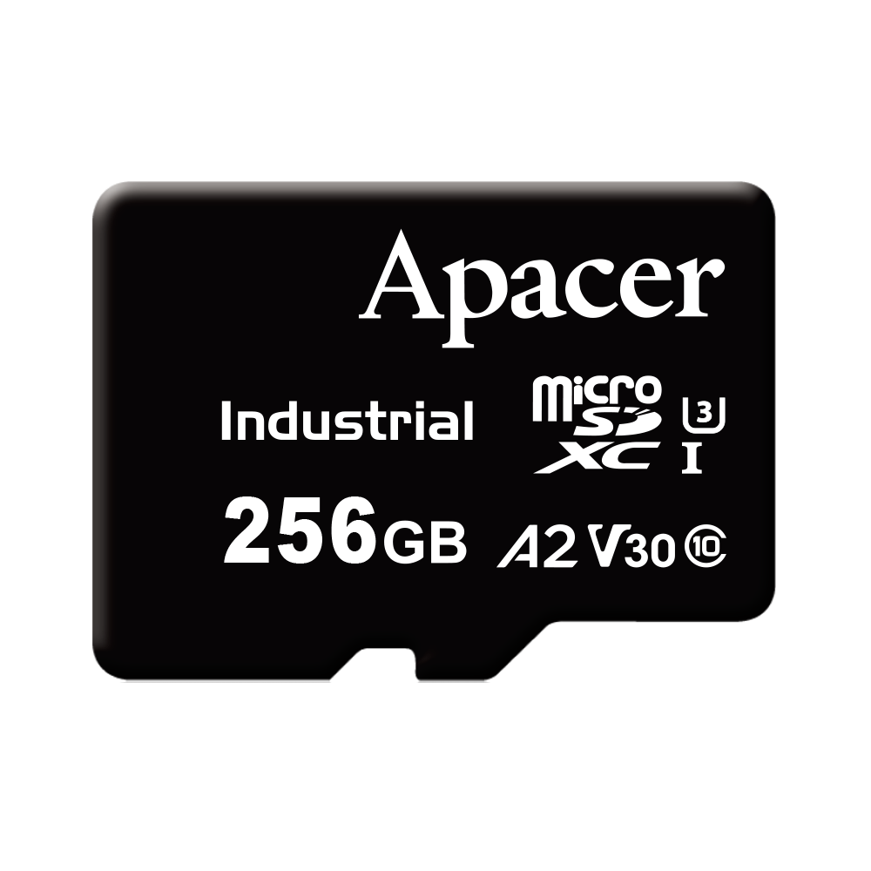
CV120-MSD Specification
Model Name | CV120-MSD
Interface | microSD 6.1
Capacity | 64GB~256GB
NAND Support | Kioxia BiCS5
External DRAM | No
Est. R/W Speed (MB/sec) | 90/85
Est. IOPS (4K Random Read) | 1.9K
Est. IOPS (4K Random Write) | 1.2K
Wide Temp. (-40°C~85°C) | Yes
Product Features | Applications
Support LDPC ECC Built-in advanced ECC Algorithm Global Wear Leveling Flash bad-block Management S.M.A.R.T. SMART Read Refresh | Industrial/Military, Surveillance, Digital Signage, POS
CS: Ready

Slide 21
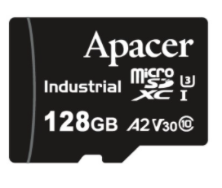
CH120-MSD Specification
Model Name | CH120-MSD
Interface | microSD 6.1
Capacity | 16GB~128GB
NAND Support | Kioxia BiCS5
External DRAM | No
Est. R/W Speed (MB/sec) | 90/80
Est. IOPS (4K Random Read) | 1.9K
Est. IOPS (4K Random Write) | 1.1K
Wide Temp. (-40°C~85°C) | Yes
Product Features | Applications
Support LDPC ECC Built-in advanced ECC Algorithm Global Wear Leveling Flash bad-block Management S.M.A.R.T. SMART Read Refresh | Industrial/Military, Surveillance, Digital Signage, POS
CS: Ready

Slide 22
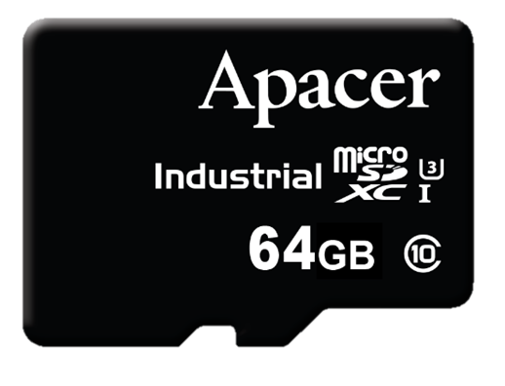
CH210-MSD Specification
Model Name | CH210-MSD
Interface | microSD 5.0
Capacity | 16GB~64GB
NAND Support | WD BiCS4
External DRAM | No
Est. R/W Speed (MB/sec) | 90 / 70
Est. IOPS (4K Random Read) | 1.3K
Est. IOPS (4K Random Write) | 0.3K
Wide Temp. (-40°C~85°C) | No
Product Features | Applications
Support LDPC ECC Built-in advanced ECC Algorithm Global Wear Leveling Flash bad-block Management S.M.A.R.T. SMART Read Refresh | Industrial/Military, Surveillance, Digital Signage, POS
CS: Ready

Slide 23
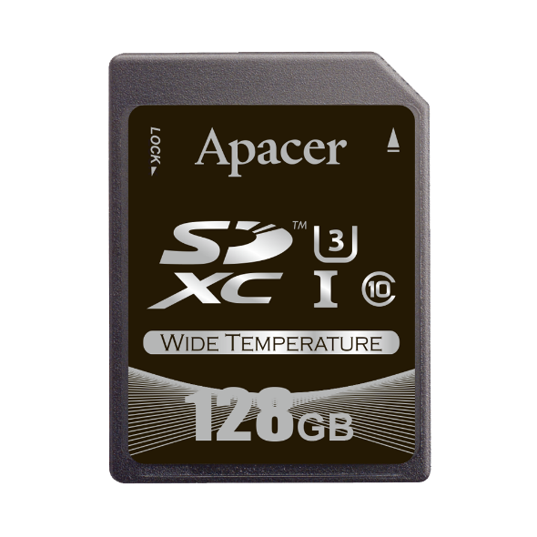
SD/microSD WORM Card Specification
Model Name | SD/microSD WORM Card
Interface | SD Specification 6.1
Capacity | 8GB~128GB
NAND Support | WD 1Znm MLC
R/W (MB/sec) | Est. 72/20
Wide Temp. (-40°C~85°C) | Yes
Product Features | Applications
Write Once Read Many Ensure Data integrity with non-rewritable storage function Data Retention 100 Years Pop-up alert if any undoable action Product Limitations - File System Support: FAT32 only - OS Support: Windows family - File must been written follows "one by one“ and sequentially | Financial and tax data, voting machines, cash register data logging, medical industry, legal evidences etc.
Photo only for reference
CS: Q4

Slide 24
Industrial Flash Card, USB, PATA SSD, eMMC
CF Card
SD / microSD Card
USB Module
USB Drive
PATA 2.5” Drive
Module (ADM)
eMMC

Slide 25
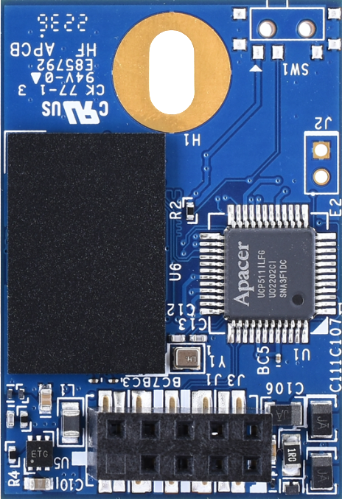
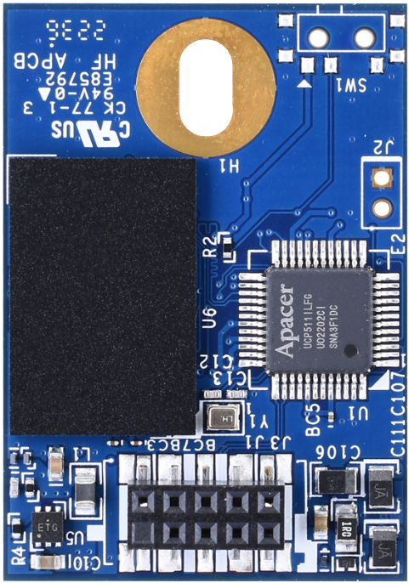
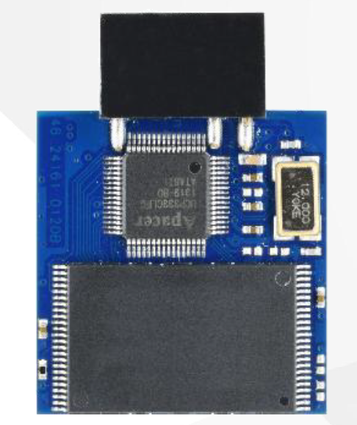
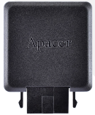
Industrial USB Module 3D NAND Roadmap
Flash | Available Now |  | Q4’23 |  |  | Q1’24 |  |  | Q2’24 |  |  | Q3’24
TLC | UV110-UFM1 128GB~256GB
 | UV110-UFM2 128GB~256GB
 | UV110-UFM3 128GB~256GB
SLC-liteX | UH110-UFM1 32GB~64GB
 | UH110-UFM2 32GB~64GB
 | UH110-UFM3 32GB~64GB
BiCS5
標準色
附屬
配色
3D TLC
2D MLC
SLC-lite
SLC
類工
BiCS5
SLC-liteX
BiCS5
Warranty: 3 years or 3K P/E cycles
BiCS5
BiCS5
BiCS5
UFM1: 90D Standard
10-pin (2x5) female header in 2.54mm
UFM2: 90D LP
10-pin (2x5) female header in 2.0mm
UFM3: 180D LP
10-pin (2x5)
female header in 2.54mm
UFM3: 180D LPH
10-pin (2x5)
female header in 2.54mm
Warranty: 5 years or 30K P/E cycles
*16GB only support Standard Temp.
Remarks:
Wide Temp.

Slide 26
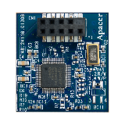
Industrial USB Module 2D NAND Roadmap
Flash | Available Now |  | Q4’23 |  |  | Q1’24 |  |  | Q2’24 |  |  | Q3’24
SLC | UDM 1U 128MB~16GB USB3.0
 | UDM2A 256MB~32GB
 | UDM2 Plus 256MB~32GB
MLC | UDM 1U-M 8GB~32GB
 | UDM2A-M 8GB~128GB
24/32nm
標準色
附屬
配色
3D TLC
2D MLC
SLC-lite
SLC
類工
24/32nm
SLC-liteX
24/32nm
Warranty: 5 years or 60K P/E cycles
15nm
15nm
Warranty: 2 years or 3K P/E cycles
Type A
Type B
Type C
Type D-LP
Type E
UDM 1U
Remarks:
Wide Temp.

Slide 27
Industrial USB Module 3D NAND Roadmap
Flash | Model | SR/SW | 2023 |  | 2024 |  | 2025
 |  |  | H1 | H2 | H1 | H2 | H1 | H2
TLC | UV110-UFM1 | 40/33
 |  | 37/31
 | UV110-UFM2 | 40/33
 |  | 37/31
 | UV110-UFM3 | 37/31
標準色
附屬
配色
3D TLC
2D MLC
SLC-lite
SLC
類工
BiCS3: 16GB~128GB *
BiCS5: 128GB~256GB
SLC-liteX
BiCS3: 16GB~128GB **
BiCS5: 128GB~256GB
BiCS5: 128GB~256GB
Remark:
*16GB only support Standard Temp.
**16GB only support Standard Temp.
Remarks:
SR/SW: Sequential Read/Write
ES CS MP EOL LTS

Slide 28
Industrial USB Module 3D NAND Roadmap
Flash | Model | SR/SW | 2023 |  | 2024 |  | 2025
 |  |  | H1 | H2 | H1 | H2 | H1 | H2
SLC-liteX | UH110-UFM1 | 41/25
 |  | 37/32
 | UH110-UFM2 | 37/32
 | UH110-UFM3 | 37/32
標準色
附屬
配色
3D TLC
2D MLC
SLC-lite
SLC
類工
BiCS3: 8GB~32GB
BiCS5: 32GB~64GB
SLC-liteX
BiCS5: 32GB~64GB
BiCS5: 32GB~64GB
Remarks:
SR/SW: Sequential Read/Write
ES CS MP EOL LTS

Slide 29
Industrial USB Module 2D NAND Roadmap
Flash | Model | SR/SW | 2023 |  | 2024 |  | 2025
 |  |  | H1 | H2 | H1 | H2 | H1 | H2
SLC | UDM 1U | 40/35
 | UDM2A | 44/41
 | UDM2 Plus | 34/22
MLC | UDM 1U-M | 90/48
 | UDM2A-M | 44/43
標準色
附屬
配色
3D TLC
2D MLC
SLC-lite
SLC
類工
128MB~16GB, USB3.0
256MB~32GB, USB2.0
256MB~32GB, USB2.0
SLC-liteX
8GB~32GB, USB3.0
8GB~128GB, USB2.0
Remarks:
SR/SW: Sequential Read/Write
ES CS MP EOL LTS

Slide 30
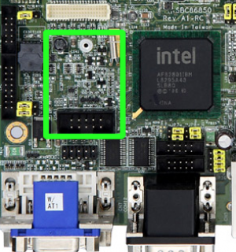
USB2.0 Module Type Overview
Model Type | Orientation v.s. motherboard | Pitch hole | Remark
Type A (STD 90D) | Horizontal | 2.54mm
Type B (STD 90D) | Horizontal | 2.54mm | With mounting header
Type C (STD 90D) / UFM1 | Horizontal | 2.54mm | With mounting screw
Type D (180D) | Vertical | 2.54mm
Type D LP / UFM3 | Vertical | 2.54mm
Type E (LP 90D) / UMF2 | Horizontal | 2.00mm | With mounting screw
標準色
附屬
配色
3D TLC
2D MLC
SLC-lite
SLC
類工
SLC-liteX
Attach to a 10-pin USB header on the embedded system

Slide 31
UV110-UFM1 Specification
Model Name | UV110-UFM1
Interface | USB2.0
Capacity | 128GB~256GB
NAND Support | Kioxia BiCS5
R/W (MB/sec) | 37/31
IOPS R/W | 1200/400
Wide Temp. (-40°C~85°C) | Yes
Connector | 90D Standard 10-pin (2x5) female header in 2.54mm
Dimension (L x W x H) | 37.8 x 26.65 x 10.91 mm
Product Features | Applications
Flash Bad-block Management Global Wear-Leveling Technology S.M.A.R.T. Support LDPC ECC Power Failure Management Page Mapping Write Protect (Optional) | Factory Automation, Transportation
CS: Ready

Slide 32
UH110-UFM1 Specification
Model Name | UH110-UFM1
Interface | USB2.0
Capacity | 32GB~64GB
NAND Support | Kioxia BiCS5
R/W (MB/sec) | 37/32
IOPS R/W | 1200/400
Wide Temp. (-40°C~85°C) | Yes
Connector | 90D Standard 10-pin (2x5) female header in 2.54mm
Dimension (L x W x H) | 37.8 x 26.65 x 10.91 mm
Product Features | Applications
Flash Bad-block Management Global Wear-Leveling Technology S.M.A.R.T. Support LDPC ECC Power Failure Management Page Mapping SLC-liteX Write Protect (Optional) | Factory Automation, Transportation
CS: Ready

Slide 33
UV110-UFM2 Specification
Model Name | UV110-UFM2
Interface | USB2.0
Capacity | 128GB~256GB
NAND Support | Kioxia BiCS5
R/W (MB/sec) | 37/31
IOPS R/W | 1200/400
Wide Temp. (-40°C~85°C) | Yes
Connector | 90D LP 10-pin (2x5) female header in 2.0mm
Dimension (L x W x H) | 37.8 x 26.65 x 8.01 mm
Product Features | Applications
Flash Bad-block Management Global Wear-Leveling Technology S.M.A.R.T. Support LDPC ECC Power Failure Management Page Mapping Write Protect (Optional) | Factory Automation, Transportation
CS: Ready

Slide 34
UH110-UFM2 Specification
Model Name | UH110-UFM2
Interface | USB2.0
Capacity | 32GB~64GB
NAND Support | Kioxia BiCS5
R/W (MB/sec) | 37/32
IOPS R/W | 1200/400
Wide Temp. (-40°C~85°C) | Yes
Connector | 90D LP 10-pin (2x5) female header in 2.0mm
Dimension (L x W x H) | 37.8 x 26.65 x 8.01 mm
Product Features | Applications
Flash Bad-block Management Global Wear-Leveling Technology S.M.A.R.T. Support LDPC ECC Power Failure Management Page Mapping Write Protect (Optional) SLC-liteX | Factory Automation, Transportation
CS: Ready

Slide 35
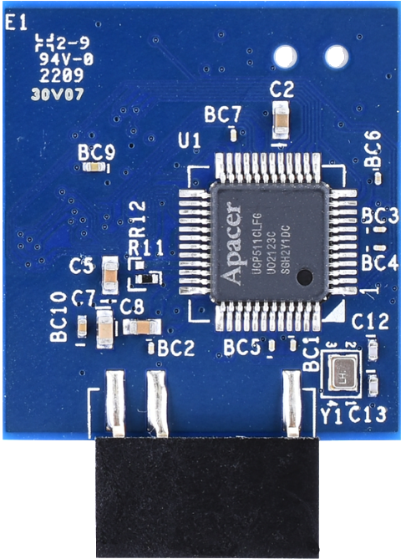
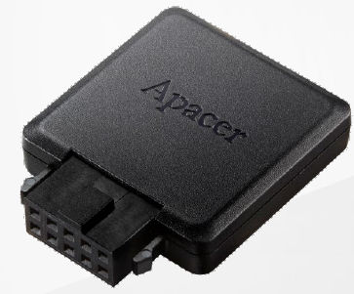
UV110-UFM3 Specification
Model Name | UV110-UFM3
Interface | USB2.0
Capacity | 128GB~256GB
NAND Support | Kioxia BiCS5
R/W (MB/sec) | 37/31
IOPS R/W | 1200/400
Wide Temp. (-40°C~85°C) | Yes
Connector | 180D LP 10-pin (2x5) female header in 2.54mm
Dimension (L x W x H) | LP: 32.5 x 24.0 x 5.0 mm (w/o housing) LPH: 35.7 x 28.1 x 7.2 mm (with housing)
Product Features | Applications
Flash Bad-block Management Global Wear-Leveling Technology S.M.A.R.T. Support LDPC ECC Power Failure Management Page Mapping Write Protect (Optional) | Factory Automation, Transportation
CS: Ready
CS: Ready

Slide 36
UH110-UFM3 Specification
Model Name | UH110-UFM3
Interface | USB2.0
Capacity | 32GB~64GB
NAND Support | Kioxia BiCS5
R/W (MB/sec) | 37/32
IOPS R/W | 1200/400
Wide Temp. (-40°C~85°C) | Yes
Connector | 180D LP 10-pin (2x5) female header in 2.54mm
Dimension (L x W x H) | LP: 32.5 x 24.0 x 5.0 mm (w/o housing) LPH: 35.7 x 28.1 x 7.2 mm (with housing)
Product Features | Applications
Flash Bad-block Management Global Wear-Leveling Technology S.M.A.R.T. Support LDPC ECC Power Failure Management Page Mapping Write Protect (Optional) SLC-liteX | Factory Automation, Transportation
CS: Ready
CS: Ready

Slide 37
Industrial USB Module 3D NAND Comparison Table
Model Name | UV110-UFM1 | UV110-UFM2 | UV110-UFM3 | UH110-UFM1 | UH110-UFM2 | UH110-UFM3
Capacity | 128GB~256GB | 128GB~256GB | 128GB~256GB | 32GB~64GB | 32GB~64GB | 32GB~64GB
Interface | USB 2.0 | USB 2.0 | USB 2.0 | USB 2.0 | USB 2.0 | USB 2.0
Flash Type | Kioxia BiCS5 | Kioxia BiCS5 | Kioxia BiCS5 | Kioxia BiCS5 | Kioxia BiCS5 | Kioxia BiCS5
R/W (MB/sec) | 37/31 | 37/31 | 37/31 | 37/32 | 37/32 | 37/32
IOPS R/W(MB/sec) | 1200/400 | 1200/400 | 1200/400 | 1200/400 | 1200/400 | 1200/400
Power consumption (Active/Idle;mA) | 100/75 | 100/75 | 100/75 | 95/75 | 95/75 | 95/75
Endurance (DWPD) | 2.74 | 2.74 | 2.74 | 21.92 | 21.92 | 21.92
Page Mapping | Yes | Yes | Yes | Yes | Yes | Yes
Wide Temp. | Yes | Yes | Yes | Yes | Yes | Yes
Write Protect | Optional | Optional | Optional | Optional | Optional | Optional
Connector (mm) | 10-pin (2x5) female header in 2.54 | 10-pin (2x5) female header in 2.00 | 10-pin (2x5) female header in 2.54 | 10-pin (2x5) female header in 2.54 | 10-pin (2x5) female header in 2.00 | 10-pin (2x5) female header in 2.54
Dimension (mm) | 37.8x26.65x10.91 | 37.8x26.65x8.01 | LP: 32.5x24.0x5.0 LPH: 35.7x28.1x7.2 | 37.8x26.65x10.91 | 37.8x26.65x8.01 | LP: 32.5x24.0x5.0 LPH: 35.7x28.1x7.2
標準色
附屬
配色
3D TLC
2D MLC
SLC-lite
SLC
類工
SLC-liteX
Mainstream
Mainstream
Mainstream
High P/E
cycles: 30K
High P/E
cycles: 30K
High P/E
cycles: 30K

Slide 38
Industrial Flash Card, USB, PATA SSD, eMMC
CF Card
SD / microSD Card
USB Module
USB Drive
PATA 2.5” Drive
Module (ADM)
eMMC

Slide 39
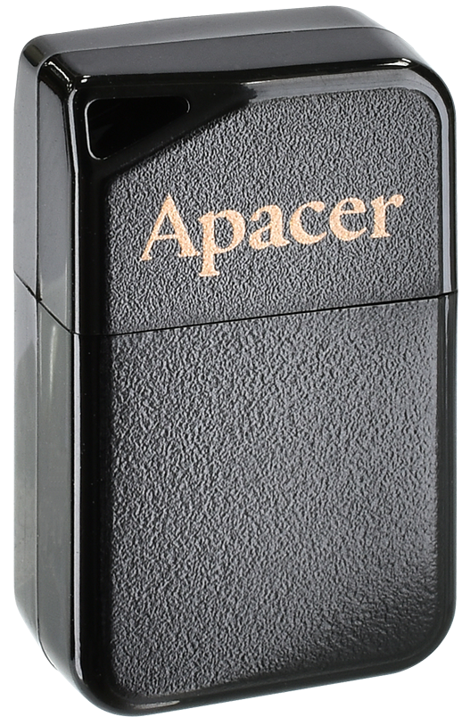
Industrial USB Drive 3D NAND Roadmap
Flash | Available Now |  | Q4’23 |  |  | Q1’24 |  |  | Q2’24 |  |  | Q3’24
TLC | UV110-UFD1 128GB~512GB
 | UV110-UFD5 128GB~256GB Air 15kv ESD Protect
 | UV110-UFD7 128GB~256GB Type-C
 | UT110-UFD2 64GB SIP
標準色
附屬
配色
3D TLC
2D MLC
SLC-lite
SLC
類工
BiCS5
BiCS5
SLC-liteX
BiCS5
BiCS5
Warranty: 3 years or 3K P/E cycles
UV110-UFD1
UV110-UFD5
UV110-UFD7
UT110-UFD2
Metal
Plastic
Plastic
Plastic
Remarks:
Wide Temp.

Slide 40
Industrial USB Drive 3D NAND Roadmap
Flash | Available Now |  | Q4’23 |  |  | Q1’24 |  |  | Q2’24 |  |  | Q3’24
SLC-liteX | UH110-UFD1 32GB~64GB
 | UH110-UFD4 4GB~8GB* Write Protect
 | UH110-UFD5 32GB~64GB Air 15kv ESD Protect
 | UH110-UFD7 32GB~64GB Type-C
標準色
附屬
配色
3D TLC
2D MLC
SLC-lite
SLC
類工
BiCS5
BiCS3
SLC-liteX
BiCS5
BiCS5
Warranty: 5 years or 30K P/E cycles
*4GB only support Standard Temp.
UH110-UFD1
UH110-UFD4
UH110-UFD5
UH110-UFD7
Metal
Metal
Plastic
Plastic
Remarks:
Wide Temp.

Slide 41
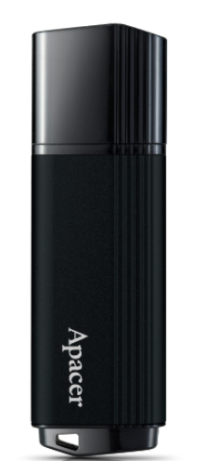
Industrial USB Drive 2D NAND Roadmap
Flash | Available Now |  | Q4’23 |  |  | Q1’24 |  |  | Q2’24 |  |  | Q3’24
SLC | EH353 256MB~32GB
 | AH321/AH322 256MB~32GB
 | US120-UFD5 256MB~32GB
 | USZ20-UFD5 256MB~32GB
24/32nm
標準色
附屬
配色
3D TLC
2D MLC
SLC-lite
SLC
類工
24/32nm
SLC-liteX
24nm
24nm
Warranty: 5 years or 60K P/E cycles
AH321
AH322
US(M)120-UFD5
USZ20-UFD5
EH353(-M)
Metal
Plastic
Plastic
Plastic
Remarks:
Wide Temp.

Slide 42
Industrial USB Drive 2D NAND Roadmap
Flash | Available Now |  | Q4’23 |  |  | Q1’24 |  |  | Q2’24 |  |  | Q3’24
MLC | EH353-M 8GB~128GB
 | UM120-UFD5 8GB~128GB
 | EH163-M 8GB~64GB SIP
 |  |  |  |  | AH322-M WORM Drive 8GB~32GB
15nm
標準色
附屬
配色
3D TLC
2D MLC
SLC-lite
SLC
類工
15nm
SLC-liteX
15nm
1Znm
Warranty: 2 years or 3K P/E cycles
US(M)120-UFD5
USZ20-UFD5
EH163-M
AH322-M WORM Drive
EH353-M
Metal
Plastic
Plastic
Plastic
Remarks:
Wide Temp.

Slide 43
Industrial USB Drive 3D NAND Roadmap
Flash | Model | SR/SW | 2023 |  | 2024 |  | 2025
 |  |  | H1 | H2 | H1 | H2 | H1 | H2
TLC | UV110-UFD1 | 260/125
 |  | 275/195
 | UT110-UFD2 | 270/85
 | UV110-UFD5 | 255/120
 |  | 270/185
 | UV110-UFD7 | 270/190
標準色
附屬
配色
3D TLC
2D MLC
SLC-lite
SLC
類工
BiCS3: 16GB~256GB
BiCS5: 128GB~512GB
SLC-liteX
BiCS5: 64GB
BiCS3: 64GB~256GB
BiCS5: 128GB~256GB
BiCS5: 128GB~256GB
Remarks:
SR/SW: Sequential Read/Write
ES CS MP EOL LTS

Slide 44
Industrial USB Drive 3D NAND Roadmap
Flash | Model | SR/SW | 2023 |  | 2024 |  | 2025
 |  |  | H1 | H2 | H1 | H2 | H1 | H2
SLC-liteX | UH110-UFD1 | 265/125
 |  | 270/140
 | UH110-UFD4 | 265/50
 | UH110-UFD5 | 270/140
 | UH110-UFD7 | 270/195
標準色
附屬
配色
3D TLC
2D MLC
SLC-lite
SLC
類工
BiCS3: 16GB~64GB
BiCS5: 32GB~64GB
SLC-liteX
BiCS3: 4GB~8GB
BiCS5: 32GB~64GB
BiCS5: 32GB~64GB
Remarks:
SR/SW: Sequential Read/Write
ES CS MP EOL LTS

Slide 45
Industrial USB Drive 2D NAND Roadmap
Flash | Model | SR/SW | 2023 |  | 2024 |  | 2025
 |  |  | H1 | H2 | H1 | H2 | H1 | H2
SLC | EH353 | 80/70
 | US120-UFD5 | 80/70
 | AH321/AH322 | 34/22
 | USZ20-UFD5 | 34/22
MLC | EH353-M | 195/95
 | UM120-UFD5 | 195/95
 | EH163-M | 225/80
 | AH322-M WORM Drive | 38/19
標準色
附屬
配色
3D TLC
2D MLC
SLC-lite
SLC
類工
256MB~32GB
256MB~32GB
256MB~32GB
SLC-liteX
256MB~32GB
8GB~128GB
8GB~128GB
8GB~64GB
8GB~32GB
Remarks:
SR/SW: Sequential Read/Write
ES CS MP EOL LTS

Slide 46
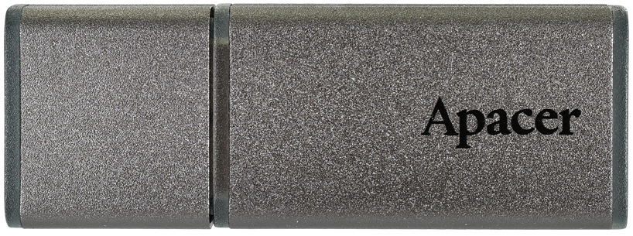
UV110-UFD1 Specification
Model Name | UV110-UFD1
Interface | USB3.2 Gen1 Type-A
Capacity | 128GB~512GB
NAND Support | Kioxia BiCS5
R/W (MB/sec) | 275/195
IOPS R/W | 3000/1000
Wide Temp. (-40°C~85°C) | Yes
Dimension (L x W x H) | 46.85 x 17.2 x 7.7 mm
Product Features | Applications
Flash Bad-block Management Global Wear-Leveling Technology S.M.A.R.T. Support LDPC ECC Power Failure Management Page Mapping SMART Read Refresh | Factory Automation, Medical, Gaming, Digital Signage, Transportation, Broadband access application, Lottery printer, Intelligent building
CS: Ready

Slide 47
UH110-UFD1 Specification
Model Name | UH110-UFD1
Interface | USB3.2 Gen1 Type-A
Capacity | 32GB~64GB
NAND Support | Kioxia BiCS5
R/W (MB/sec) | 270/140
IOPS R/W | 3000/900
Wide Temp. (-40°C~85°C) | Yes
Dimension (L x W x H) | 46.85 x 17.2 x 7.7 mm
Product Features | Applications
Flash Bad-block Management Global Wear-Leveling Technology S.M.A.R.T. Support LDPC ECC Power Failure Management Page Mapping SMART Read Refresh SLC-liteX | Factory Automation, Medical, Gaming, Digital Signage, Transportation, Broadband access application, Lottery printer, Intelligent building
CS: Ready

Slide 48
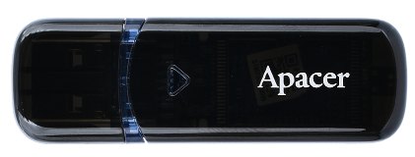
UV110-UFD5 Specification
Model Name | UV110-UFD5
Interface | USB3.2 Gen1 Type-A
Capacity | 128GB~256GB
NAND Support | Kioxia BiCS5
R/W (MB/sec) | 270/185
IOPS R/W | 2900/900
Wide Temp. (-40°C~85°C) | Yes
Dimension (L x W x H) | 56.05 x 18.0 x 8.5 mm
Product Features | Applications
Air 15kv ESD Protection Flash Bad-block Management Global Wear-Leveling Technology S.M.A.R.T. Support LDPC ECC Power Failure Management Page Mapping SMART Read Refresh | Factory Automation, Medical, Gaming, Digital Signage, Transportation, Broadband access application, Lottery printer, Intelligent building
CS: Ready

Slide 49
UH110-UFD5 Specification
Model Name | UH110-UFD5
Interface | USB3.2 Gen1 Type-A
Capacity | 32GB~64GB
NAND Support | Kioxia BiCS5
R/W (MB/sec) | 270/140
IOPS R/W | 3000/900
Wide Temp. (-40°C~85°C) | Yes
Dimension (L x W x H) | 56.05 x 18.0 x 8.5 mm
Product Features | Applications
Air 15kv ESD Protection Flash Bad-block Management Global Wear-Leveling Technology S.M.A.R.T. Support LDPC ECC Power Failure Management Page Mapping SMART Read Refresh SLC-liteX | Factory Automation, Medical, Gaming, Digital Signage, Transportation, Broadband access application, Lottery printer, Intelligent building
CS: Ready

Slide 50
UH110-UFD4 Specification
Model Name | UH110-UFD4
Interface | USB3.1 Gen1 Type-A
Capacity | 4GB~8GB
NAND Support | Kioxia BiCS3
R/W (MB/sec) | 265/50
IOPS R/W | 3300/1100
Wide Temp. (-40°C~85°C) | Yes (only 8GB support)
Dimension (L x W x H) | 51.15 x 17.2 x 7.7 mm
Product Features | Applications
Write Protect Flash Bad-block Management Global Wear-Leveling Technology S.M.A.R.T. Support LDPC ECC Power Failure Management Page Mapping SMART Read Refresh SLC-liteX | Factory Automation, Medical, Gaming, Digital Signage, Transportation, Broadband access application, Lottery printer, Intelligent building
CS: Ready

Slide 51
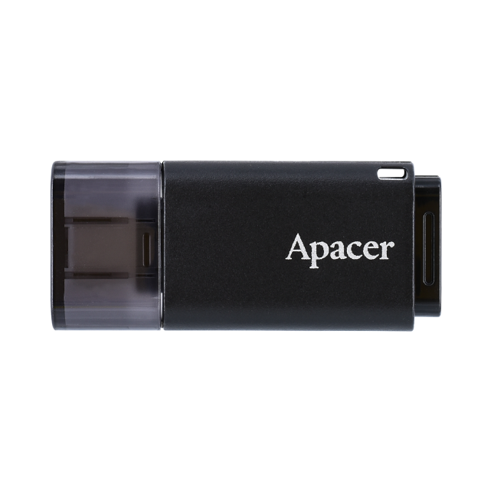
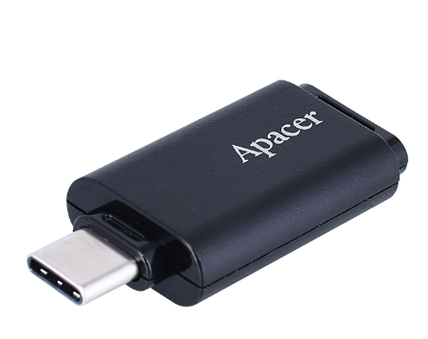
UV110-UFD7 Specification
Model Name | UV110-UFD7
Interface | USB3.2 Gen1 Type-C
Capacity | 128GB~256GB
NAND Support | Kioxia BiCS5
R/W (MB/sec) | 270/190
IOPS R/W | 2800/1000
Wide Temp. (-40°C~85°C) | Yes
Dimension (L x W x H) | 43.0 x 18.9 x 7.9 mm
Product Features | Applications
Flash Bad-block Management Global Wear-Leveling Technology S.M.A.R.T. Support LDPC ECC Power Failure Management Page Mapping SMART Read Refresh | Factory Automation, Medical, Gaming, Digital Signage, Transportation, Broadband access application, Lottery printer, Intelligent building
CS: Ready

Slide 52
UH110-UFD7 Specification
Model Name | UH110-UFD7
Interface | USB3.2 Gen1 Type-C
Capacity | 32GB~64GB
NAND Support | Kioxia BiCS5
R/W (MB/sec) | 270/195
IOPS R/W | 3100/1200
Wide Temp. (-40°C~85°C) | Yes
Dimension (L x W x H) | 43.0 x 18.9 x 7.9 mm
Product Features | Applications
Flash Bad-block Management Global Wear-Leveling Technology S.M.A.R.T. Support LDPC ECC Power Failure Management Page Mapping SMART Read Refresh SLC-liteX | Factory Automation, Medical, Gaming, Digital Signage, Transportation, Broadband access application, Lottery printer, Intelligent building
CS: Ready

Slide 53
UT110-UFD2 Specification
Model Name | UT110-UFD2
Interface | USB3.2 Gen1 Type-A
Capacity | 64GB
NAND Support | Kioxia BiCS5
R/W (MB/sec) | 270/85
IOPS R/W | 2700/500
Wide Temp. (-40°C~85°C) | No
Dimension (L x W x H) | 23.1 x 14.25 x 6.9 mm
Product Features | Applications
Flash Bad-block Management Global Wear-Leveling Technology S.M.A.R.T. Support LDPC ECC Power Failure Management Page Mapping SMART Read Refresh | Factory Automation, Medical, Gaming, Digital Signage, Transportation, Broadband access application, Lottery printer, Intelligent building
CS: Ready

Slide 54
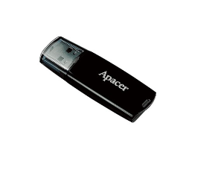
AH322-M WORM Drive Specification
Model Name | AH322-M WORM Drive
Interface | USB2.0 Type-A
Capacity | 8GB~32GB
NAND Support | WD 1Znm MLC
R/W (MB/sec) | 38/19
Wide Temp. (-40°C~85°C) | Yes
Dimension (L x W x H) | 55.29 x 18.00 x 8.50 mm
Product Features | Applications
Write Once Read Many Ensure Data integrity with non-rewritable storage function Data Retention 100 Years S.M.A.R.T. SMART Read Refresh Product Limitations - File System Support: FAT32 only - OS Support: Windows family - File must been written follows "one by one“ and sequentially | Financial and tax data, voting machines, cash register data logging, medical industry, legal evidences etc.
CS: E/Nov.

Slide 55
Industrial USB Drive 3D NAND Comparison Table
Model Name’ | UV110-UFD1 | UV110-UFD5 | UV110-UFD7 | UT110-UFD2 | UH110-UFD1 | UH110-UFD4 | UH110-UFD5 | UH110-UFD7
Capacity | 128GB~512GB | 128GB~256GB | 128GB~256GB | 64GB | 32GB~64GB | 4GB~8GB | 32GB~64GB | 32GB~64GB
Interface | USB 3.2 gen1 Type-A | USB 3.2 gen1 Type-A | USB 3.2 gen1 Type-C | USB 3.2 gen1 Type-A | USB 3.2 gen1 Type-A | USB 3.1 gen1 Type-A | USB 3.2 gen1 Type-A | USB 3.2 gen1 Type-C
Flash Type | Kioxia BiCS5 | Kioxia BiCS5 | Kioxia BiCS5 | Kioxia BiCS5 | Kioxia BiCS5 | Kioxia BiCS3 | Kioxia BiCS5 | Kioxia BiCS5
R/W (MB/sec) | 275/195 | 270/185 | 270/190 | 270/85 | 270/140 | 265/50 | 270/140 | 270/195
IOPS R/W(MB/sec) | 3000/1000 | 2900/900 | 2800/1000 | 2700/500 | 3000/900 | 3300/1100 | 3000/900 | 3100/1200
Power consumption (Active/Idle;mA) | 230/85 | 220/85 | 215/85 | 130/60 | 200/85 | 185/75 | 200/85 | 195/85
Endurance (DWPD) | 2.74 | 2.74 | 2.74 | 2.74 | 21.74 | 21.9 | 21.92 | 21.92
Page Mapping | Yes | Yes | Yes | Yes | Yes | Yes | Yes | Yes
Wide Temp. | Yes | Yes | Yes | No | Yes | Yes (4GB not supported) | Yes | Yes
LED | Blue | Blue | No | No | Blue | Blue | Blue | No
Write Protect | No | No | No | No | No | Yes | No | No
Dimension (mm) | 46.85x17.2x7.7 | 56.05x18.0x8.5 | 43.0x18.9x7.9 | 23.1x14.25x6.9 | 46.85x17.2x7.7 | 51.15x17.2x7.7 | 56.05x18.0x8.5 | 43.0x18.9x7.9
標準色
附屬
配色
3D TLC
2D MLC
SLC-lite
SLC
類工
SLC-liteX
Mainstream
15kv ESD Prevention
Mainstream
Smaller
High P/E cycles: 30K
Write Protect
15kv ESD Prevention
High P/E cycles: 30K

Slide 56
Industrial USB Drive 2D NAND Comparison Table
Model Name | AH321 | AH322 | USZ20-UFD5 | EH353 | US120-UFD5 | EH353-M | UM120-UFD5 | EH163-M | AH322-M WORM Drive
Capacity | 256MB~32GB |  |  | 256MB~32GB |  | 8GB~128GB |  | 8GB~64GB | 8GB~32GB
Interface | USB 2.0 Type-A |  |  | USB 3.0 Type-A |  | USB 3.0 Type-A |  | USB 3.0 Type-A | USB 2.0 Type-A
Flash Type | Kioxia 24nm SLC |  |  | Kioxia 24nm SLC |  | Kioxia 15nm MLC |  | Kioxia 15nm MLC | WD 1Znm MLC
R/W (MB/sec) | 34/22 |  |  | 80/70 |  | 195/95 |  | 225/80 | Est. 33/12
Power consumption (Active/Idle;mA) | 185/65 |  |  | 225/65 |  | 275/85 |  | 190/45 | Est. 165/60
Endurance (TBW) | 1768 |  |  | 1752 |  | 273 |  | 352 | -
Page Mapping | No |  |  | No |  | No |  | No | No
Wide Temp. | Yes |  |  | Yes |  | Yes |  | No | Yes
LED | Yellow Green |  |  | No (Metal Housing) | Blue | No (Metal Housing) | Blue | No | Yes
Dimension (mm) | 60.59x19.0x8.0 | 55.29x18.0x8.5 | 56.05x18.0x8.5 | 59.0x18.4x9.1 | 56.05x18.0x8.5 | 59.0x18.4x9.1 | 56.05x18.0x8.5 | 23.1x14.25x6.9 | 55.29x18.0x8.5
Product Image
標準色
附屬
配色
3D TLC
2D MLC
SLC-lite
SLC
類工
SLC-liteX
Mainstream
Mainstream
Mainstream
Smaller
Security

Slide 57
Industrial Flash Card, USB, PATA SSD, eMMC
CF Card
SD / microSD Card
USB Module
USB Drive
PATA 2.5” Drive
Module (ADM)
eMMC

Slide 58
PATA 2.5” SSD Roadmap
Flash | Available Now |  | Q4’23 |  |  | Q1’24 |  |  | Q2’24 |  |  | Q3’24
SLC | AFD257 8GB~128GB
MLC | AFD257-M 32GB~256GB
24/32nm
標準色
附屬
配色
3D TLC
2D MLC
SLC-lite
SLC
類工
Warranty: 5 years or 60K P/E cycles
15nm
Warranty: 2 years or 3K P/E cycles
SLC-liteX
Remarks:
Wide Temp.

Slide 59
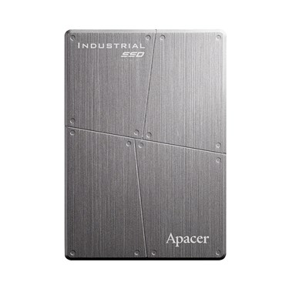
PATA 2.5” SSD Roadmap
Flash | Model | SR/SW | 2023 |  | 2024 |  | 2025
 |  |  | H1 | H2 | H1 | H2 | H1 | H2
SLC | AFD257 | 100/95
MLC | AFD257-M | 100/90
標準色
附屬
配色
3D TLC
2D MLC
SLC-lite
SLC
類工
8GB~128GB
32GB~256GB
SLC-liteX
Remarks:
SR/SW: Sequential Read/Write
ES CS MP EOL LTS

Slide 60
PATA Module Roadmap
Flash | Available Now |  | Q4’23 |  |  | Q1’24 |  |  | Q2’24 |  |  | Q3’24
SLC | ADC4 256MB~ 8GB
 | ADM5S 128MB~ 64GB
MLC | ADM5S-M 8GB~ 128GB
24/32nm
標準色
附屬
配色
3D TLC
2D MLC
SLC-lite
SLC
類工
24/32nm
Warranty: 5 years or 60K P/E cycles
15nm
SLC-liteX
Warranty: 2 years or 3K P/E cycles
Remarks:
Wide Temp.

Slide 61
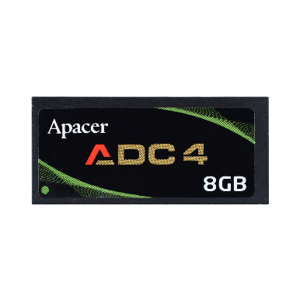
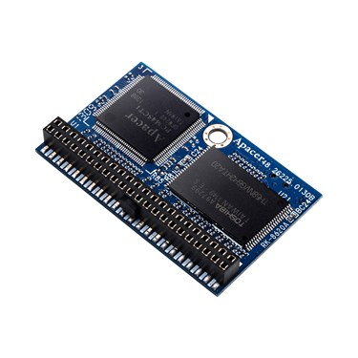
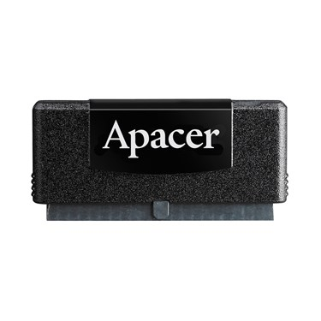
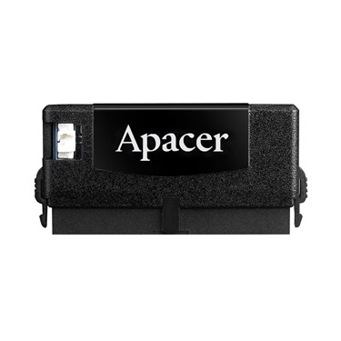
PATA SSD Module Roadmap
Flash | Model | SR/SW | 2023 |  | 2024 |  | 2025
 |  |  | H1 | H2 | H1 | H2 | H1 | H2
SLC | ADC4 | 42/35
 | ADM5S | 75/65
MLC | ADM5S-M | 105/100
標準色
附屬
配色
3D TLC
2D MLC
SLC-lite
SLC
類工
256MB~8GB
128MB~64GB
SLC-liteX
8GB~128GB
Remarks:
SR/SW: Sequential Read/Write
ES CS MP EOL LTS

Slide 62
Industrial Flash Card, USB, PATA SSD, eMMC
CF Card
SD / microSD Card
USB Module
USB Drive
PATA 2.5” Drive
Module (ADM)
eMMC

Slide 63
Industrial eMMC Roadmap
標準色
附屬
配色
3D TLC
2D MLC
SLC-lite
SLC
類工
Flash | Available Now |  | Q4’23 |  |  | Q1’24 |  |  | Q2’24 |  |  | Q3’24
MLC | EM110 8GB~16GB
TLC | EV130 32GB~128GB
SLC-liteX | EH130 8GB~32GB
14nm
SLC-liteX
Bics3
Bics3
Warranty: 3 years
Remarks:
Wide Temp.

Slide 64
Commercial eMMC Roadmap
標準色
附屬
配色
3D TLC
2D MLC
SLC-lite
SLC
類工
Flash | Available Now |  | Q4’23 |  |  | Q1’24 |  |  | Q2’24 |  |  | Q3’24
MLC | EM120 8GB
TLC | ET130 16GB~64GB
 | ET150 128GB
14nm
SLC-liteX
Bics5
Bics5
Warranty: 1 years

Slide 65
Industrial eMMC Roadmap
標準色
附屬
配色
3D TLC
2D MLC
SLC-lite
SLC
類工
Flash | Model | SR/SW | 2023 |  | 2024 |  | 2025
 |  |  | H1 | H2 | H1 | H2 | H1 | H2
MLC | EM110 | 225/125
TLC | EV130 | 280/240
SLC-liteX | EH130 | 260/240
8GB~16GB
SLC-liteX
32GB~128GB
8GB~32GB
Remarks:
SR/SW: Sequential Read/Write
ES CS MP EOL LTS

Slide 66
Commercial eMMC Roadmap
標準色
附屬
配色
3D TLC
2D MLC
SLC-lite
SLC
類工
Flash | Model | SR/SW | 2023 |  | 2024 |  | 2025
 |  |  | H1 | H2 | H1 | H2 | H1 | H2
MLC | EM120 | 225/125
TLC | ET130 | 315/195
 | ET150 | 315/195
8GB
SLC-liteX
16GB~32GB
128GB
Remarks:
SR/SW: Sequential Read/Write
ES CS MP EOL LTS

Slide 67
Industrial & Commercial eMMC Product Specification
 | Industrial Grade |  |  | Commercial Grade
Model | EM110 | EV130 | EH130 | EM120 | ET130 | ET150
Interface | eMMC5.1 HS400 |  |  | eMMC5.1 HS400
Capacity | 8GB-16GB | 32GB-128GB | 8GB-32GB | 8GB | 16GB-64GB | 128GB
Form Factor | 153 Ball FBGA |  |  | 153 Ball FBGA
Flash Type | MLC | TLC | SLC-LiteX | MLC | TLC | TLC
R/W (Max.) | 225/125 | 280/240 | 260/240 | 225/125 | 315/195
Operation Voltage | VCC = 3.3V ; VCCQ=1.8V / 3.3V |  |  | VCC = 3.3V ; VCCQ=1.8V / 3.3V
Operation Temp. | -40~85℃ |  |  | -25~85℃
Warranty | 3 years |  |  | 1 year
標準色
附屬
配色
3D TLC
2D MLC
SLC-lite
SLC
類工
SLC-liteX

