Slide 1
Apacer Industrial SSD & DRAM Solutions
for Transportation Applications
Sales and Marketing Center
June 2022

Slide 2
Agenda
‧ Overview
‧ Challenges and Requirements
‧ Featured Technologies for Transportation Applications
‧ Recommended Products
‧ Customer Success Case
‧ Apacerʼs Strengths

Slide 3
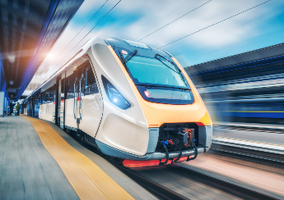
Overview
As autonomous driving, smart cars and the Internet of Vehicles (IoV) are expected to become early adopters of 5G technology, the application requirements for in-vehicle and transportation data storage will naturally change as a result.
From navigation systems, In-Vehicle Infotainment (IVI) and Advanced Driver Assistance Systems (ADAS) to surveillance and intelligent transportation systems outdoors, industrial SSDs and memory modules are increasingly tasked with reliably reading and writing data.

Slide 4
Agenda
‧ Overview
‧ Challenges and Requirements
‧ Featured Technologies for Transportation Applications
‧ Recommended Products
‧ Customer Success Case
‧ Apacerʼs Strengths

Slide 5
Challenges and Requirements
Tough enough to survive anywhere in the world
The transportation industry has to develop vehicles and systems that will be used in a variety of harsh environments. From bitterly cold conditions to burning desert landscapes, transportation technology has to resist the extremes of temperature, humidity, dust and vibration. And natural weather systems aren’t the end of it. Many parts of the world where vehicles need to travel are badly polluted.
Voltage instability is no longer a problem
Especially in developing countries or remote areas, voltage supply can sometimes be compromised. The data stored on an SSD may be lost or corrupted by any instant power instability. Even worse, it may cause an SSD to stop working and lead to system shutdown in the long run.

Slide 6
Transportation Applications

Slide 7
Agenda
‧ Overview
‧ Challenges and Requirements
‧ Featured Technologies for Transportation Applications
‧ Recommended Products
‧ Customer Success Case
‧ Apacerʼs Strengths

Slide 8
Featured Technologies for Transportation Applications
In the transportation industry, manufacturers have to consider the varied and punishing environments where their products will be used. Apacer stays ahead of its competitors because of its focus on power stability, longevity, survivability and value-added applications.
Power Stability
Longevity
Survivability
Value-added
Applications
‧ CorePower
‧ DataDefender™
‧ Over-provisioning
‧ SLC-liteX
‧ Fixed BOM
‧ 6+6 PCN/EOL Policy
‧ Anti-Sulfuration
‧ Conformal Coating
‧ Nano Coating (IP57)
‧ Sidefill
‧ Wide Temperature
‧ 30µ Gold Finger
‧ Double-barreled Solution
- CoreAnalyzer2
- SSDWidget 2.0

Slide 9
Power Stability
CorePower
This is a hardware-based technology designed to prevent data loss and ensure the stability of data transmission during a power outage using a backup power supply to allow sufficient time to move all cached data to NAND flash.
DataDefender™
Combines both firmware and hardware mechanisms to ensure data integrity, allowing more time for volatile data to be stored in the event of power loss.

Slide 10
Longevity
Over-provisioning
Apacerʼs SSDs support over-provisioning, which sets aside a certain portion of the physical capacity of the memory to carry out garbage collection, wear-leveling and bad block management. The result is a longer operating lifetime.
SLC-liteX
Apacer's 3D NAND SLC-liteX technology breaks through the limitations of existing technology and provides up to 100,000 P/E cycles, which is 33 times more than MLC or industrial 3D TLC.

Slide 11
Survivability
Anti-Sulfuration
Apacer's world's first patented anti-sulfuration DRAM modules and anti-sulfuration SSDs with the industry's highest level of anti-corrosion ANSI/ISA 71.04 G3 Certification can meet the needs of industrial products facing harsh environments.
Conformal Coating
Conformal coating improves product reliability when applied on the surface of printed circuit boards. This protective film can safeguard devices from dust ingression and liquid immersion.
Nano Coating
This IP57 waterproof and dustproof solution is ideal for SSD modules as it provides invulnerable protection for the components on the devices. Nano Coating adopts Chemical Vapor Deposition (CVD) to create a thin, transparent polymer film.

Slide 12
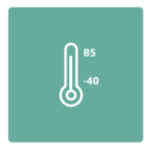
Survivability
Sidefill
Apacerʼs Sidefill technology strengthens the connections between solder joints and their board, making them more robust and vibration-resistant. It also allows for heat dissipation to offset thermal damage.
Wide Temperature
Products rated for wide temperature operation are designed with wide temperature support to ensure reliable operation in extreme temperatures ranging from -40ºC to 85ºC.
30µ Gold Finger
With the 30µ gold plating, the connector interface is more reliable and can withstand potential damage in industrial applications.

Slide 13
Value-added
Applications
Double-barreled Solution
Apacer’s Double-barreled Solution is comprised of CoreAnalyzer2 and SSDWidget 2.0. CoreAnalyzer2 helps determine which SSD and firmware are most suitable for a customer, and SSDWidget2.0 lets customers remotely monitor SSD status in real-time.
CoreAnalyzer2
CoreAnalyzer2 is an exclusive, analytic data-behavior technology implemented on our SSD products. Featuring collecting and analyzing data of customers' host system, it can help our customers analyze their usage behavior so they can choose the best-suited device for their application.
SSDWidget 2.0
Apacer SSDWidget 2.0 is a comprehensive disk monitoring and maintaining utility. Designed with the concepts of S.M.A.R.T., SSDWidget2.0 can monitor an SSDʼs health-related information and provide SSD status for lifetime monitoring and workload analysis.

Slide 14
Agenda
‧ Overview
‧ Challenges and Requirements
‧ Featured Technologies for Transportation Applications
‧ Recommended Products
‧ Customer Success Case
‧ Apacerʼs Strengths

Slide 15
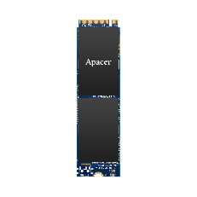
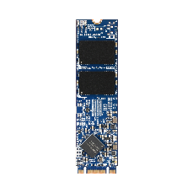
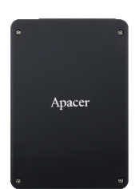
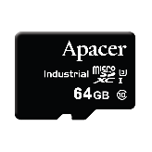
Recommended Products: SSD
Model | PV220-M280 | SV250-M280 | SV24P-M280 | SV24P-25 | PH920-M280 | SH250-25 | CH120-MSD
Features | Anti-Sulfuration |  | CorePower |  | SLC-liteX
Form Factor | M.2 2280 | M.2 2280 | M.2 2280 | 2.5” | M.2 2280 | 2.5” | microSD
Interface | PCIe Gen3 x4 | SATA 3.2 (6Gb/s) | SATA 3.2 (6Gb/s) | SATA 3.2 (6Gb/s) | PCIe Gen3 x4 | SATA 3.2 (6Gb/s) | SD 6.1
Connector | M.2 M Key | M.2 B & M key | M.2 B & M key | (7+15) pin | M.2 M Key | (7+15) pin | -
NAND Flash Type | 3D TLC
Capacity | 240~1920 GB | 240~1920 GB | 120~1920 GB | 120~1920 GB | 160~640 GB | 10~320 GB | 16~128 GB
External DRAM | No | No | Yes | Yes | No | No | -
Max. R/W Performance (MB/sec) | 1710/1685 | 560/520 | 560/495 | 560/495 | 1740/1530 | 560/520 | 90/80
Standard Operating Temp. (°C) | 0 ~ + 70 | 0 ~ + 70 | 0 ~ + 70 | 0 ~ + 70 | 0 ~ + 70 | 0 ~ + 70 | - 25 ~ + 85
Wide Temp. (°C) | - 40 ~ + 85 | - 40 ~ + 85 | - 40 ~ + 85 | - 40 ~ + 85 | - 40 ~ + 85 | - 40 ~ + 85 | - 40 ~ + 85
MTBF (Hours) | >3,000,000 | >3,000,000 | >3,000,000 | >3,000,000 | >3,000,000 | >3,000,000 | >3,000,000
Recommended Applications | Crane Truck, Excavator, Vehicles in Harsh Environments |  | Server |  | Passenger Information System, Surveillance |  | Navigation

Slide 16
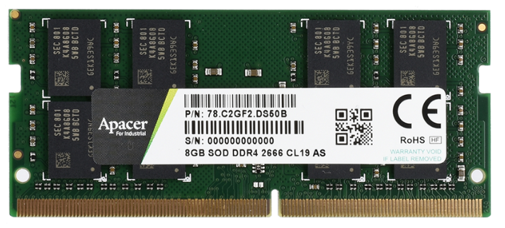
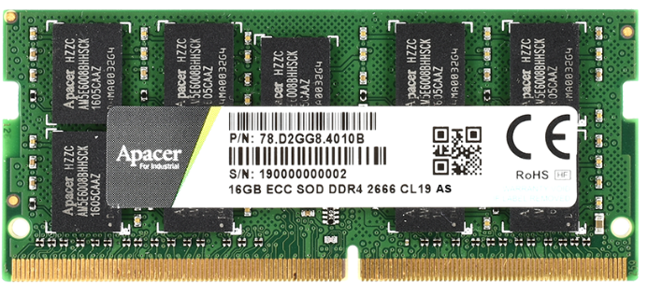
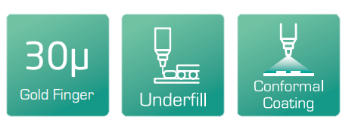
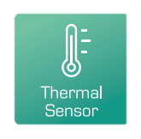
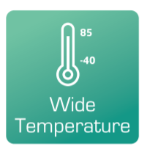
Recommended Products: DRAM
Anti-Sulfuration Memory Modules
Module Type | Anti-Sulfuration UDIMM | Anti-Sulfuration SODIMM | Anti-Sulfuration RDIMM | Anti-Sulfuration ECC UDIMM | Anti-Sulfuration ECC SODIMM
Memory Technology | DDR4
Frequency | 2133/2400/2666/2933/3200
Density | 4GB/8GB/ 16GB/32GB | 4GB/8GB/ 16GB/32GB | 4GB/8GB/ 16GB/32GB | 4GB/8GB/ 16GB/32GB | 4GB/8GB/ 16GB/32GB
Voltage | 1.2v | 1.2v | 1.2v | 1.2v | 1.2v
Pin Count | 288-Pin | 260-Pin | 288-Pin | 288-Pin | 260-Pin
Width | 64-Bit | 64-Bit | 72-Bit | 72-Bit | 72-Bit
PCB Height | 1.23" | 1.18" | 1.23" | 1.23" | 1.18"
Operation Temperature (°C) | TC = 0 ~ + 85 | TC = 0 ~ + 85 | TC = 0 ~ + 85 | TC = 0 ~ + 85 | TC = 0 ~ + 85
Value-added Technology

Slide 17
Recommended Products: DRAM
VLP (Very Low Profile) Memory Modules
Module Type | VLP UDIMM | VLP SODIMM | VLP RDIMM | VLP ECC UDIMM | VLP ECC SODIMM
Memory Technology | DDR4
Frequency | 2133/2400/2666/2933/3200
Density | 4GB/8GB/ 16GB/32GB | 4GB/8GB | 4GB/8GB/ 16GB/32GB | 4GB/8GB/ 16GB/32GB | 4GB/8GB
Voltage | 1.2v | 1.2v | 1.2v | 1.2v | 1.2v
Pin Count | 288-Pin | 260-Pin | 288-Pin | 288-Pin | 260-Pin
Width | 64-Bit | 64-Bit | 72-Bit | 72-Bit | 72-Bit
PCB Height | 0.738" | 0.709" | 0.738" | 0.738" | 0.7"
Operation Temperature (°C) | TC = 0 ~ + 85 | TC = 0 ~ + 85 | TC = 0 ~ + 85 | TC = 0 ~ + 85 | TC = 0 ~ + 85
Value-added Technology

Slide 18
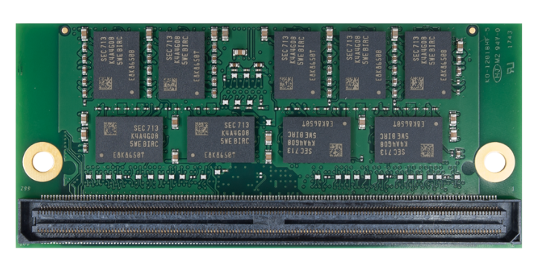
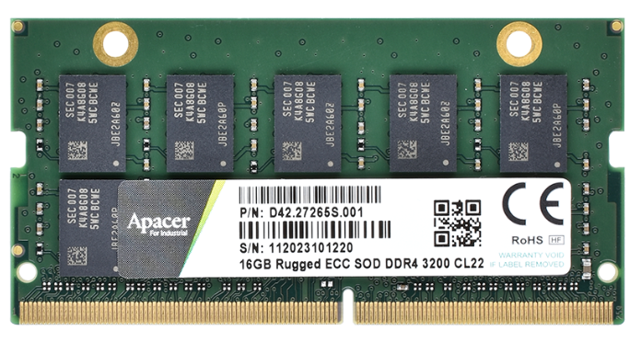
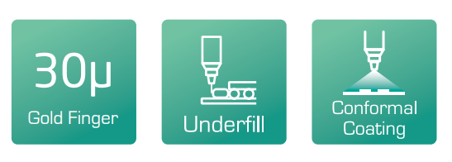
Recommended Products: DRAM
Rugged Memory Modules
Module Type | XR-DIMM | Rugged SODIMM
Memory Technology | DDR4
Frequency | 2133/2400 | 2133/2400/2666/2933/3200
Density | 8GB/16GB | 8GB/16GB/32GB
Voltage | 1.2v | 1.2v
Pin Count | 300-Pin | 260-Pin
Width | 64-Bit / 72-Bit | 64-Bit / 72-Bit
PCB Height | 1.466" | 1.377"
Operation Temperature (°C) | TC = - 40 ~ + 85 | TC = 0 ~ + 85 / - 40 ~ + 85
Value-added Technology

Slide 19
Agenda
‧ Overview
‧ Challenges and Requirements
‧ Featured Technologies for Transportation Applications
‧ Recommended Products
‧ Customer Success Case
‧ Apacerʼs Strengths

Slide 20
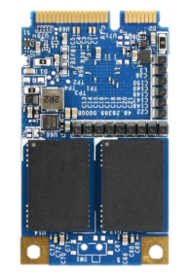
Success Case: Traveler & Tourist Information System
Solutions
SM23P-300
VA Technologies
CorePower
Challenges
Results and Benefits
On-train application, vibration resistance
Power instability
Small size form factor that can fit in each cabin display
Thanks to a special PCB hardware design to enhance SSD’s durability and reliability, SSD can operate smoothly in low power consumption mode.
High-speed transmission software design can achieve instant data analysis and data sync to database.
Notes:
#808080

Slide 21
Agenda
‧ Overview
‧ Challenges and Requirements
‧ Featured Technologies for Transportation Applications
‧ Recommended Products
‧ Customer Success Case
‧ Apacerʼs Strengths

Slide 22
Apacerʼs Strengths
Received IATF 16949 2016 Letter of Conformance
Widely Recognized Certification
Longevity
Strong R&D and Customization Capabilities
Fixed BOM support
6+6 PCN/EOL Policy
Unique S/N for RMA tracking

Slide 23
Thank you!
industrial.apacer.com/
©Copyright Apacer Technology Inc. Confidential. Unauthorized use, dissemination,
distribution, or reproduction of this document is not allowed without the permission of
Apacer Technology Inc. Specifications of details may change without notice.
This document and its contents are confidential©Copyright Apacer Technology Inc.

