Slide 1
Apacer Industrial SSD & DRAM Solutions
for Healthcare Applications
Sales and Marketing Center
Oct. 2022

Slide 2
Agenda
‧ Overview
‧ Challenges and Requirements
‧ Featured Technologies for Healthcare Applications
‧ Recommended Products
‧ Customer Success Cases
‧ Apacerʼs Strengths

Slide 3
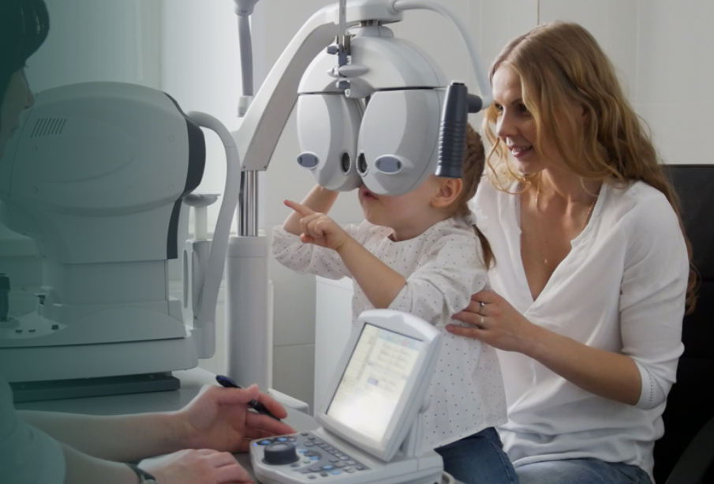
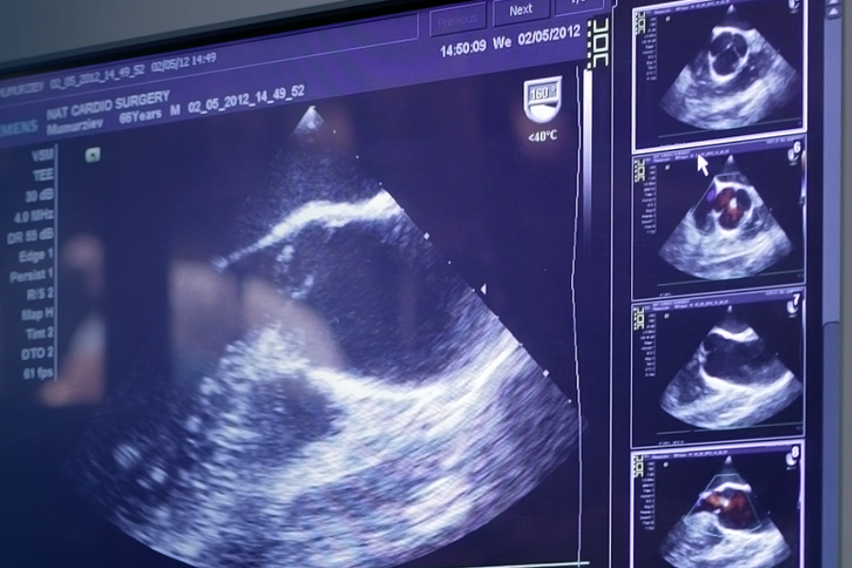
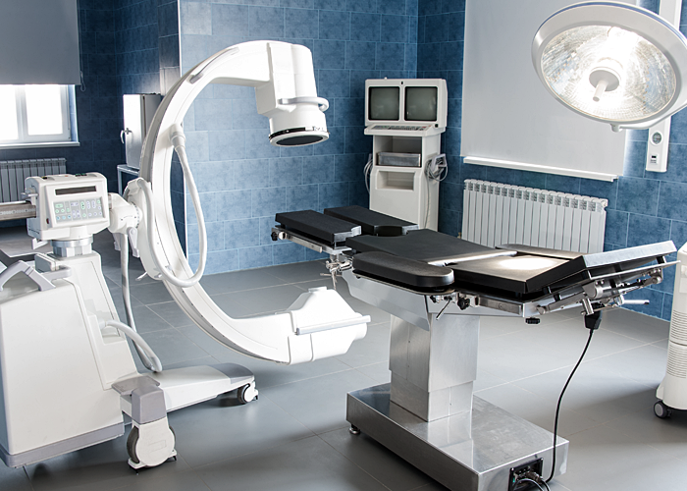
Overview
With the rapid development of 5G and AI image recognition technology, applications such as cloud medical imaging platforms and telemedicine will become future auxiliary diagnostic tools. Yet high-quality, high-resolution image storage data must be the foundation for realizing this vision of smart medical care.
Meanwhile, healthcare storage applications used in demanding and challenging environments also require exemplary performance, reliability, and product longevity.

Slide 4
Agenda
‧ Overview
‧ Challenges and Requirements
‧ Featured Technologies for Healthcare Applications
‧ Recommended Products
‧ Customer Success Cases
‧ Apacerʼs Strengths

Slide 5
Challenges and Requirements
Data integrity is crucial: Corruption is unacceptable
The integrity and immediacy of the data stored in medical devices is closely related to the diagnosis, monitoring and treatment of a disease. Corrupted or incomplete data may bring risks to interruption of medical services, negatively affecting diagnosis efficiency, and even delaying the timing of diagnosis and treatment.
Privacy is paramount: Encryption protects against intrusion
Patients also want to make sure that their data is protected against outside intrusion. The storage solutions need to prevent the patient's private data and diagnosis records from being exposed to the threat of improper external storage access.
Electrostatic Discharge (ESD) protection is required
Medical devices often come into contact with the human body, and they are susceptible to damage from to electrostatic discharge (ESD). Therefore, protection methods must be developed and incorporated to disperse ESD in such a way as to avoid vulnerable circuits.

Slide 6
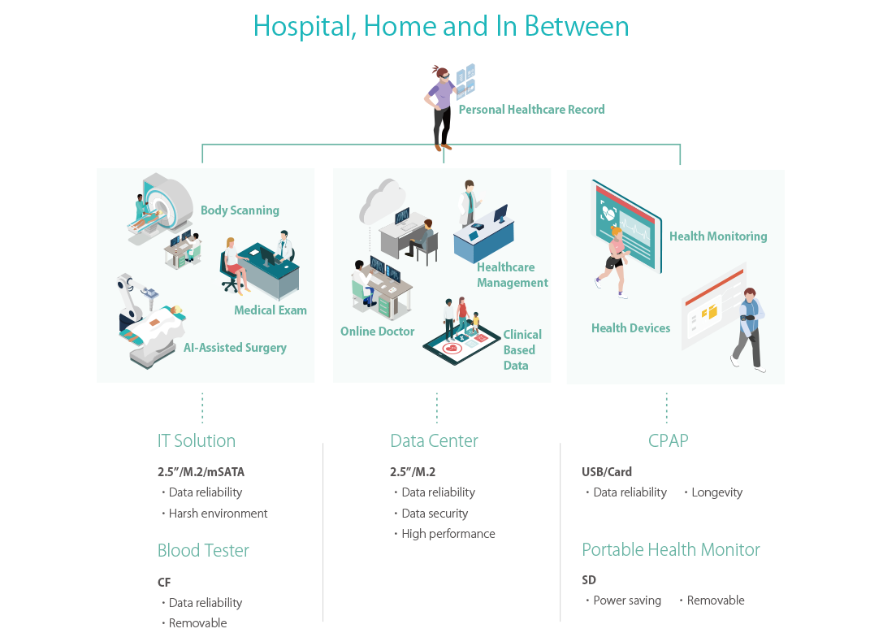
Healthcare Applications

Slide 7
Agenda
‧ Overview
‧ Challenges and Requirements
‧ Featured Technologies for Healthcare Applications
‧ Recommended Products
‧ Customer Success Cases
‧ Apacerʼs Strengths

Slide 8
Featured Technologies for Healthcare Applications
Apacer's featured technologies are based on four key considerations: data integrity, data security, reliability & endurance and longevity to help healthcare applications meet the challenging standards of their industry.
Data Integrity
Data Security
Reliability & Endurance
Longevity
‧ End-to-end Data Protection
‧ Smart Read Refresh™
‧ Bidirectional Security
Identification
‧ Signed Firmware
‧ TCG Opal 2.0
‧ Conformal Coating
‧ ESD Protection
‧ SLC-liteX
‧ CoreSnapshot
‧ SSDWidget 2.0
‧ Fixed BOM
‧ 6+6 PCN/EOL Policy
Notes:
CoreEraser?

Slide 9
Data Integrity
End-to-end Data Protection
This technology ensures that whenever data moves from the host to the controller or from the controller to DRAM or NAND flash, error checking is applied. In some cases, error correction will also be part of the circuit.
Smart Read Refresh™
Apacerʼs Smart Read RefreshTM helps avoid read disturb errors from occurring. It ensures that during read operations, when the read operation threshold is reached, the data is refreshed by re-writing it to a different block for future use.

Slide 10
Data Security
Bidirectional Security Identification
A security verification mechanism is implanted between the device and the platform to prevent the data in the device from being stolen if it is subjected to a hacker’s invasion.
Signed Firmware
Apacerʼs Signed Firmware technology is a secure way to update firmware. By including a digital signature, a firmware update will be authenticated by the Apacer SSD before a firmware update is performed. This extra layer of protection keeps drives secure.
TCG Opal 2.0
Apacer offers TCG Opal 2.0-compliant self-encrypting drives (SEDs) which incorporate AES encryption for rock-solid data protection. Buyers love TCG Opal 2.0ʼs Instant Keychange™ technology, which uses cryptographic erasure to scramble a drive in less than a second. This technology is also available independently upon request.

Slide 11
Reliability & Endurance
Conformal Coating
Conformal coating improves product reliability when applied on the surface of printed circuit boards. This protective film can safeguard devices from dust ingression and liquid immersion.
ESD Protection
Excellent electrostatic protection which has passed the test conditions of IEC 61000-4-2: air discharge ±15KV and contact discharge ±8KV. Provides a high standard of protection for electromagnetic susceptibility (EMS) that meets the medical equipment standard EN60601-1-2.
SLC-liteX
Apacer's 3D NAND SLC-liteX technology breaks through the limitations of existing technology and provides up to 100,000 P/E cycles, which is 33 times more than MLC or industrial 3D TLC.

Slide 12
Longevity
CoreSnapshot
Full backup and recovery of SSD data can be performed in one second, which can instantly eliminate catastrophic system issues and prevent data damage or downtime from translating into operational risks and losses.
SSDWidget 2.0
Apacer SSDWidget 2.0 is a comprehensive disk monitoring and maintaining utility. Designed with the concepts of S.M.A.R.T., SSDWidget2.0 can monitor an SSDʼs health-related information and provide SSD status for lifetime monitoring and workload analysis.

Slide 13
Agenda
‧ Overview
‧ Challenges and Requirements
‧ Featured Technologies for Healthcare Applications
‧ Recommended Products
‧ Customer Success Cases
‧ Apacerʼs Strengths

Slide 14
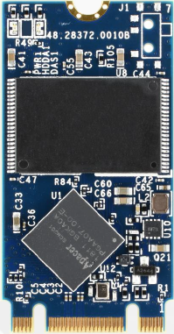
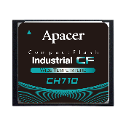
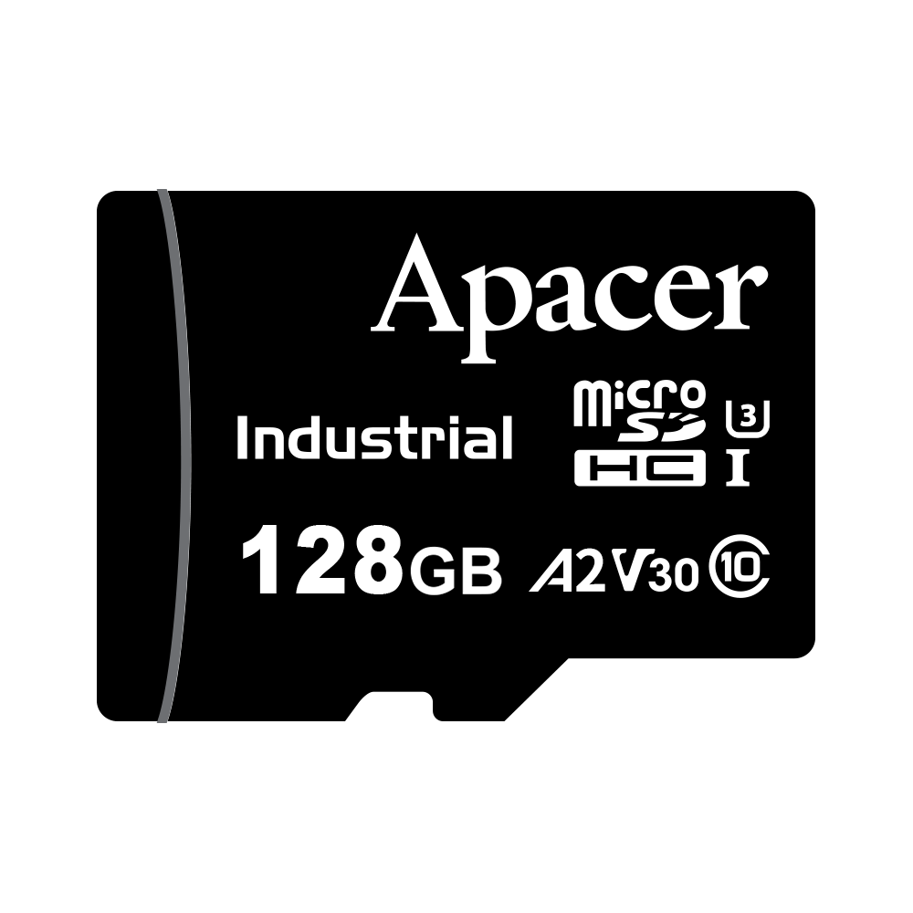
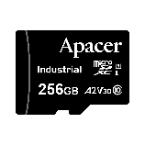
Recommended Products: SSD
Model | PV210-M280 | PV220-M280 | SH250-M242 | CH710-CF | CH120-MSD | CV120-MSD | UV110-UFD5 | UV110-UFD1
Features | High Performance, High Capacity |  | High Endurance w/ SLC-liteX Technology (Reaching up to 100,000 P/E cycles) |  |  | High Endurance | ESD Protection | Security Identification
Form Factor | M.2 2280 |  | M.2 2242 | CompactFlash Type I | Micro SD |  | USB Flash Drive
Interface | PCIe Gen3 x4 |  | SATA | PC Card Memory Mode; PC Card I/O Mode; True IDE Mode | SD 6.1 |  | USB 3.1 Gen1
Connector | M.2 M Key |  | M.2 B & M key | 50-pin | - | - | USB Type A Plug
NAND Flash Type | 3D TLC
Capacity | 240~1920 GB | 120~1920 GB | 10~160 GB | 8~64 GB | 16~128 GB | 64~256 GB | 64~256 GB | 16~256 GB
External DRAM | Yes | No | No | No | - | - | No | No
Max. R/W Performance (MB/sec) | 3100/2630 | 1695/1685 | 560/520 | 115/80 | 90/80 | 90/85 | 255/120 | 260/125
Standard Operating Temp. (°C) | 0 ~ + 70 | 0 ~ + 70 | 0 ~ + 70 | 0 ~ + 70 | -25 ~ + 85 | -25 ~ + 85 | 0 ~ + 70 | 0 ~ + 70
Wide Temp. (°C) | - 40 ~ + 85 | - 40 ~ + 85 | - 40 ~ + 85 | - 40 ~ + 85 | - 40 ~ + 85 | - 40 ~ + 85 | - 40 ~ + 85 | - 40 ~ + 85 *
MTBF (Hours) | >3,000,000 | >3,000,000 | >3,000,000 | >1,000,000 | >3,000,000 | >3,000,000 | >3,000,000 | >3,000,000
Recommended Applications | Computer Tomography, Precise Diagnostic Equipment |  | PE cycles: 100,000; Ultrasound | Respirator, ECG |  |  | Mobile Diagnostic Machine | X-ray Machine
* Not supported on 16GB

Slide 15
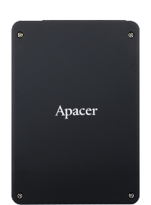
Recommended Products: SSD
Model | SV250-25 | SV250-M280 | SV250-M242
Features | High Endurance w/ Smart Read Refresh™ & CoreSnapshot Technology
Form Factor | 2.5" | M.2 2280 | M.2 2242
Interface | SATA 3.2 (6Gb/s)
Connector | (7+15) pin male | M.2 B & M key | M.2 B & M key
NAND Flash Type | 3D TLC
Capacity | 240~960 GB | 30~960 GB | 30~480 GB
External DRAM | No | No | No
Max. R/W Performance (MB/sec) | 560/520 | 560/520 | 560/515
Standard Operating Temp. (°C) | 0 ~ + 70 | 0 ~ + 70 | 0 ~ + 70
Wide Temp. (°C) | - 40 ~ + 85 | - 40 ~ + 85 | - 40 ~ + 85
MTBF (Hours) | >3,000,000 | >3,000,000 | >3,000,000
Recommended Applications | General Medical Applications

Slide 16
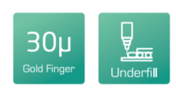
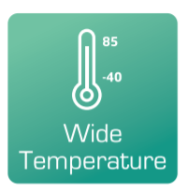
Recommended Products: DRAM
Module Type | SODIMM | RDIMM | ECC UDIMM | ECC SODIMM | VLP ECC UDIMM | VLP ECC SODIMM
Memory Technology | DDR4
Frequency | 2133/2400/2666/2933/3200
Density | 2G/4G/ 8G/16G/32G | 4G/8G/ 16G/32G/64G | 4G/8G/ 16G/32G | 4G/8G/ 16G/32G | 4G/8G/ 16G/32G | 4G/8G
Voltage | 1.2v | 1.2v | 1.2v | 1.2v | 1.2v | 1.2v
Pin Count | 260-Pin | 288-Pin | 288-Pin | 260-Pin | 288-Pin | 260-Pin
Width | 64-Bit | 72-Bit | 72-Bit | 72-Bit | 72-Bit | 72-Bit
PCB Height | 1.18" | 1.23" | 1.23" | 1.18" | 0.738" | 0.7"
Operation Temperature. (°C) | TC = 0 ~ + 85 | TC = 0 ~ + 85 | TC = 0 ~ + 85 | TC = 0 ~ + 85 | TC = 0 ~ + 85 | TC = 0 ~ + 85
Value-added Technology

Slide 17
Agenda
‧ Overview
‧ Challenges and Requirements
‧ Featured Technologies for Healthcare Applications
‧ Recommended Products
‧ Customer Success Cases
‧ Apacerʼs Strengths

Slide 18
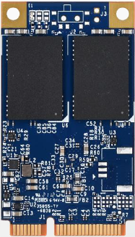
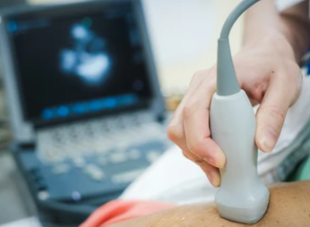
Success Cases: Portable Ultrasound
Solutions
SV250-300
VA Technologies
Firmware customization
Challenges
Results and Benefits
Needs to have high reliability
ESD protection requires air 15KV/ contact 8KV
Always-on mobile devices need to utilize low power consumption SSD
Thanks to a special PCB hardware design to enhance SSD’s durability and reliability, SSD can operate smoothly in low power consumption mode.
High-speed transmission software design can achieve instant data analysis and data sync to database.
Notes:
#808080

Slide 19
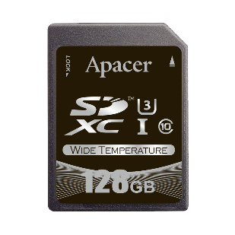
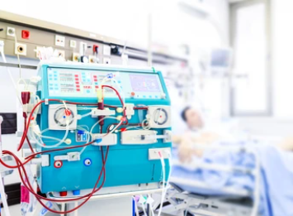
Success Cases: Dialysis Machine
Solutions
SD R1-M, UH110-UFD1
VA Technologies
SLC-liteX
Page Mapping
SSDWidget
Wide Temperature
Challenges
Results and Benefits
SSD with high endurance feature to handle small 4K file write usage scenario.
Mobile devices utilize extended temperature SSDs in response to extreme environments.
Build up a medical mobile device which utilizes two storage media: 1. SD for bootloader, 2. USB for data storage.
Fast boot up & high endurance to prevent SSD crash under frequent data write conditions.
Wide temperature solution to work in extreme environment.
Uses SSD Widget to monitor health status of SD & USB.
Notes:
#808080

Slide 20
Agenda
‧ Overview
‧ Challenges and Requirements
‧ Featured Technologies for Healthcare Applications
‧ Recommended Products
‧ Customer Success Cases
‧ Apacerʼs Strengths

Slide 21
Apacerʼs Strengths
Widely Recognized Certification
Longevity
Strong R&D and Customization Capabilities
Fixed BOM support
6+6 PCN/EOL Policy
Unique S/N for RMA tracking

Slide 22
Thank you!
industrial.apacer.com/
©Copyright Apacer Technology Inc. Confidential. Unauthorized use, dissemination,
distribution, or reproduction of this document is not allowed without the permission of
Apacer Technology Inc. Specifications of details may change without notice.
This document and its contents are confidential©Copyright Apacer Technology Inc.

