Slide 1
Apacer Industrial SSD & DRAM Solutions
for Gaming Applications
Sales and Marketing Center
July 2023

Slide 2
Agenda
‧ Overview
‧ Challenges and Requirements
‧ Featured Technologies for Gaming Applications
‧ Recommended Products
‧ Customer Success Cases
‧ Apacerʼs Strengths

Slide 3
Overview
Confidentiality and data protection of game play data and programming patterns in storage applications are of primary concern and cannot be compromised.
In order to meet the high-end image processing and strict security demands of the gaming industry, Apacer offers high-performance industrial SSD and memory solutions, and implements critical security features without sacrificing our well-known reliability benchmarks.

Slide 4
Agenda
‧ Overview
‧ Challenges and Requirements
‧ Featured Technologies for Gaming Applications
‧ Recommended Products
‧ Customer Success Cases
‧ Apacerʼs Strengths

Slide 5
Challenges and Requirements
Security is clearly a major concern for manufacturers
Data storage of the gaming machine is highly correlated with the fairness of the game. It is often connected with the operator's financial flow or financial system. In view of such, the key to gaming application lies in ensuring the integrity of the stored data and preventing it from being arbitrarily invaded or tampered with.
Reliability is also a crucial selling point
Reliability is also a crucial selling point for gaming machines, since many of them will be operating 24/7 without much downtime for maintenance. Gaming machines often also require read-intensive operations.
Eye-catching displays are more important than ever
In order to provide the best audio-visual entertainment experience, high-end image processing and high-resolution display technologies are revolutionizing the global casino gaming industry. The demand for high-performance storage and memory products has also grown.

Slide 6
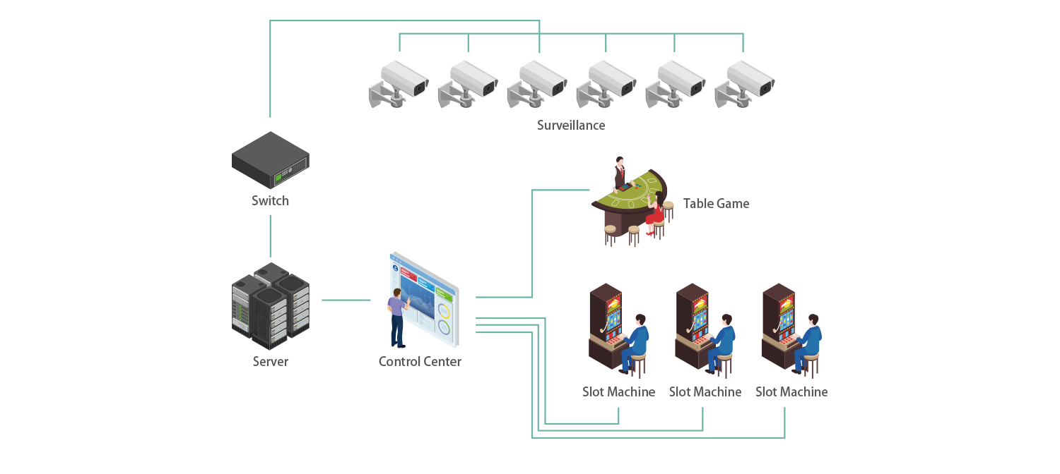
Gaming Applications

Slide 7
Agenda
‧ Overview
‧ Challenges and Requirements
‧ Featured Technologies for Gaming Applications
‧ Recommended Products
‧ Customer Success Cases
‧ Apacerʼs Strengths

Slide 8
Featured Technologies for Gaming Applications
Apacer's featured technologies are based on four key considerations: data security, reliability & endurance, data integrity and longevity to help gaming applications meet the challenging standards of their industry.
Data Security
Reliability & Endurance
Data Integrity
Longevity
‧ AES 256-bit
Encryption
‧ Signed Firmware
‧ TCG Opal 2.0
‧ Write Protect
‧ DataDefender™
‧ Over-provisioning
‧ Page Mapping
‧ SLC-liteX
‧ Thermal Throttling
‧ Wide Temperature
‧ DataRAID™
‧ Smart Read Refresh™
‧ Double-barreled Solution
‧ Fixed BOM
‧ 6+6 PCN/EOL Policy
Notes:
刪除Data retention

Slide 9
Data Security
AES 256-bit Encryption
The security standard trusted by the US government and many international security agencies. It’s an efficient and highly secure way of encrypting data to keep it safe from hackers and other bad actors.
Signed Firmware
A secure way to update firmware. By including a digital signature, a firmware update will be authenticated by the Apacer SSD before a firmware update is performed. This extra layer of protection keeps drives secure.
TCG Opal 2.0
Apacer offers TCG Opal 2.0-compliant self-encrypting drives (SEDs) which incorporate AES encryption for rock-solid data protection.
Write Protect
Write protect can prevent drives from unauthorized data writing via a hardware switch/pin or vendor software command.

Slide 10
Reliability & Endurance
DataDefender™
Combines both firmware and hardware mechanisms to ensure data integrity, allowing more time for volatile data to be stored in the event of power loss.
Over-provisioning
Apacerʼs SSDs support over-provisioning, which sets aside a certain portion of the physical capacity of the memory to carry out garbage collection, wear-leveling and bad block management. The result is a longer operating lifetime.
Page Mapping
This is an advanced flash management technology and can increase random access speeds, extend SSD lifespans, reduce block erase frequency, and achieve optimal performance.

Slide 11
Reliability & Endurance
SLC-liteX
Apacer's 3D NAND SLC-liteX technology breaks through the limitations of existing technology and provides up to 100,000 P/E cycles, which is 33 times more than MLC or industrial 3D TLC.
Thermal Throttling
Thermal throttling mechanism dynamically adjusts frequency scaling to enhance data reliability and provides sustained performance while overheating.
Wide Temperature
Products rated for wide temperature operation are designed with wide temperature support to ensure reliable operation in extreme temperatures ranging from -40ºC to 85ºC.

Slide 12
Data Integrity
DataRAID™
Using this algorithm, a certain amount of space is given over to aggregating and resaving the existing parity data used for error checking. So, in the event that data becomes corrupted, the parity data can be compared to the existing uncorrupted data and the content of the corrupted data can be rebuilt.
Smart Read Refresh™
Apacerʼs Smart Read RefreshTM helps avoid read disturb errors from occurring. It ensures that during read operations, when the read operation threshold is reached, the data is refreshed by re-writing it to a different block for future use.

Slide 13
Longevity
Double-barreled Solution
Apacer’s Double-barreled Solution is comprised of CoreAnalyzer2 and SSDWidget 2.0. CoreAnalyzer2 helps determine which SSD and firmware are most suitable for a customer, and SSDWidget2.0 lets customers remotely monitor SSD status in real-time.

Slide 14
Agenda
‧ Overview
‧ Challenges and Requirements
‧ Featured Technologies for Gaming Applications
‧ Recommended Products
‧ Customer Success Cases
‧ Apacerʼs Strengths

Slide 15
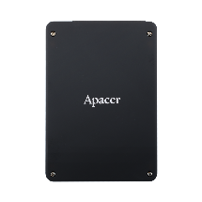
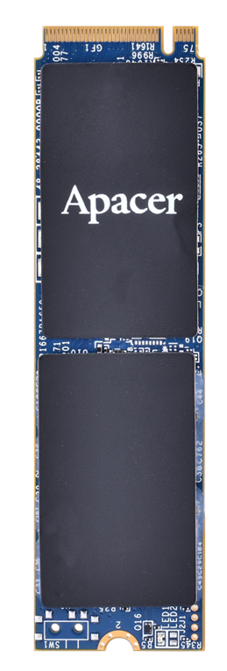
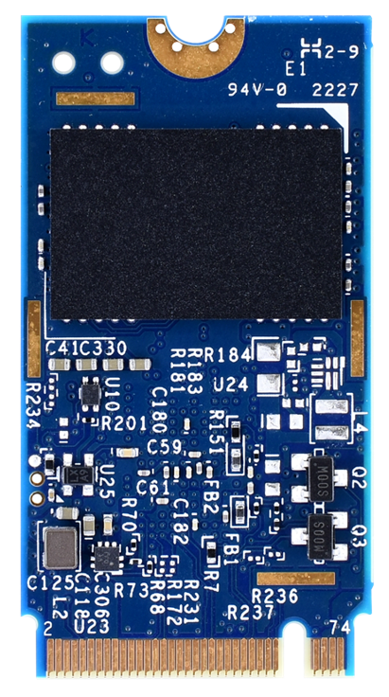
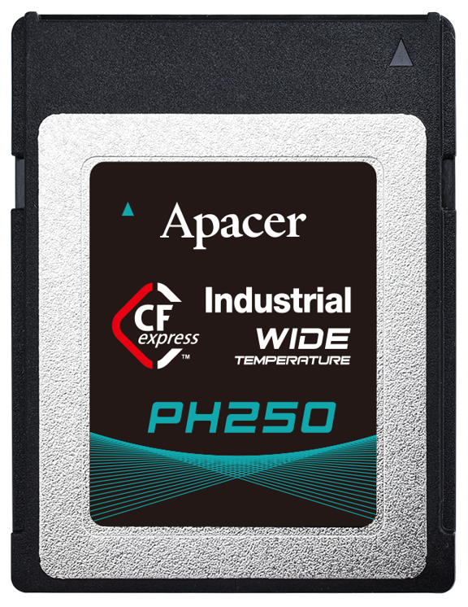
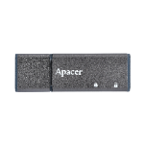
Recommended Products:
High Endurance 3D NAND SLC-liteX SSD series
(Reaching up to 100,000 P/E Cycles)
Model | SH250-25 | PH250-M280 | PH250-M242 | PH250-CFX | UH110-UFD4 | CH210- MSD
Features | AES 256-bit Encryption | AES 256-bit Encryption, DataDefender™ | AES 256-bit Encryption, DataDefender™ | AES 256-bit Encryption, DataDefender™, Write Protect | Write Protect | Smart Read Refresh™
Form Factor | 2.5" | M.2 2280 | M.2 2242 | CFexpress 2.0 Type B | USB Flash Drive | microSD
Interface | SATA 3.2 (6Gb/s) | PCIe Gen4 x4 | PCIe Gen4 x4 | PCIe Gen4 x4 | USB 3.1 Gen1 | SD 5.0
Connector | (7+15) pin | M.2 M Key | M.2 M Key | - | USB Type A Plug | -
NAND Flash Type | 3D TLC
Capacity | 10~320 GB | 160GB ~ 640GB | 160GB ~ 320GB | 160GB ~ 320GB | 4~8 GB | 16~64 GB
External DRAM | No | No | No | No | - | -
Max. R/W Performance (MB/sec) | 560/520 | 3325/3020 | 3500/2885 | 2900/1500 | 265/50 | 90/70
Standard Operating Temp. (°C) | 0 ~ + 70 | 0 ~ + 70 | 0 ~ + 70 | 0 ~ + 70 | 0 ~ + 70 | 0 ~ + 70
Wide Temp. (°C) | - 40 ~ + 85 | - 40 ~ + 85 | - 40 ~ + 85 | - 40 ~ + 85 | - 40 ~ + 85 | Not support
MTBF (Hours) | >3,000,000 | >3,000 | >3,000 | >3,000 | >3,000,000 | >3,000,000
Recommended Applications | Jackpot Controller |  |  |  | Electronic Gaming Machine | Jackpot Controller & EGM
14

Slide 16
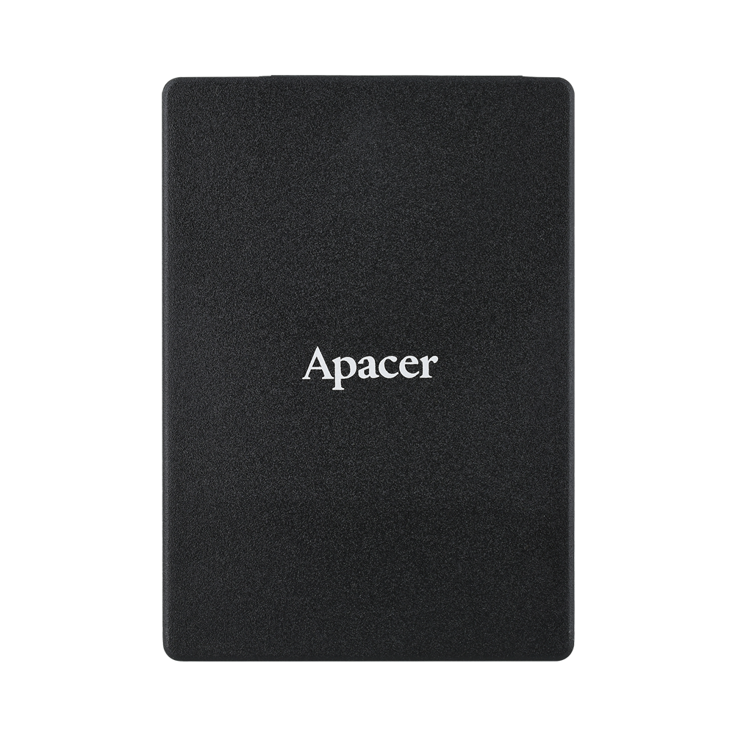
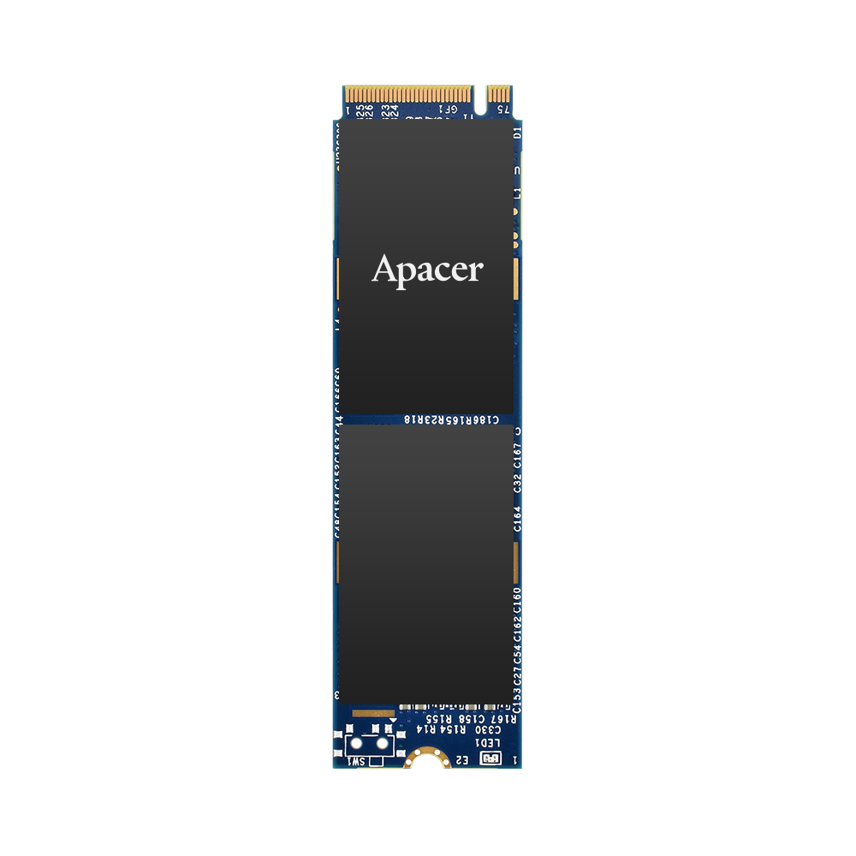
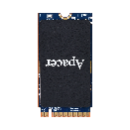
Recommended Products: SSD
Model | PT220-M280 | PV220-M280 | ST250-25 | PT250-M280 | PT250-M242 | PV250-CFX
Features | High Performance, DataDefender™ | High Performance, DataDefenderTM, Heatsink (Option) | DataDefender™ | High Performance, Sidefill, Heatsink (Option) | High Performance | AES 256-bit Encryption, Write Ptotect
Form Factor | M.2 2280 | M.2 2280 | 2.5” | M.2 2280 | M.2 2242 | CFexpress 2.0 Type B
Interface | PCIe Gen3 x4 | PCIe Gen3 x4 | SATA 3.2 (6Gb/s) | PCIe Gen4 x4 | PCIe Gen4 x4 | PCIe Gen3 x2
Connector | M.2 M Key | M.2 M Key | (7+15) pin male | M.2 M Key | M.2 M Key | -
NAND Flash Type | 3D TLC
Capacity | 128GB ~ 2TB | 240GB ~ 960GB | 128GB ~ 2TB | 256GB ~ 2TB | 256GB ~ 1TB | 240GB ~ 960GB
External DRAM | No | No | No | No | No | No
Max. R/W Performance (MB/sec) | 2400/2240 | 2390/2205 | 560/510 | 3680/3400 | 3500/2885 | 2900/1500
Standard Operating Temp. (°C) | 0 ~ + 70 | 0 ~ + 70 | 0 ~ + 70 | 0 ~ + 70 | 0 ~ + 70 | 0 ~ + 70
Wide Temp. (°C) | - | - 40 ~ + 85 | - | - | - | - 40 ~ + 85
MTBF (Hours) | >3,000,000 | >3,000,000 | >3,000,000 | >3,000,000 | >3,000 | >3,000
Recommended Applications | Electronic Gaming Machine
15

Slide 17
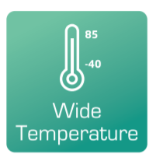
Recommended Products: DRAM
Module Type | UDIMM | SODIMM | ECC UDIMM | ECC SODIMM
Memory Technology | DDR4
Frequency | 2133/2400/2666/2933/3200
Density | 2GB/4GB/ 8GB/16GB/32GB | 2GB/4GB/ 8GB/16GB/32GB | 4GB/8GB/ 16GB/32GB | 4GB/8GB/ 16GB/32GB
Voltage | 1.2v | 1.2v | 1.2v | 1.2v
Pin Count | 288-Pin | 260-Pin | 288-Pin | 260-Pin
Width | 64-Bit | 64-Bit | 72-Bit | 72-Bit
PCB Height | 1.23" | 1.18" | 1.23" | 1.18"
Operation Temperature. (°C) | TC = 0 ~ + 85 | TC = 0 ~ + 85 | TC = 0 ~ + 85 | TC = 0 ~ + 85
Value-added Technology

Slide 18
Agenda
‧ Overview
‧ Challenges and Requirements
‧ Featured Technologies for Gaming Applications
‧ Recommended Products
‧ Customer Success Cases
‧ Apacerʼs Strengths

Slide 19
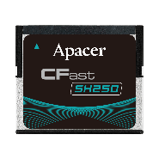
Success Cases: Gaming Machine
Solutions
SH250-CFast
VA Technologies
SLC-liteX
Smart Read Refresh™
Write Protect
Customized CHS setting
Challenges
Results and Benefits
Machines will be operating 24/7, so they will require a stable, high-endurance storage solution.
Operations are often read-intensive.
Devices need to be tamper-proof to protect the confidentiality of game play data and programming patterns.
SLC-liteX optimizations provide up to 100K P/E cycles, delivering excellent endurance.
Smart Read Refresh™ to prevent SSD crashes under frequent data read conditions, so read-intensive operations won’t be a problem.
Write protect switch to prevent drives from unauthorized data writing, so data cannot be altered.
Notes:
#808080

Slide 20
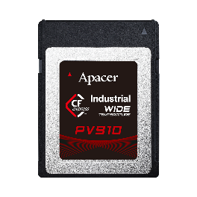
Success Cases: Gaming Machine
Solutions
PV910-CFX
VA Technologies
Smart Read Refresh™
Signed Firmware
Write Protect
Challenges
Results and Benefits
Machines will be operating 24/7, so they will require a stable, high-endurance storage solution.
Operations are often read-intensive.
Devices need to be tamper-proof to protect the confidentiality of game play data and programming patterns.
Smart Read Refresh™ to prevent SSD crashes under frequent data read conditions, so read-intensive operations won’t be a problem.
Write protect to prevent drives from unauthorized data writing via GPIO Pin 10 and vendor software commands.
Signed Firmware is a secure way to update firmware. This extra layer of protection keeps drives secure.
Notes:
#808080

Slide 21
Success Cases: Gaming Machine
Solutions
PV220-M280
VA Technologies
DataDefender ™
Wide Temperature
Heatsink design
Challenges
Results and Benefits
Machines will be operating 24/7, so they will require a stable, high-endurance storage solution.
PCIe SSD’s operation causes it to increase in temperature as well, the result could be damage to the hardware or corrupted data.
DataDefender™ is an advanced technology of power failure management which combines both firmware and hardware mechanisms to ensure data integrity.
Apacer’s heatsink design is developed for heat dissipation to cool both the NAND Flash and the Controller IC, while still allowing an SSD to deliver high-speed performance, as well as prevent heat-related damage from occurring.
Notes:
新增

Slide 22
Agenda
‧ Overview
‧ Challenges and Requirements
‧ Featured Technologies for Gaming Applications
‧ Recommended Products
‧ Customer Success Cases
‧ Apacerʼs Strengths

Slide 23
Apacerʼs Strengths
Widely Recognized Certification
Longevity
Strong R&D and Customization Capabilities
Fixed BOM support
6+6 PCN/EOL Policy
Unique S/N for RMA tracking

Slide 24
Thank you!
industrial.apacer.com/
©Copyright Apacer Technology Inc. Confidential. Unauthorized use, dissemination,
distribution, or reproduction of this document is not allowed without the permission of
Apacer Technology Inc. Specifications of details may change without notice.
This document and its contents are confidential©Copyright Apacer Technology Inc.

