Slide 1
Apacer Industrial SSD & DRAM Solutions
for Factory Automation Applications
Sales and Marketing Center August, 2022

Slide 2
Agenda
‧ Overview
‧ Challenges and Requirements
‧ Featured Technologies for Factory Automation Applications
‧ Recommended Products
‧ Customer Success Cases
‧ Apacerʼs Strengths

Slide 3
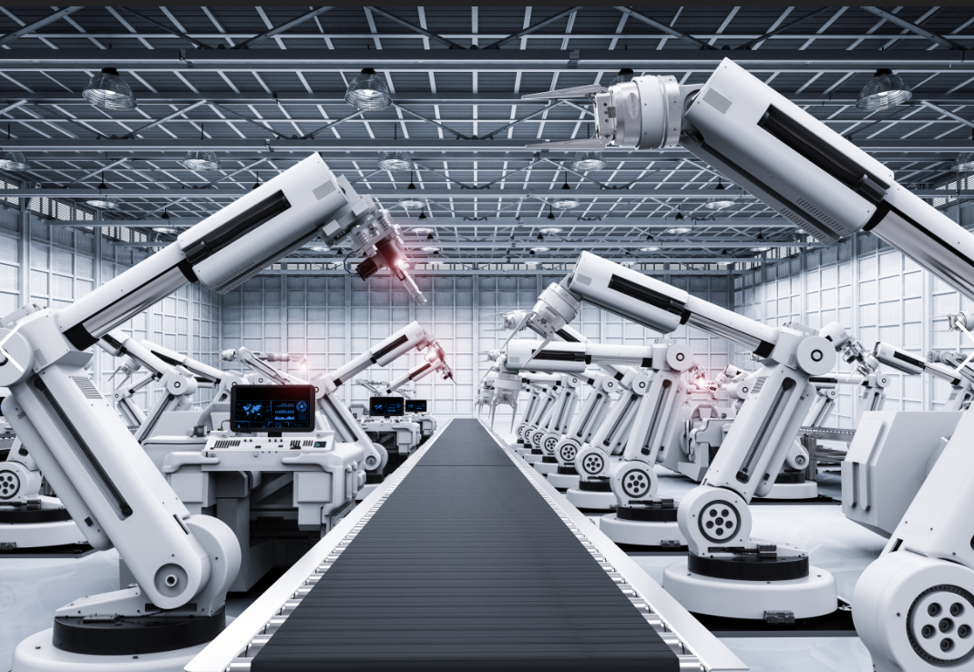
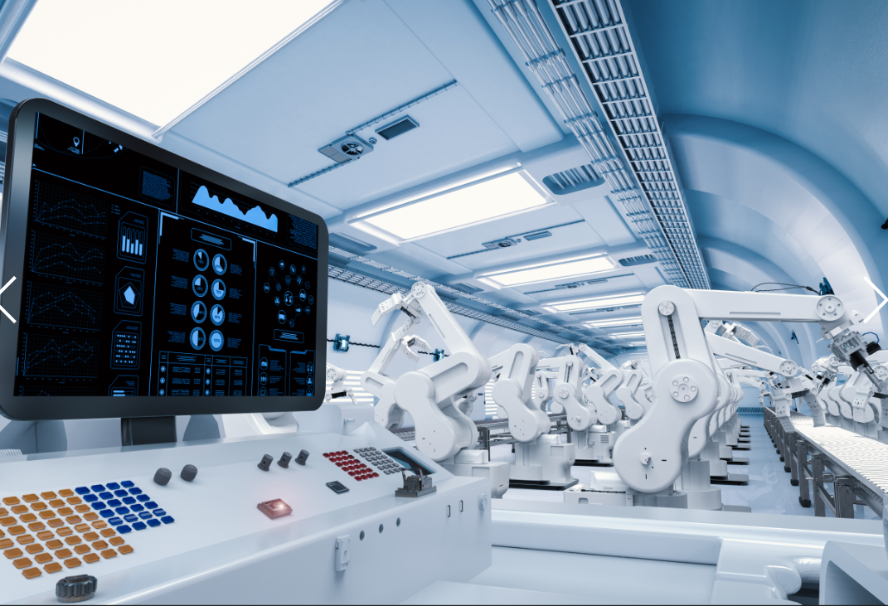
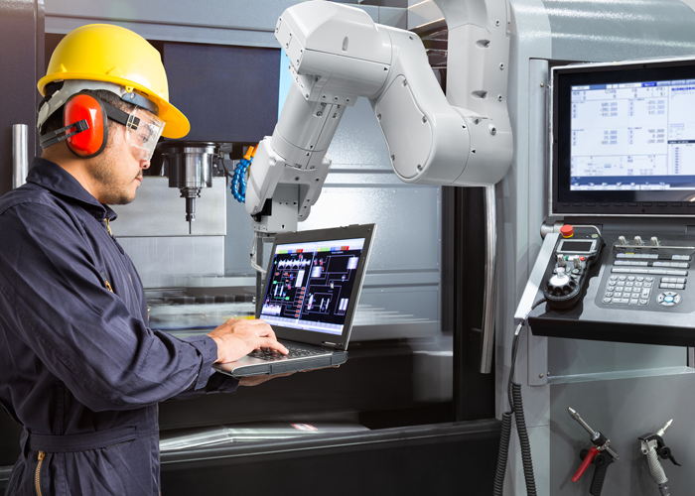
Overview
Factory automation provides a compelling way to boost quality, efficiency, sustainability and security. Developing truly independent automated facilities requires not only components with incredible reliability and robust designs, but also
excellent data integrity.
In order to meet the demands of the factory automation industry, Apacer offers
high-performance industrial SSD and memory solutions, and provides a variety of
value-adding technologies to help ensure reliability, stability and data integrity.

Slide 4
Agenda
‧ Overview
‧ Challenges and Requirements
‧ Featured Technologies for Factory Automation Applications
‧ Recommended Products
‧ Customer Success Cases
‧ Apacerʼs Strengths

Slide 5
Challenges and Requirements
Data integrity is a major criterion for success
In the factory automation industry, the more production steps that are automated, the more data needs to be collected and analyzed. The key to factory automation application lies in gathering and analyzing data and excellent data integrity.
Endurance and power stability are also crucial concerns
Since the facilities of factory automation will be operating without manpower and may operate 24/7, it is important to ensure the lifetime of storage operation and prevent data corruption when an unexpected power failure occurred.
Sulfur or contaminants that pollute the air may cause storage damage
In certain situations, automated factories need to operate in high-temperature or highly polluted environments. Electronic components are prone to corrosion or even creep corrosion sulfuration, which leads to shortened lifespans and unexpected failures.

Slide 6
Factory Automation Applications

Slide 7
Agenda
‧ Overview
‧ Challenges and Requirements
‧ Featured Technologies for Factory Automation Applications
‧ Recommended Products
‧ Customer Success Cases
‧ Apacerʼs Strengths

Slide 8
Featured Technologies for Factory Automation Applications
To meet the specific needs of the factory automation industry, Apacer stays ahead of its competitors by providing a variety of value-added technologies, including power stability, data integrity, longevity, survivability, and data security.
Power Stability
Data Integrity
Longevity
Survivability
Data Security
‧ CorePower
‧ DataDefender™
‧ CoreSnapshot
‧ SLC-liteX
‧ Over-provisioning
‧ Fixed BOM
‧ 6+6 PCN/EOL Policy
‧ Anti-Sulfuration
‧ Conformal Coating
‧ Nano Coating (IP57)
‧ Sidefill
‧ Wide Temperature
‧ Bidirectional Security
Identification
‧ TCG Opal 2.0

Slide 9
Power Stability
CorePower
This is a hardware-based technology designed to prevent data loss and ensure the stability of data transmission during a power outage using a backup power supply to allow sufficient time to move all cached data to NAND flash.
DataDefender™
Combines both firmware and hardware mechanisms to ensure data integrity, allowing more time for volatile data to be stored in the event of power loss.

Slide 10
Data Integrity
CoreSnapshot
Full backup and recovery of SSD data can be performed in one second, which can instantly eliminate catastrophic system issues and prevent data damage or downtime from translating into operational risks and losses.

Slide 11
Longevity
SLC-liteX
Apacer's 3D NAND SLC-liteX technology breaks through the limitations of existing technology and provides up to 100,000 P/E cycles, which is 33 times more than MLC or industrial 3D TLC.
Over-provisioning
Apacerʼs SSDs support over-provisioning, which sets aside a certain portion of the physical capacity of the memory to carry out garbage collection, wear-leveling and bad block management. The result is a longer operating lifetime.

Slide 12
Survivability
Anti-Sulfuration
Apacer's world's first patented anti-sulfuration DRAM modules and anti-sulfuration SSDs with the industry's highest level of anti-corrosion ANSI/ISA 71.04 G3 Certification can meet the needs of industrial products facing harsh environments.
Conformal Coating
Conformal coating improves product reliability when applied on the surface of printed circuit boards. This protective film can safeguard devices from dust ingression and liquid immersion.
Nano Coating
This IP57 waterproof and dustproof solution is ideal for SSD modules as it provides invulnerable protection for the components on the devices. Nano Coating adopts Chemical Vapor Deposition (CVD) to create a thin, transparent polymer film.

Slide 13
Survivability
Sidefill
Apacerʼs Sidefill technology strengthens the connections between solder joints and their board, making them more robust and vibration-resistant. It also allows for heat dissipation to offset thermal damage.
Wide Temperature
Products rated for wide temperature operation are designed with wide temperature support to ensure reliable operation in extreme temperatures ranging from -40°C to 85°C.

Slide 14
Data Security
Bidirectional Security Identification
A security verification mechanism is implanted between the device and the platform to prevent the data in the device from being stolen if it is subjected to a hacker’s invasion.
TCG Opal 2.0
Apacer offers TCG Opal 2.0-compliant self-encrypting drives (SEDs) which incorporate AES encryption for rock-solid data protection. Buyers love TCG Opal 2.0ʼs Instant Keychange™ technology, which uses cryptographic erasure to scramble a drive in less than a second. This technology is also available independently upon request.

Slide 15
Agenda
‧ Overview
‧ Challenges and Requirements
‧ Featured Technologies for Factory Automation Applications
‧ Recommended Products
‧ Customer Success Cases
‧ Apacerʼs Strengths

Slide 16
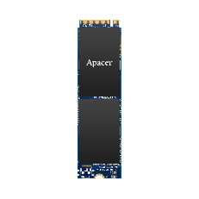
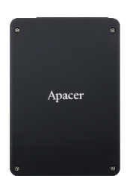
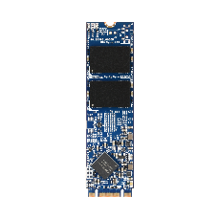
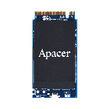
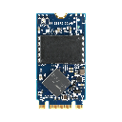
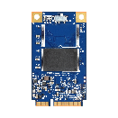
Recommended Products: SSD
Model | PV220-M280 | PV220-M242 | SV240-25 | SV24P-25 | SV250-M280 | SV24P-M280 | SH250-M242 | SV250-300
Features | Anti-Sulfuration, CoreGlacier™ | DataDefender™ | AES 256-bit Encryption | CorePower | CoreSnapshot, Anti-Sulfuration | CorePower | AES 256-bit Encryption, High Endurance, SLC-liteX | AES 256-bit Encryption, TCG Opal 2.0, Write Protect Switch
Form Factor | M.2 2280 | M.2 2242 | 2.5” | 2.5” | M.2 2280 | M.2 2280 | M.2 2242 | JEDEC MO-300
Interface | PCIe Gen3 x4 | PCIe Gen3 x4 | SATA 3.2 (6Gb/s) | SATA 3.2 (6Gb/s) | SATA 3.2 (6Gb/s) | SATA 3.2 (6Gb/s) | SATA 3.2 (6Gb/s) | SATA 3.2 (6Gb/s)
Connector | M.2 M Key | M.2 M Key | (7+15) pin | (7+15) pin | M.2 B & M Key | M.2 B & M Key | M.2 B & M Key | 52-pin mSATA
NAND Flash Type | 3D TLC
Capacity | 120~1920 GB | 240~960 GB | 120~1920 GB | 120~1920 GB | 30~1920 GB | 120~1920 GB | 10~160 GB | 30~1920 GB
External DRAM | No | No | Yes | Yes | No | Yes | No | No
Max. R/W Performance (MB/sec) | 2350/2230 | 2390/2205 | 560/505 | 560/495 | 560/520 | 560/495 | 560/520 | 560/515
Standard Operating Temp. (°C) | 0 ~ + 70 | 0 ~ + 70 | 0 ~ + 70 | 0 ~ + 70 | 0 ~ + 70 | 0 ~ + 70 | 0 ~ + 70 | 0 ~ + 70
Wide Temp. (°C) | - 40 ~ + 85 | - 40 ~ + 85 | - 40 ~ + 85 | - 40 ~ + 85 | - 40 ~ + 85 | - 40 ~ + 85 | - 40 ~ + 85 | - 40 ~ + 85
MTBF (Hours) | >3,000,000 | >3,000,000 | >3,000,000 | >3,000,000 | >3,000,000 | >3,000,000 | >3,000,000 | >3,000,000
Recommended Applications | Motor Automation |  | IPC |  | Wafer Die Cutting |  | CNC System | Wire Processing System, Semiconductor Manufacturing Equipment

Slide 17
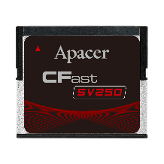
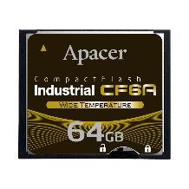
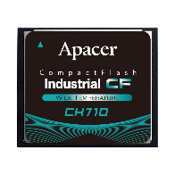
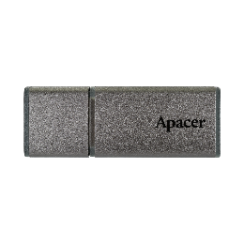
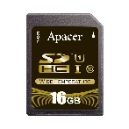
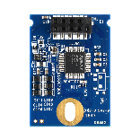
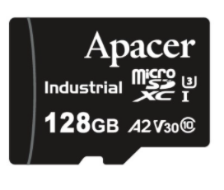
Recommended Products: SSD
Model | SV250-CFast | Industrial SD R1 | CH120-MSD | Industrial CF6A | CH710-CF | UV110-UFD1 | UH110-UFM1
Features | TCG Opal 2.0, Write Protect Switch | High Endurance, SLC-liteX (CH120-MSD) |  |  | High Endurance, SLC-liteX | Bidirectional Security Identification | High Endurance, SLC-liteX
Form Factor | CFast | SD | Micro SD | CompactFlash Type I | CompactFlash Type I | USB Flash Drive | USB Disk Module
Interface | SATA 3.2 (6Gb/s) | SD 3.0 | SD 6.1 | PC Card Memory Mode; PC Card I/O Mode; True IDE Mode | PC Card Memory Mode; PC Card I/O Mode; True IDE Mode | USB 3.1 Gen1 | USB 2.0
Connector | (7+17) pin | - | - | 50-pin | 50-pin | USB Type A Plug | 10-pin (2x5) Female Header in 2.54mm
NAND Flash Type | 3D TLC | SLC | 3D TLC | SLC | 3D TLC | 3D TLC | 3D TLC
Capacity | 30~480 GB | 512MB, 1~16 GB | 16~128 GB | 256MB ~ 32GB | 8~64 GB | 16~256 GB | 8~32 GB
External DRAM | No | - | - | No | No | No | No
Max. R/W Performance (MB/sec) | 560/515 | 43/41 | 90/80 | 60/65 | 115/80 | 260/125 | 41/25
Standard Operating Temp. (°C) | 0 ~ + 70 | - | -25 ~ + 85 | 0 ~ + 70 | 0 ~ + 70 | 0 ~ + 70 | 0 ~ + 70
Wide Temp. (°C) | - 40 ~ + 85 | - 40 ~ + 85 | - 40 ~ + 85 | - 40 ~ + 85 | - 40 ~ + 85 | -40 ~ + 85 *Not supported on 16GB | - 40 ~ + 85
MTBF (Hours) | >3,000,000 | >3,000,000 | >3,000,000 | >2,000,000 | >3,000,000 | >3,000,000 | >3,000,000
Recommended Applications | Factory Machine Controller | Robot, Semiconductor Manufacturing Equipment, Inspection equipment |  | Semiconductor Manufacturing Equipment, Factory Machine Controller |  | Welding, Solar Energy, Charging, Farming Ventilation

Slide 18
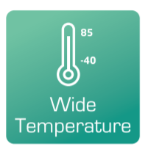
Recommended Products: DRAM
Module Type | UDIMM | SODIMM | ECC UDIMM | ECC SODIMM
Memory Technology | DDR4
Frequency | 2133/2400/2666/2933/3200
Density | 2GB/4GB/ 8GB/16GB/32GB | 2GB/4GB/ 8GB/16GB/32GB | 4GB/8GB/ 16GB/32GB | 4GB/8GB/ 16GB/32GB
Voltage | 1.2v | 1.2v | 1.2v | 1.2v
Pin Count | 288-Pin | 260-Pin | 288-Pin | 260-Pin
Width | 64-Bit | 64-Bit | 72-Bit | 72-Bit
PCB Height | 1.23" | 1.18" | 1.23" | 1.18"
Operation / Wide Temperature. (°C) | TC= 0 to 85 / -40 to 85 | TC= 0 to 85 / -40 to 85 | TC= 0 to 85 / -40 to 85 | TC= 0 to 85 / -40 to 85
Value-added Technology

Slide 19
Agenda
‧ Overview
‧ Challenges and Requirements
‧ Featured Technologies for Factory Automation Applications
‧ Recommended Products
‧ Customer Success Cases
‧ Apacerʼs Strengths

Slide 20
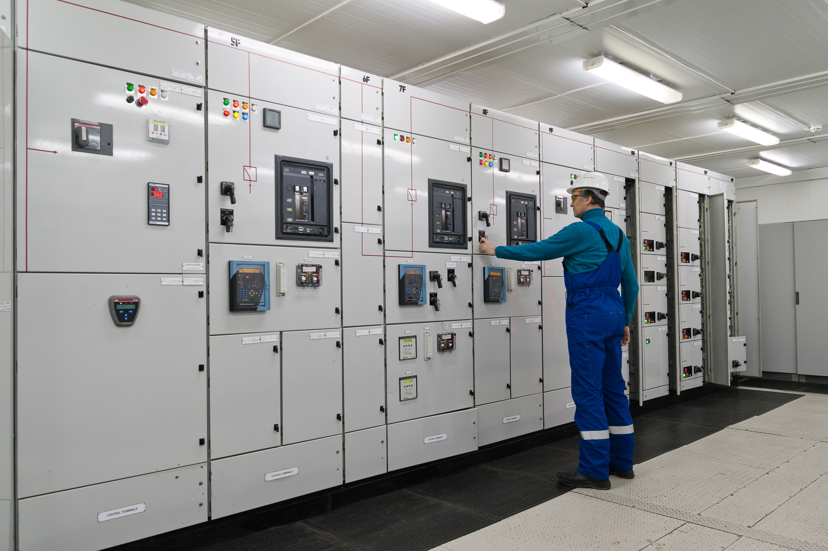
Success Case: IPC for Factory Automation
Solutions
SV250-CFast
VA Technologies
Firmware customization
Challenges
Results and Benefits
Small form factor needed
Customize threshold value
No Device Sleep
UL standard compliance
Firmware customization leads to customer’s platform compatibility with system operation stability.
Notes:
#808080

Slide 21
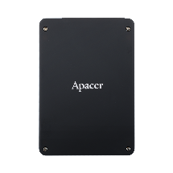
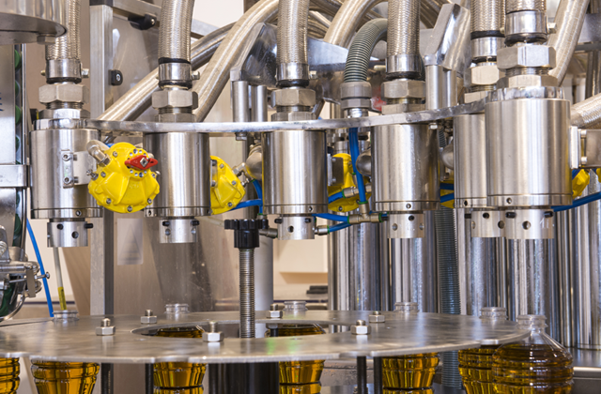
Success Case: SCADA System
Solutions
SV250-25
VA Technologies
Conformal coating
DataDefender™
CoreAnalyzer2
SSDWidget 2.0
Challenges
Results and Benefits
Extremely low tolerance for downtime
Device operational lifetime has to up to 10 years
Polluted environment
This resulted in the creation of a durable, trustworthy processing system that proved resilient enough to function smoothly even after years of continuous use.
Notes:
#808080

Slide 22
Agenda
‧ Overview
‧ Challenges and Requirements
‧ Featured Technologies for Factory Automation Applications
‧ Recommended Products
‧ Customer Success Cases
‧ Apacerʼs Strengths

Slide 23
Apacerʼs Strengths
Widely Recognized Certification
Longevity
Strong R&D and Customization Capabilities
Fixed BOM support
6+6 PCN/EOL Policy
Unique S/N for RMA tracking

Slide 24
Thank you!
industrial.apacer.com/
©Copyright Apacer Technology Inc. Confidential. Unauthorized use, dissemination,
distribution, or reproduction of this document is not allowed without the permission of
Apacer Technology Inc. Specifications of details may change without notice.
This document and its contents are confidential©Copyright Apacer Technology Inc.

