Slide 1
Apacer Industrial SSD & DRAM Solutions
for 5G Networking Applications
Sales and Marketing Center
October, 2022

Slide 2
Agenda
‧ Overview
‧ Challenges and Requirements
‧ Featured Technologies for 5G Networking Applications
‧ Recommended Products
‧ Customer Success Cases
‧ Apacerʼs Strengths

Slide 3
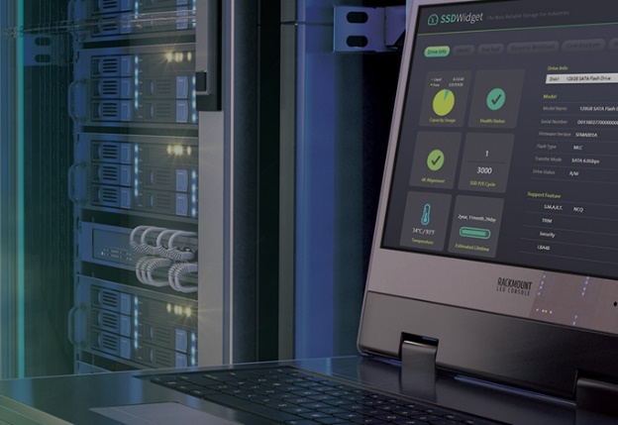
Overview
Under 5G and ORAN infrastructures, from one userʼs mobile phone to a multi-storey data center, everything is connected to a more flexible and scalable network. As server and networking applications need to process loads of big data, memory products with higher capacity and endurance, faster speed of data processing,
and higher level of data security are on demand.
Understanding the best and most efficient ways to protect and store data,
Apacer is committed to helping the server and 5G networking industry grow into
the next decade and beyond.

Slide 4
Agenda
‧ Overview
‧ Challenges and Requirements
‧ Featured Technologies for 5G Networking Applications
‧ Recommended Products
‧ Customer Success Cases
‧ Apacerʼs Strengths

Slide 5
Challenges and Requirements
Hardware that runs in harsh environments
Since the internet is everywhere, the hardware that supports it needs to be able to run everywhere. Server and networking components need to be tough enough to survive in punishing environments.
Longer lifespans even for write-intensive operation
Highly active networks involve a large amount of write operations for small packets of data. It needs to allocate the resource in the most efficient configurations for these kinds of situations, extending the operational lifetime of networked devices.
Find the idea solution to handle workload changes
Some networks struggle when their workload changes drastically over time. It is important to find the most suitable solution for their needs, even if that means a very flexible solution that can handle abnormal or unusual changes in workload.

Slide 6
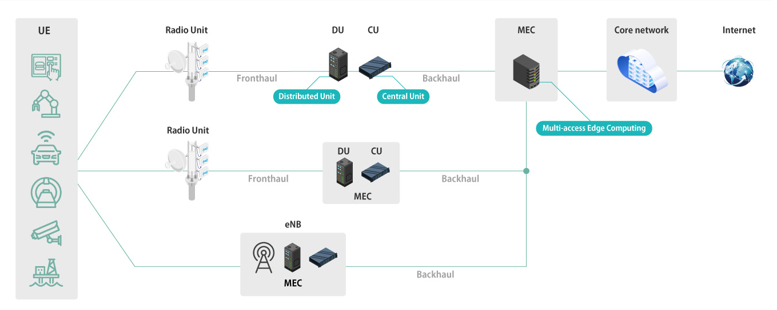
5G Networking Infrastructure: O-RAN Mobile Network
Under the deployment of 5G and open radio access network (O-RAN) structure, smart networking devices of AIoT have also flourished. It is a powerful technology for a new generation and enables edge computing to make the Internet of Things more effective and efficient.

Slide 7
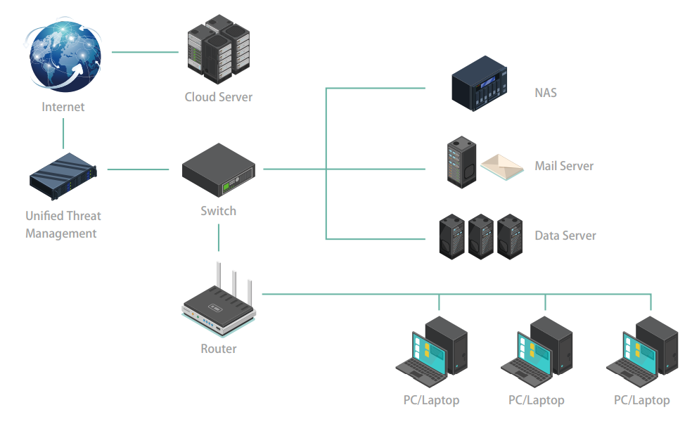
5G Networking Infrastructure: Industrial and Enterprise
Corporate networks often contain confidential which can be accessed by certain authorized users. This is why more comprehensive networking infrastructure is required, such as
mail server encryption, firewalls, NAS and other additional features of data protection.

Slide 8
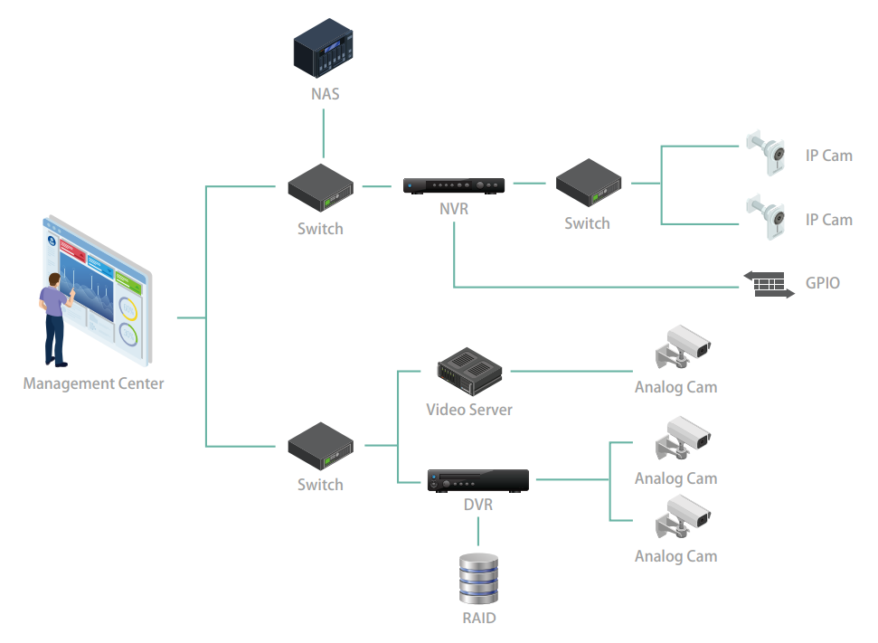
5G Networking Infrastructure: Surveillance
Both households and corporations are investing in surveillance, including intruder detection technologies, real-time IP camera monitoring and security footage storage. A centralized data storage solution allows archival and retrieval of security footage and associated metadata at the press of a button.

Slide 9
Agenda
‧ Overview
‧ Challenges and Requirements
‧ Featured Technologies for 5G Networking Applications
‧ Recommended Products
‧ Customer Success Cases
‧ Apacerʼs Strengths

Slide 10
Featured Technologies for 5G Networking Applications
As one of the innovators in the field of industrial storage and memory, Apacer is committed to offering a wide range of industrial-grade SSD and DRAM solutions and cutting-edge technologies featuring multiple approaches to protection.
Power Stability
Longevity
& Value-added
Survivability
Data Security
‧ CorePower
‧ DataDefender™
‧ SLC-liteX
‧ SSDWidget 2.0
‧ Fixed BOM
‧ 6+6 PCN/EOL Policy
‧ Anti-Sulfuration
‧ Conformal Coating
‧ Nano Coating (IP57)
‧ Sidefill
‧ Wide Temperature
‧ Bidirectional
Security Identification
‧ Signed Firmware
‧ TCG Opal 2.0

Slide 11
Power Stability
CorePower
This is a hardware-based technology designed to prevent data loss and ensure the stability of data transmission during a power outage using a backup power supply to allow sufficient time to move all cached data to NAND flash.
DataDefender™
Combines both firmware and hardware mechanisms to ensure data integrity, allowing more time for volatile data to be stored in the event of power loss.

Slide 12
Longevity &
Value-added Software
SLC-liteX
Apacer's 3D NAND SLC-liteX technology breaks through the limitations of existing technology and provides up to 100,000 P/E cycles, which is over 33 times more than MLC or industrial 3D TLC.
SSDWidget 2.0
Apacer SSDWidget 2.0 is a comprehensive disk monitoring and maintaining utility. Designed with the concepts of S.M.A.R.T., SSDWidget2.0 can monitor an SSDʼs health-related information and provide SSD status for lifetime monitoring and workload analysis.

Slide 13
Survivability
Anti-Sulfuration
Apacer's world's first patented anti-sulfuration DRAM modules and anti-sulfuration SSDs with the industry's highest level of anti-corrosion ANSI/ISA 71.04 G3 Certification can meet the needs of industrial products facing harsh environments.
Conformal Coating
Conformal coating improves product reliability when applied on the surface of printed circuit boards. This protective film can safeguard devices from dust ingression and liquid immersion.
Nano Coating
This IP57 waterproof and dustproof solution is ideal for SSD modules as it provides invulnerable protection for the components on the devices. Nano Coating adopts Chemical Vapor Deposition (CVD) to create a thin, transparent polymer film.

Slide 14
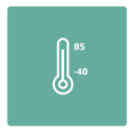
Survivability
Sidefill
Apacerʼs Sidefill technology strengthens the connections between solder joints and their board, making them more robust and vibration-resistant. It also allows for heat dissipation to offset thermal damage.
Wide Temperature
Products rated for wide temperature operation are designed with wide temperature support to ensure reliable operation in extreme temperatures ranging from -40°C to 85°C.

Slide 15
Data Security
Bidirectional Security Identification
A security verification mechanism is implanted between the device and the platform to prevent the data in the device from being stolen if it is subjected to a hacker’s invasion.
Signed Firmware
Apacerʼs Signed Firmware technology is a secure way to update firmware. By including a digital signature, a firmware update will be authenticated by the Apacer SSD before a firmware update is performed. This extra layer of protection keeps drives secure.
TCG Opal 2.0
Apacer offers TCG Opal 2.0-compliant self-encrypting drives (SEDs) which incorporate AES encryption for rock-solid data protection. Buyers love TCG Opal 2.0ʼs Instant Keychange™ technology, which uses cryptographic erasure to scramble a drive in less than a second. This technology is also available independently upon request.

Slide 16
Agenda
‧ Overview
‧ Challenges and Requirements
‧ Featured Technologies for 5G Networking Applications
‧ Recommended Products
‧ Customer Success Cases
‧ Apacerʼs Strengths

Slide 17
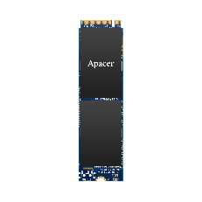
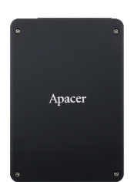
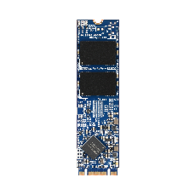
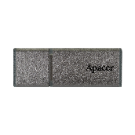
Recommended Products: SSD
Model | PV930-M280 | PV210-M280 | PV220-M280 | PH920-M280 | SV24P-25 | SH250-25 | SH250-M280 | UH110-UFD1
Features | High Performance, Signed Firmware | TCG Opal 2.0 | Anti-Sulfuration | High Endurance, Signed Firmware | CorePower, TCG Opal 2.0 | High Endurance, TCG Opal 2.0 | High Endurance, TCG Opal 2.0 Anti-Sulfuration | High Endurance, Bidirectional Security Identification
Form Factor | M.2 2280 | M.2 2280 | M.2 2280 | M.2 2280 | 2.5” | 2.5” | M.2 2280 | USB Flash Drive
Interface | PCIe Gen4 x4 | PCIe Gen3 x4 | PCIe Gen3 x4 | PCIe Gen3 x4 | SATA 3.2 (6Gb/s) | SATA 3.2 (6Gb/s) | SATA 3.2 (6Gb/s) | USB 3.1 Gen1
Connector | M.2 M Key | M.2 M Key | M.2 M Key | M.2 M Key | (7+15) pin | (7+15) pin | M.2 B & M Key | USB Type A Plug
NAND Flash Type | 3D TLC | 3D TLC | 3D TLC | 3D TLC | 3D TLC | 3D TLC | 3D TLC | 3D TLC
Capacity | 480~1920 GB | 240~1920 GB | 120~1920 GB | 160~640 GB | 120~1920 GB | 10~320 GB | 10~320 GB | 16~64 GB
External DRAM | Yes | Yes | No | No | Yes | No | No | No
Max. R/W Performance (MB/sec) | 5080/4735 | 3130/2620 | 1710/1685 | 1740/1530 | 560/495 | 560/520 | 560/520 | 265/125
IOPS (4K Random Write) | 633K | 521K | 263K | 265K | 84K | 74K | 74K | 700
Standard Operating Temp. (°C) | 0 ~ + 70 | 0 ~ + 70 | 0 ~ + 70 | 0 ~ + 70 | 0 ~ + 70 | 0 ~ + 70 | 0 ~ + 70 | 0 ~ + 70
Wide Temp. (°C) | - | - 40 ~ + 85 | - 40 ~ + 85 | - 40 ~ + 85 | - 40 ~ + 85 | - 40 ~ + 85 | - 40 ~ + 85 | -40 ~ + 85 (16GB Not supported)
MTBF (Hours) | >3,000,000 | >3,000,000 | >3,000,000 | >3,000,000 | >3,000,000 | >3,000,000 | >3,000,000 | >3,000,000
Recommended Applications | 5G-ORAN CU, DU, MEC | 5G-ORAN DU, MEC | 5G-ORAN DU MEC, Fronthaul Gateway, Switch, Router, SD-WAN, Firewall | 5G-ORAN DU MEC, Fronthaul Gateway, Switch, Router |  | 5G-ORAN DU MEC, Fronthaul Gateway, Switch, Router |  | Switch, Firewall

Slide 18
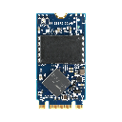
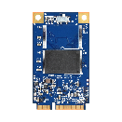
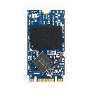
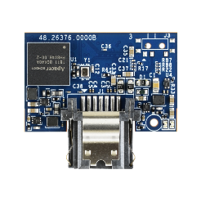
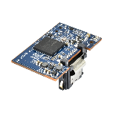
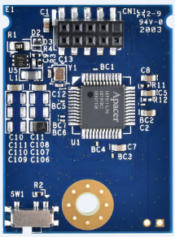
Recommended Products: SSD
Model | SH250-M242 | SH250-300 | SV250-25 | SV250-M280 | SV250-M242 | SV250-300 | SV250-7LP2 | UV110-UFM2
Features | High Endurance, TCG Opal 2.0 |  | TCG Opal 2.0 | Anti-Sulfuration, TCG Opal 2.0 | TCG Opal 2.0 | TCG Opal 2.0 | Compact, Write Protect Switch
Form Factor | M.2 2242 | JEDEC MO-300 | 2.5” | M.2 2280 | M.2 2242 | JEDEC MO-300 | SATA Disk Module | USB Disk Module
Interface | SATA 3.2 (6Gb/s) | SATA 3.2 (6Gb/s) | SATA 3.2 (6Gb/s) | SATA 3.2 (6Gb/s) | SATA 3.2 (6Gb/s) | SATA 3.2 (6Gb/s) | SATA 3.2 (6Gb/s) | USB 2.0
Connector | M.2 B & M Key | 52-pin mSATA | (7+15) pin | M.2 B & M Key | M.2 B & M Key | 52-pin mSATA | 7 pin | 10-pin (2x5) female header in 2.00mm
NAND Flash Type | 3D TLC | 3D TLC | 3D TLC | 3D TLC | 3D TLC | 3D TLC | 3D TLC | 3D TLC
Capacity | 10~160 GB | 10~160 GB | 30~1920 GB | 30~1920 GB | 30~960 GB | 30~1920 GB | 30~120 GB | 16~128 GB
External DRAM | No | No | No | No | No | No | No | No
Max. R/W Performance (MB/sec) | 560/520 | 560/520 | 560/520 | 560/520 | 560/515 | 560/515 | 560/510 | 40/33
IOPS (4K Random Write) | 75K | 75K | 73K | 73K | 73K | 71K | 75K | 300
Standard Operating Temp. (°C) | 0 ~ + 70 | 0 ~ + 70 | 0 ~ + 70 | 0 ~ + 70 | 0 ~ + 70 | 0 ~ + 70 | 0 ~ + 70 | 0 ~ + 70
Wide Temp. (°C) | - 40 ~ + 85 | - 40 ~ + 85 | - 40 ~ + 85 | - 40 ~ + 85 | - 40 ~ + 85 | - 40 ~ + 85 | - 40 ~ + 85 | - 40 ~ + 85
MTBF (Hours) | >3,000,000 | >3,000,000 | >3,000,000 | >3,000,000 | >3,000,000 | >3,000,000 | >3,000,000 | >3,000,000
Recommended Applications | Router, Switch, Fronthaul Gateway |  | 5G Small Cell, uCPE, SD-WAN, Firewall |  |  |  | Switch, SD-WAN, Firewall

Slide 19
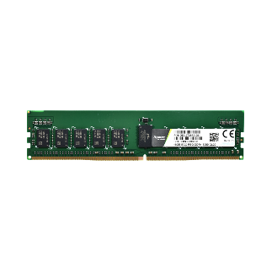
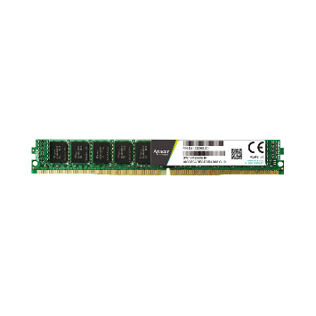
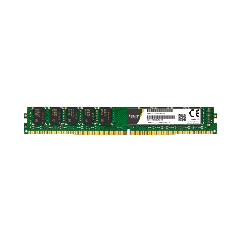
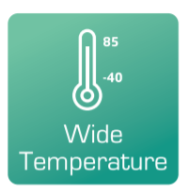
Recommended Products: DRAM
Module Type | RDIMM | ECC UDIMM | ECC SODIMM | VLP RDIMM | VLP ECC UDIMM
Memory Technology | DDR4
Frequency | 2133/2400/ 2666/2933/3200 | 2133/2400/2666/2933/3200 |  | 2133/2400/2666/2933/3200
Density | 4G/8G/16G/ 32G/64G/128G | 4G/8G/ 16G/32G | 4G/8G/ 16G/32G | 4G/8G/ 16G/32G | 4G/8G/ 16G/32G
Voltage | 1.2v | 1.2v | 1.2v | 1.2v | 1.2v
Pin Count | 288-Pin | 288-Pin | 260-Pin | 288-Pin | 288-Pin
Width | 72-Bit | 72-Bit | 72-Bit | 72-Bit | 72-Bit
PCB Height | 1.23" | 1.23" | 1.18" | 0.738" | 0.738"
Operation Temperature (°C) | TC = 0 ~ + 85 | TC = 0 ~ + 85 | TC = 0 ~ + 85 | TC = 0 ~ + 85 | TC = 0 ~ + 85
Value-added Technology
(Optional)
(Optional)
(Optional)
(Optional)

Slide 20
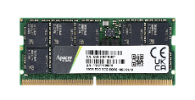
Recommended Products: DRAM
Module Type | ECC UDIMM | ECC SODIMM |  | RDIMM
Memory Technology | DDR5
Frequency | DDR5-4800
Capacity | 16GB / 32GB
Voltage | 1.1v | 1.1v |  | 1.1v
Pin Count | 288-Pin | 262-Pin |  | 288-Pin
Width | 72-Bit | 72-Bit |  | 80-Bit
PCB Height | 1.23" | 1.18" |  | 1.23"
Operation Temperature (°C) | TC = 0 ~ + 85 |  | TC = 0 ~ + 85 |  | TC = 0 ~ + 85
Value-added technologies
(Optional)
(Optional)
(Optional)

Slide 21
Agenda
‧ Overview
‧ Challenges and Requirements
‧ Featured Technologies for 5G Networking Applications
‧ Recommended Products
‧ Customer Success Cases
‧ Apacerʼs Strengths

Slide 22
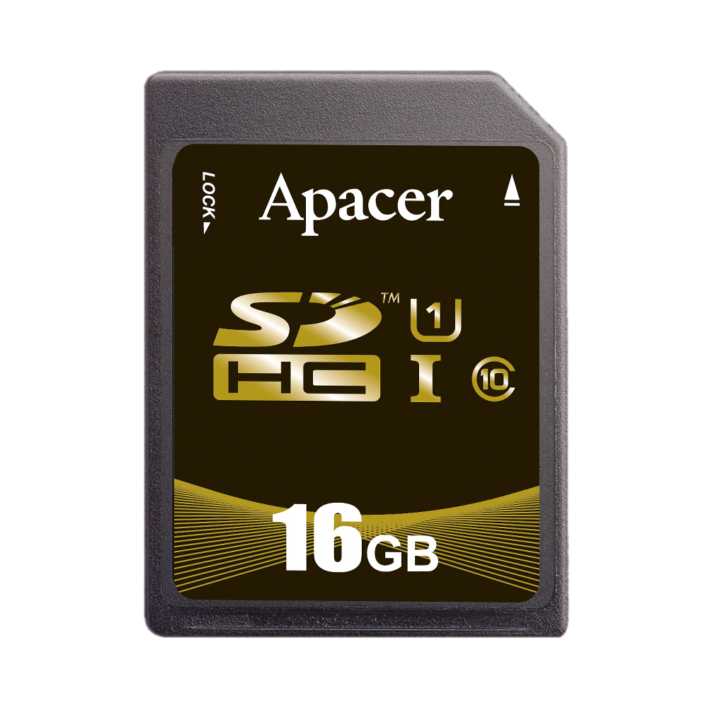
Use Case: 5G Switches
laptop
Solutions
Internet
Router
Server
PH920-M280 , Industrial SD R1,
DDR4 ECC SODIMM
Network Switch
Write-intensive applications with small amounts of data
Phone
VA Technologies
CoreAnalyzer
SLC-liteX
Signed Firmware
SSDWidget (customized SDK)
Other devices
Challenges
Results and Benefits
Preventing malicious code to be stored and loaded in SSD
Intensive write-focused operation with small amounts of data.
Non-standard Linux OS plus need for constant SSD monitoring.
Successfully created a customized monitoring UI to anticipate the end of SD cardsʼ operational lifetimes.
The operational lifetimes for industrial SSDs were greatly increased.
Reduce the risk of systems be attacked by hackers.

Slide 23
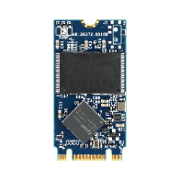
Use Case: 5G Base Station
5G
Surveillance
Solutions
Internet
Automobile
SH250-M242, SG250-M242
DDR4 ECC SODIMM
Core network
5G Base Station
Smart Factory
VA Technologies
Outdoors for 24/7 uninterrupted operation
SLC-liteX
Anti-Sulfuration
Platform Customized Service
Other devices
Challenges
Results and Benefits
An ideal match through multi-party testing and verification and adjustment of the signals of both Apacer’s SSDs and the customer’s platforms.
Strengthens the stability of various applications and platform operations.
Successfully assisted the customer in maximizing cost-effectiveness.
SSD and DRAM stability must remain constant even after extended operation in harsh environments.
The precise demands of this specific case will require careful customization.
Notes:
#808080

Slide 24
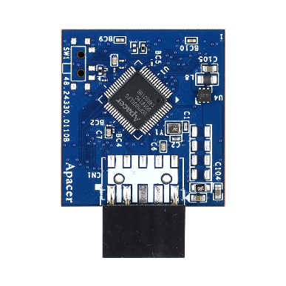
Use Case: 5G Wireless Network
Solutions
UDM 2A
VA Technologies
Anti-Sulfuration
Firmware customization
Interface customization
Outdoors for 24/7
uninterrupted operation
Challenges
Results and Benefits
Needs to have extremely high stability to cope with 24-hour non-stop operation
High environmental tolerance
Cost-effectively upgrade
Non-standard Linux OS
Supported Anti-Sulfuration to prolong SSD lifespan in extreme environment
Greatly improves the durability and reliability
Avoiding motherboard redesign

Slide 25
Agenda
‧ Overview
‧ Challenges and Requirements
‧ Featured Technologies for Server & Networking Applications
‧ Recommended Products
‧ Apacerʼs Strengths

Slide 26
Apacerʼs Strengths
Widely Recognized Certification
Longevity
Strong R&D and Customization Capabilities
Fixed BOM support
6+6 PCN/EOL Policy
Unique S/N for RMA tracking

Slide 27
Thank you!
industrial.apacer.com/
©Copyright Apacer Technology Inc. Confidential. Unauthorized use, dissemination,
distribution, or reproduction of this document is not allowed without the permission of
Apacer Technology Inc. Specifications of details may change without notice.
This document and its contents are confidential©Copyright Apacer Technology Inc.

